Slide 1
Learning outcomes based engineering curricula
Good practices identified in FINEEC’s engineering programme accreditations.
Senior Advisor Touko Apajalahti
31 March 2016

Slide 2
Planning of the programme outcomes

Slide 3
What we evaluate in the accreditations: programme aims
Are the programme aims, which describe the educational task and purpose of the programme, consistent with the mission of the higher education institution?
  what the programme aims are, how and how well have they been described
Do the programme aims reflect identified needs of employers and other stakeholders?
  Were the relevant industry and labour market organisations and other stakeholders consulted?
  Was the methodology and schedule of consultation adequate in order to identify their educational needs?

Slide 4
What we evaluate in the accreditations: programme level learning outcomes
Do the programme level learning outcomes describe the knowledge, understanding, skills and abilities that the programme enables graduates to demonstrate?
  Have the programme learning outcomes been established in terms of what students are expected to know, understand and/or be able to demonstrate after completion of the learning process?
Are the programme level learning outcomes consistent with a) the programme aims b) with national qualifications frameworks c) with FINEEC’s reference learning outcomes for accreditation?
  Analysis of the programme learning outcomes vs. the FINEEC reference programme learning outcomes is done by the programme in the self-evaluation

Slide 5
What we evaluate in the accreditations: course level learning outcomes
Do the course level learning outcomes, including thesis work and possible practical training, aggregate to the programme’s learning outcomes?
  Analysis of how the course learning outcomes aggregate to the programme level learning outcomes is done by the programme in the self-evaluation
Does the curriculum give comprehensive information on all the individual courses of the programme, including thesis work and possible practical training
Is the curriculum accessible to students?

Slide 6
Good practices: identification of the needs of employers
Foresight process: identify important employers, arrange interviews with the companies, document the interviews, analyse what common needs the companies have.
RDI projects and paid-services: teachers co-operate with companies
Feedback collection from companies where students do their practical placements or thesis work
Advisory board, where there are members from teachers, students and companies
When new programme outcomes are defined, there is a commenting possibility for companies

Slide 7
Good practices: definition of programme aims
Describing programme aims as targeted competence upon graduation
Describing an overall learning outcome (or theme) for each semester of the programme
A couple of examples:

Slide 8
In the JAMK degree programme in Mechanical Engineering, you will, depending on your specialisation, learn to control, develop and manage manufacturing of products especially in engineering workshops or, alternatively, learn how to develop and design machines and equipment using CAD and 3D modelling software. You can expand your expertise in production technology through maintenance-related studies or strengthen your product development skills in studies focusing on sheet metal structures and user-centered oriented design, for example.

Slide 9
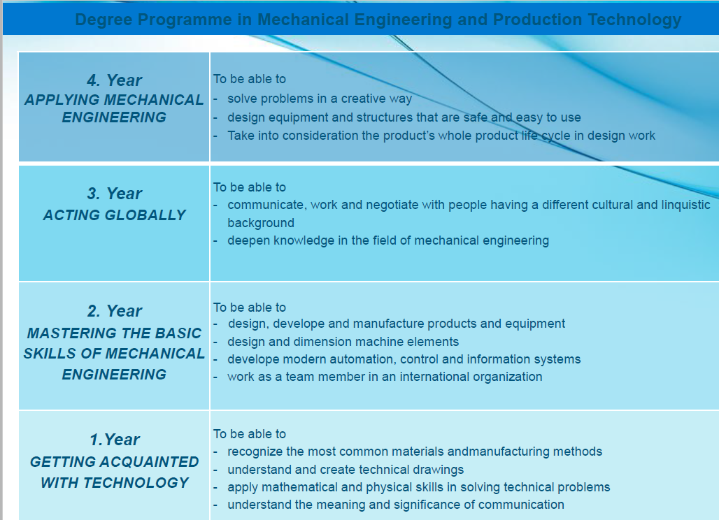

Slide 10
Good practices: definition of programme level learning outcomes
Describing programme level learning outcomes as “competence areas” or “learning outcome categories”
Taking into account the different study options, and defining the programme level learning outcomes separately for each branch
An example from JAMK university of Applied Sciences:

Slide 11
Competence Code | TKNPE
Competence title | Basics of mechanical engineering
Field of study | Technology, communication and transport
Degree programme | Bachelor's Degree Programme in Mechanical Engineering
Competence description | * can use mathematics and physics to describe the phenomena in mechanical engineering and to solve mechanical problems * is familiar with the most common components and machine elements used in mechanical engineering and understands the functions and operational principles of the most widely used machines * is familiar with the most common mechanical measurements * is familiar with the fundamentals of energy technology and energy usage
Source: JAMK online study guide:

Slide 12
Good practice: course descriptions
Number of ECTS Credits and student workload
Prerequisites and co-requisites
Learning Outcomes. An example from JAMK:
  The students learn how to model and simulate physical systems relevant to their own field of expertise.
  In addition to the numerical simulation methods, they also learn how to write and solve differential equations analytically
Related programme level learning outcomes marked
  For example a course in Applied Mathematics and Physics is defined to be related to the learning outcome of Knowledge and Understanding
Course Material listed
Prior Learning Recognition Procedures

Slide 13
Good practice: course descriptions
Assessment methods
Grading & criteria. An example from JAMK:
    Excellent (5): The student masters the principles of the course, and is able to apply them innovatively in challenging engineering applications.
    Very good (4): The student masters the essential knowledge of the course, and is able to apply his skills to usual engineering problems.
    Good (3): The student masters the basic principles of the course, and is able to solve basic engineering problems.
    Satisfactory (2): The student is familiar with the basic knowledge and terminology of the course, but has some problems with applying the knowledge. He can nevertheless solve simple engineering problems.
    Adequate (1): The student is familiar with the basic knowledge and terminology of the course but has significant problems with applications.
Planned Learning activities and Teaching Methods
  An example from JAMK: Contact lessons/virtual lessons, supervised calculation exercises/independent calculation exercises, independent work, online work.

Slide 14
Good practice: how courses aggregate to the programme level learning outcomes
Definition of the programme level learning outcomes as learning outcome categories
Marking to each course description how it is linked to the programme level learning outcomes
Building a matrix of this model
Again, an example from JAMK:

Slide 15
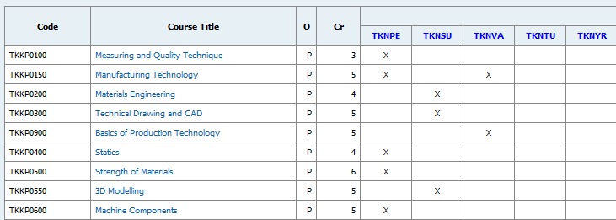
Programme level learning outcomes
(shortcodes)
Source: JAMK online study guide

Slide 16
Good practice: accessibility to students
Online (or printed) study guide, with complete information on all courses and other components of the curriculum, such as thesis work or practical placement.
All information from the same platform / booklet.
A quality assurance process to check that all course descriptions are ok and up to the standard, before published

Slide 17
Common challenges:
Not always clear how individual courses relate to the programme level learning outcomes.
Learning outcomes definitions & other course descriptions are not always as detailed as they should be.
Students have to search for information from multiple sources such as the study guide, intranet, online learning environments
How to tackle these?
Good quality management procedures that ensure good enough information
Functional feedback channels from students and external stakeholders that bring up potential issues

Slide 18
Planning of the programme implementation

Slide 19
What we evaluate in the engineering programme accreditations?
Does the teaching and learning process, including the assessment of students, enable students to demonstrate that they have achieved the intended course and programme level learning outcomes?
Do the students have an active role in co-creating the learning process?
Does the assessment of students reflects this approach?

Slide 20
Relevant questions for doing the evaluation
Are the teaching and learning methods consistent with the learning outcomes of the individual courses, and with the programme learning outcomes? How do the practical placements contribute to the achievement of the learning outcomes?
Are the assessment methods and criteria designed to check the achievement of the intended course learning outcomes in a credible way? Are the assessment methods both rigorous and fair?
Does the programme use some kind of independent and external scrutiny of the assessment of students?
Does the curriculum embed a student-centred learning and teaching approach that enables flexible learning paths and encourages students to take an active role in co-creating the learning process?
•

Slide 21
Relevant evidence
Do the results of the monitoring of student opinion on the learning process provide evidence of the adequacy and effectiveness of the learning process?
Do the results of the monitoring of the students’ achievement of the learning outcomes provide evidence of the effectiveness of the learning process in the courses?
Do the results of the monitoring of students’ progression in their studies provide evidence of the effectiveness of the learning process?

Slide 22
Good practice regarding planning teaching and learning
Programme board, which includes all the teachers and student representatives, plans the curriculum together.
Teaching methods are derived from the learning outcomes, using for example Bloom’s taxonomy as a helping tool to decide which would be the best methods for each course.
Planning not only individual courses, but seeing that the totality of the used methods is varied enough, and that the workload is sensible to the student. (For example so that not all project reports are due at the same week)

Slide 23
Good practice: teaching and learning methods
Co-operation with industry, to bring real-life projects and topics to the studies.
Team-work and project work, emulating the real-life work done in the companies. Including also non-technical aspects (environmental, social & economical constraints) in the project.
Joint courses between programmes from different fields, to enhance multidisciplinary competences
Teaching also in English at some courses
A personal learning plan (PLP) which is updated as students personal career plans develop
Mid-term course feedback which can affect an already ongoing course

Slide 24
Good practice: assessment
Link the assessment to the learning outcomes: how to best enable students to demonstrate that they know how to do the things they should be able to do.
Use of varied methods, chosen based on what should be demonstrated
  Calculations
  Written exams
  Project reports
  Learning diaries, portfolios
  Presentations
  Drama, real-life emulations, etc… possibilities are endless!
Give useful feedback to students: not only the grade, but how they have mastered the different learning outcomes

Slide 25
Good practice: quality management of assessment
Use of multiple actors in assessment, not relying only on one teacher’s evaluation
  self-evaluation, peer evaluation, working-life feedback, double marking by teachers…
Making a matrix of how each learning outcome of a course is addressed by the assessment methods.
Include real chances for discussing the assessment, and also possibility to a fair appeal’s process.
Doing statistical analysis of the grades, to see if there are notable changes from the norm, taking action when something odd is seen.

Slide 26
Common challenges
Relying too much on “traditional ways” of teaching and assessment: lectures + exam.
Including only the teacher in the assessment.
Not choosing the teaching methods, learning activities and assessment methods based on an analysis of the learning outcomes.
Not giving enough feedback to the students regarding how they have reached the learning outcomes.
Possible solutions:
Begin the planning always from the learning outcomes, using tools such as a matrix to see that everything is covered. Using the findings from pedagogics, such as Bloom’s taxonomy, to help in the design.

