Slide 1
Report
Helka Kekäläinen
23.-24.2.2016 Baku

Slide 2
What makes a good report?

Slide 3
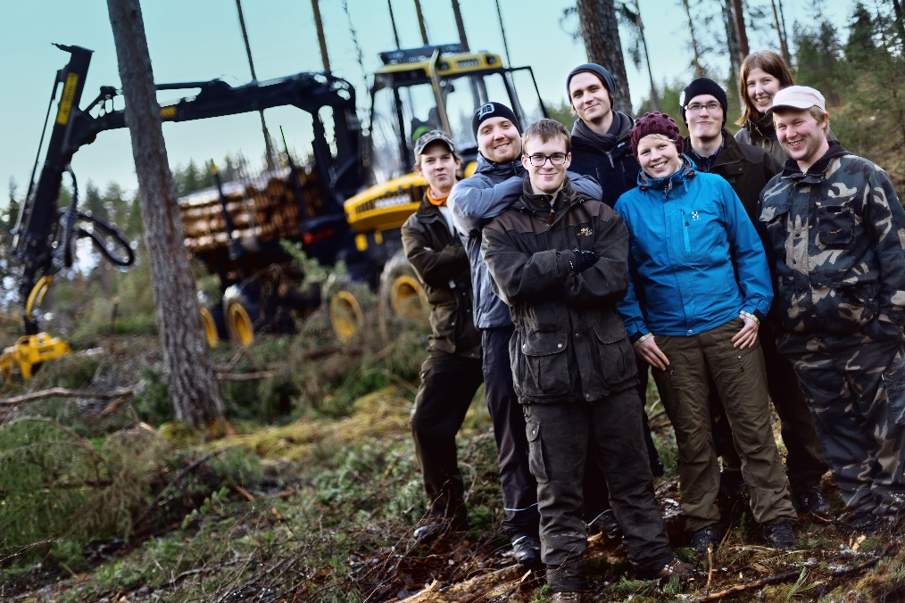
For whom do we write?
The HEI participating in the evaluation –
Feedback on the quality system and its continuous development
Higher Education Evaluation Committee –
Basis for the decision concerning the result
Other HEIs –
Dissemination of good practices
Notes:
Picture: University of Applied Sciences HAMK

Slide 4

Excellent report from the HEI perspective
The HEI
recognises itself
The HEI
receives
new ideas
The HEIs
feel that they are treated equally
The report
is well-argued

Slide 5
An ideal report from the agency perspective
Length → short, short and short
Structure → clearly defined
Style → simple, precise, focused
Tone → neutral, objective
Content → minimum description maximum analysis
Notes:
as short as possible
as clearly defined as possible
maximum analysis, and evaluation, evidence-based text

Slide 6
Evidence based well-founded and balanced
The report should include clear references to the evidence gathered
The decision-making process is transparent – based on what, and why the committee comes to that conclusion
All assessments and decisions are well founded – both the positive and negative ones
The committee strives for a consensual decision; reasoned dissenting views are outlined separately in the report
The report is a public document!

Slide 7
Commendations: good examples
We particularly commend the support given by the academic affairs team at Faculty level to the students and the student-led tutor system to support students.
There are modern, attractive, well equipped and spacious facilities, and a good location provides a high quality teaching and learning environment.
The teaching staff actively involve students in different research projects. Staff clearly understand the role of research in curriculum development.
Academic staff can attend different training courses on teaching and supervision of their choice. The College organises training in accordance with the objectives of the University.

Slide 8
Recommendations: some examples
The programme should be modernised to reduce the burden of factual knowledge and allow time for reflection and critical thinking skills to develop.
It is recommended that the electronic feedback system be changed in order to guarantee that student feedback remains anonymous. It is further suggested that this system is totally transparent so that information about anonymity, what information is available and how it is used is known by both students and teaching staff.
In order to maintain a high quality in the MA programme, no modules from the Bachelor programmes should be accepted in the Masters programme (if they are assessed in the same way as in the BA).

Slide 9
Recommendations (cont.)
The attractiveness of the MA programme should be increased in order to increase the number of domestic and international students. It is recommended to:
work on the further internationalisation of the MA in Recreation Management and to include more international lecturers
make steps towards an MA in Recreation Management taught in English in order to attract international students
consider cooperation with other Estonian universities and foreign universities (e.g. the University of Jyväskylä) with regard to PhD development or a PhD programme (which makes the orientation more academic)

Slide 10
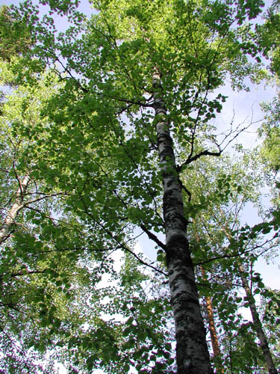
The report text
is
in line with
the final
assessment
Notes:
The report text should be in line with the development stage

Slide 11
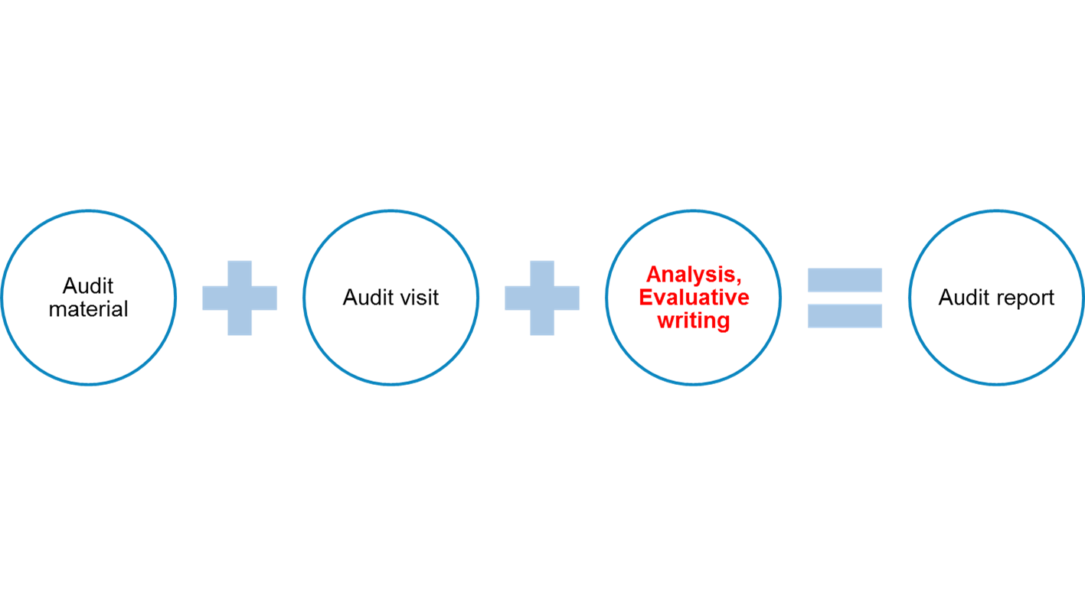
  Refer to the evidence:
  “The interviews confirmed that quality work is integrated in the daily management as described in the self-evaluation report.“
  Keep in mind the strategic objectives
  "The quantitative and qualitative indicators of education enable the leadership to follow the achievement of the institutional strategic aims."

Slide 12
Identify problems and development needs
  A problem: "It is not clear how the QM system supports emerging research projects outside the priority areas.“
  A recommendation: "The audit team recommends considering the mechanisms to promote innovative and emerging research fields."
Notes:
Identify problems and development needs in quality management

Slide 13
Highlight strengths and good practices
  For instance, a strength can include improvement of processes: "The audit team received evidence that the student feedback has led to the development of counselling and guidance services.“
  Good practice – a concrete procedure that other HEIs could learn from: "The alumni board meets four times a year to get an update on the development of the HEI. All the alumni feedback is filed and available for future reference."

Slide 14
What makes a good report?
A good report addresses all the issues in the criteria, makes its evaluation understandable
and provides valuable feedback

