Slide 1
QUALITY ASSURANCE OF HIGHER EDUCATION IN FINLAND
Senior Advisor Kati Isoaho
26 November 2015

Slide 2
DIVISION OF LABOUR IN STATE-LEVEL QUALITY ASSURANCE OF HE
FINNISH EDUCATION EVALUATION CENTRE
Carries out audits of the quality systems of higher education institutions
Carries out thematic evaluations on HE
Develops the evalution of education (processes, methods, participation of differents stakeholder groups etc.)
Supports higher education institutions in issues of quality assurance and quality work
Cooperates actively in international networks on QA (ENQA, NOQA, INQAAHE)
MINISTRY OF EDUCATION AND CULTURE
Is responsible for steering of higher education institutions (financial steering and indicators, performance agreements with HEIs, information steering)
Is responsible for steering and regulating on distribution of educational responsibilities (fields, degrees and specialisations) based on the proposals of the universities or universities of applied sciences
Is responsible for nation-wide student surveys (Bachelor’s level graduates)

Slide 3
INSTITUTIONAL RESPONSIBILITY ON QUALITY ASSURANCE
The HEIs must evaluate their education, research/RDI and other activities, including societal and regional impact
The HEIs shall also take part in external evaluation of their activities and quality assurance systems on a regular basis
HEIs are free to choose the evaluation agency which carries out the external evaluation of the quality system (on a regular basis)
Also FINEEC operates internationally (audit of the University of Graz in 2013)
The HEIs must publish the findings of the evaluations they undertake

Slide 4
FINNISH EDUCATION EVALUATION CENTRE = FINEEC
Independent state-level expert organisation
Established in 2014 (1.5.2014)
What means independency in this case?
Independent in decion-making and operations
use of the budget
project plans for the each evaluation
appoitment of the evalution experts (universities, labour market representatives, other stakeholders, students)
results of the evaluations and publish of the reports
recruitment of the staff members
internal structure of the centre
communications and interaction with society and stakeholders

Slide 5
WHAT DOES THE GOVERNMENT AND MoEC DO ON FINHEEC
Gov: nominates the Evaluation Council and Higher Education Evaluation Committee (4-years period)
MoEC: Approval of the National Plan on Evaluation of Education (long-term plan on the level of evaluation targets and action lines) based on the proposal of the Evaluation Council
Gov and MoEC: Appoitment of the Director of FINEEC

Slide 6
STEERING OF THE DEGREES AND CURRICULA IN FINLAND

Slide 7
DISTRUBUTION OF EDUCATIONAL RESPONSIBILITIES
Universities
In the Government Decree on Universities (as stated in the Universities Act)
Based on the proposals of the universities
Universities of Applied Sciences (UASs)
Part of the operating licences of the UAS
Based on the proposals of the UASs
In recent years a lot of national debate on the structural development and distribution of education responsibilities among the HEIs
MoEC empasizes larger entities as well cooperation within the educational fields

Slide 8
REGULATION ON DEGREES IN FINLAND (1/4)
Laws and decrees provide a general framework for the HE degrees:
Mainly separate regulation for universities and universities of applied sciences
University Law 558/2009
Government’s decree on universities 770/2009
Government’s decree on university degrees 794/2004
Law on universities of applied sciences 932/2014
Government’s decree on universities of applied sciences 1128/2014

Slide 9
REGULATION ON DEGREES IN FINLAND (2/4)
Number of credits in each degree type
Aimed duration of studies
General structure of the degrees (mainly same for all fields of study)
General targets of the degrees (mainly same for all fields of study)
Content of the curricula designed and decided primarily at the university-level

Slide 10
REGULATION ON DEGREES IN FINLAND (3/4)
Level of language skills required from graduates
Compliance with European Union’s and other international regulation in some fields of study (medicine, midwifery etc.)
Regulation on diplomas awarded

Slide 11
REGULATION ON DEGREES IN FINLAND (4/4)
Decree on system of higher education degrees (464/1998)
Covers both universities and universities of applied sciences
Defines how different kind of HE degrees relate to each other
Degrees belonging to the first cycle of HE degrees
Degrees belonging to the second cycle of HE degrees
Legal status of the degrees and studies as qualifications to public posts

Slide 12
FINNISH EDUCATION EVALUATION CENTRE

Slide 13
TASKS OF FINEEC
To evaluate activities of education and training providers and higher education institutions
To undertake evaluations of learning outcomes
To audit quality systems
To conduct thematic evaluations and evaluations of educational fields
To support education and training providers and HEIs
To develop evaluation of education

Slide 14

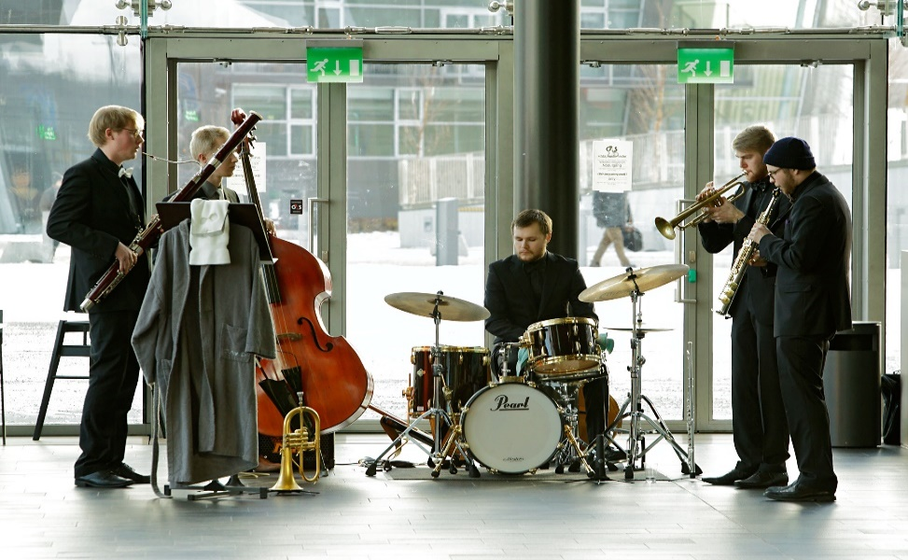
FROM PRE-SCHOOL TO HIGHER EDUCATION
Pre-Primary and Primary
Upper secondary education
Vocational education and training
Basic education in arts
Liberal adult education
Adult education
Higher education

Slide 15
OPERATIVE PRINCIPLES
Decision-making independent of external influence
Follows the principle of enhancement-led evaluation
Actively disseminates the results of evaluations

Slide 16
EVALUATION COUNCIL 2015-2018
13 members
Chair: Managing Director, Rector Tapio Huttula, Humak University of Applied Sciences
Vice-chair: Head of Education and Cultural Services Sampo Suihko, City of Espoo
Appointed by the government
Supervises and develops the Evaluation Centre´s activities
Takes part in the strategic planning of the Centre
Prepares statements of far-reaching consequences
Prepares the National Plan of Evaluation of Education (revised plan should be finished by the end of 2015)
Handles project plans of evaluations

Slide 17
EVALUATIONS OF HIGHER EDUCATION BY FINEEC
Audits of Quality Systems of HEI`s
Universities and Universities of Applied Sciences
Since 2005, all the institutions audited at least once
Thematic evaluations
  Study paths and working life co-operation between vocational education and training and professional higher education (ongoing)
  Subject teachers of Swedish language (ongoing)
Evaluations of educational fields
Education and training in early childhood education (finished in 2013)
Voluntary Engineering Programme Accreditations (EUR-ACE)

Slide 18
FINEEC AUDITS AND
THEIR IMPACT ON
HIGHER EDUCATION

Slide 19
FINEEC AUDIT – BACKGROUND AND PHILOSOPHY
Finland’s response to the request of the Bologna process to develop a comprehensive national higher education QA system (”system of accreditation, certification or comparable procedure”)
Institutional approach – the same model for both higher education sectors (universities and universities of applied sciences)
  Comprehensive approach – covers research/RDI, education and social impact – and overall quality management
External assessment of internal QA - reflects institutions’ autonomy and responsibility, and a large measure of trust
  HEIs are responsible for the quality of their operations
  Each institution develops its quality system based on its own needs and goals

Slide 20
ENHANCEMENT-LED APPROACH
Aim to support HEIs in the enhancement of quality and establishment of quality culture by
producing information to assist HEIs to develop their activities, and by
(2) exchanging and disseminating good practices among other HEIs
As a result of the audit, an institution either passes the audit and receives a quality label or is subject to a subsequent re-audit
  Institutions are neither rewarded for a positive result nor punished for a negative one – there are no financial incentives or loss of degree-awarding powers

Slide 21
AUDIT MANUAL: PROCESS AND CRITERIA
Audits are based on FINEEC Audit Manual (process and criteria)
http://karvi.fi/app/uploads/2015/02/KARVI_0215.pdf
Full cycle of audits conducted during the years 2005-2012, the second audit round going on (until 2018)
  Feedback from the audited Finnish HEIs shows that they have been quite satisfied with the audits
  The model refined four times
  Well-established and stable procedure
Impact studies, institutions’ feedback and follow-up reports: Improvement of management and feedback systems as well as results of activities, new operational and quality cultures in HEIs

Slide 22
AUDIT TARGETS
1. Quality policy
4. Quality management of the HEI’s core duties, incl. essential services supporting these
5. Samples of degree education (3 programmes)
2. Quality system’s link with strategic management
3. Development of the quality system
6. The quality system as a whole
4b) RDI & artistic activities
4c) Societal inter-action and regional development work
4d) Optional audit target
4a) Degree education

Slide 23
CRITERIA USED IN THE AUDIT
Audits employ a set of criteria that is based on a scale of four development stages of quality management
  absent
  emerging
  developing
  advanced
The development phase for each audit target is determined individually, including each degree programme sample
The audit team can propose that the institution passes the audit if none of the targets are ‘absent’ and if the quality system as a whole is at least ‘developing’

Slide 24
AUDIT TARGET 6. THE QUALITY SYSTEM AS A WHOLE

Slide 25
AUDIT PROCESS
Agreement negotiation
Preliminary time frame for the audit
Self-evaluation
Compilation and submission of other audit material
Audit visit
Audit team’s report and recommen-dation regarding the audit result
Publication of the report
Quality label – valid for 6 years
Concluding seminar at the HEI
Higher Education Evaluation Committee appoints the audit team.
Higher Education Evaluation Committee makes the decision on the result.
If the HEI does not pass the audit, re-audit in 2-3 years
Feedback from the HEI and audit team
Next audit in 6 years
Follow-up seminar 3 years after the audit

Slide 26
AUDIT MATERIAL
Basic material
Self-evaluation report
  The report is structured according to FINEEC guidelines
  The structure mirrors the audit criteria, the length is limited
  Each chapter ends with a summary table of strengths and areas in need of development, as recognised by the institution
Electronic materials
Interviews
Requested additional material

Slide 27
FINEEC AUDIT TEAMS
An audit team usually consists of five members
  In case of bigger institutions, can be up to seven members
Selected so that they represent
the two higher education sectors (research universities, professionally oriented HEIs)
students
working life outside the higher education sector
Experience and knowledge of the optional audit target

Slide 28
AUDIT AGREEMENT
FINEEC signs an agreement on the audit with the HEI
The following issues are recorded in the agreement:
͘͘ Audit targets (incl. the optional target)
͘͘ Audit procedure and time frame
͘͘ The national or international composition of the audit team and the language to be used to carry out the audit (Finnish, Swedish or English)
͘͘ Duration of the audit visit (3–5 days)
͘͘ Price of the audit (costs are shared between FINEEC and HEI)
͘͘ Commitment to a potential re-audit

Slide 29
FINEEC´S HIGHER EDUCATION EVALUATION COMMITTEE
Committee has 9 members: HEIs, students, working life represented
Professor Jouni Välijärvi, University of Jyväskylä/Chair
Rector Anneli Pirttilä, Saimia UAS/Vice Chair
Decides on Audit manual, audit teams and audit outcomes
Approves the project plans, planning groups and evaluation teams of evaluations that concern higher education

Slide 30
OUTCOME OF AN AUDIT
The FINEEC Higher Education Evaluation Committee decides on the audit result on the basis of the proposal by the audit team and on the audit report
The task of the Committee is to ensure that decisions are impartial
HEIs that pass the audit receive a quality label and are added to the register of audited institutions maintained on FINEEC’s website
http://karvi.fi/en/higher-education/audits-quality-systems/audit-register/

Slide 31
AUDITS 2005-2015
 |  | Universities of applied sciences | Universities | All Finnish higher education institutions
Publication year of the audit report | Total number of audits | Re-audit decisions | Re-audit decisions | Re-audit decisions, total
2005 | 2 |  |  | 0
2006 | 6 | 2 |  | 2
2007 | 5 | 1 |  | 1
2008 | 6 |  | 2 | 2
2009 | 10 | 1 | 1 | 2
2010 | 8 |  | 1 | 1
2011 | 9 |  | 1 | 1
2012 | 3 (2) |  |  | 0
2013 | 3
2014 | 2 |  | 1 | 1
2015 | 7 |  | 1 | 1
Total | 61 | 4 (0) | 7 (2) | 11

Slide 32
GENERAL REMARKS ON THE FIRST AUDIT ROUND
Nearly one in five audits (18%) resulted in a re-audit decision
  14% of the UASs vs. 24% of the universities
Feedback from the audited HEIs
  On the whole, HEIs quite satisfied with the audits; satisfaction remained relatively constant throughout the first audit round
  UASs slightly more satisfied than universities
  The management and central administration had the most positive view on the quality work in both higher education sectors

Slide 33
HEIS’ VIEWS ON THE IMPACT OF THE AUDIT
Improvement of management systems, strengthening of strategic work
Several UASs report on the link between the quality system and the improved results of their activities (regarding, e.g., dropout rate, progression and completion of studies)
Improvement of feedback systems (student, working life and alumni)
Participation of students and external stakeholders in the development of operations enhanced and supported
Dissemination of good practices within and between HEIs
More cooperation within institutions between different units and between HEIs, benchmarking activities have increased
New evaluation cultures – external evaluations now seen as more significant tools in the development (international evaluations utilised at different organisational levels)

Slide 34
CONCLUSIONS
Audits as enhancement-led evaluations have received wide acceptance
  Mutual trust
  Open and supportive communication
Audits have contributed to the development of Finnish higher education by
  Changing quality and operational cultures in HEIs and by increasing cooperation within the whole field of higher education
  Inclining HEIs to learn from one another and share information and good practices with one another, also between the two higher education sectors – mutual understanding and collaboration between the sectors have been enhanced

Slide 35
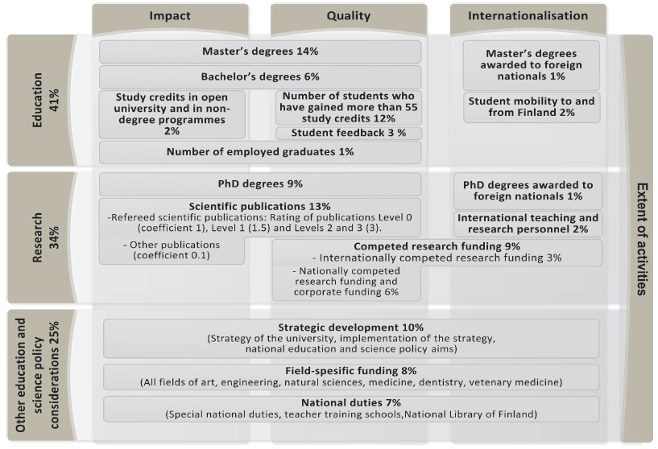
FUNDING MODEL OF UNIVERSITIES

Slide 36
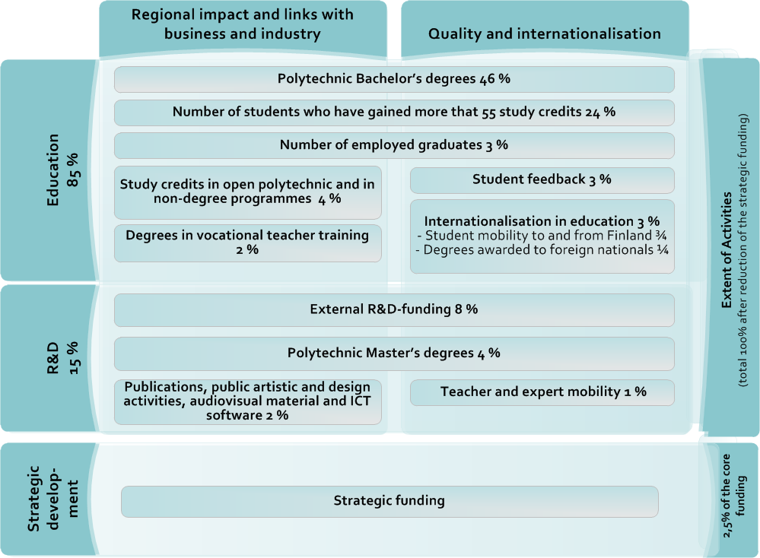
FUNDING MODEL OF UAS’S

