Slide 1

Piloting Standards and Guidelines for Quality Assurance of Higher Education in Azerbaijan - AzSG
Helka Kekäläinen, PhD
Project Leader

Slide 2
EHEA Challenges for Azerbaijan
Comparable degrees > easier mobility, recognition etc.
More international degree programmes (English taught) > opportunities for mobility, development of international and intercultural skills
Renewal of curricula > working-life relevance, employability (stakeholder participation), lifelong learning, university and business collaboration, alumni work
More focus on university pedagogics, learner-centred education
More active student participation, students as active actors in HEIs, responsible for their studies
”Mobility for better learning”, more international cooperation, partnerships, peer learning activities, sharing good practice

Slide 3
Main principles and values of the ESG – European Standards and Guidelines
Twin-purpose of QA: accountability and enhancement
Transparency and external expertise in QA processes
Encourage culture of quality within HEIs
HEIs have primary responsibility for quality and QA
Efficient & effective organisational structures for provision and support of programmes
Processes to demonstrate accountability
Diversity and innovation
Interests of society safeguarded

Slide 4
Main phases of the pilot evaluations

Slide 5
… in line with the ESG:
Appointment and training of the international evaluation group
Self-evaluation and compilation of other material by the higher education institution
Site visit to the higher education institution
The international evaluation group’s report
Publication of the report

Slide 6
Composition of international evaluation group
Five members: 3 from Azerbaijan, 2 from Finland/Estonia
Members represent different personnel groups at HEIs, and students
The goal is to include a few individuals with prior experience in the external evaluation of higher education institutions
Members and Chair appointed by Project Leaders; before appointment the HEI is given the opportunity to comment on the composition, especially from the perspective of disqualification
Members are on an equal footing as evaluators
Project manager from FINEEC/EKKA takes part in the team’s activities as an expert of external evaluation of higher education and supports the work of the committee

Slide 7
Support for the Self-evaluations
3 step by step trainings for the pilot institutions during the autumn term 2016
Pilot evaluations will take place in March-April 2017
Pilot institutions: Azerbaijan State Pedagogical University, Azerbaijan State University of Economics and Azerbaijan Technical University

Slide 8
Outline for
Site visit

Slide 9
The purpose is to verify and supplement the observations made based on the written material submitted by the HEI.
The goal is to make the site visit an interactive event that supports the development of the institution’s operations.
The project manager prepares a schedule of the visit in cooperation with the higher education institution, and in accordance with the wishes expressed by the evaluation group.
The site visit lasts three days.

Slide 10
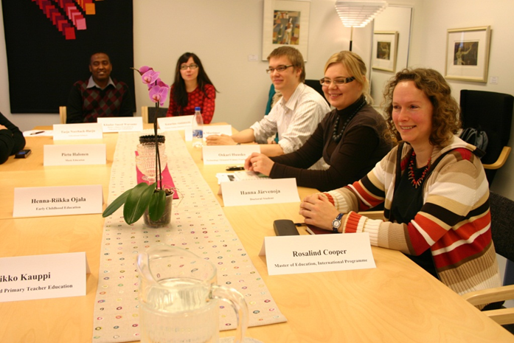
Photo by:
Students from the University of Oulu

Slide 11
Outline for
International evaluation group’s report

Slide 12
The findings of the evaluation are summarised in a report, written collaboratively by the international evaluation group
The report follows a standardised structure and covers:
  Description of the assessment process;
  Concise description of the higher education institution;
  Evidence, analysis and findings;
  Strengths and features of good practice;
  Recommendations for further development and follow-up action.
The institution is given the opportunity to point out errors of fact before the report is finalised
The report is published on Projects’s website

Slide 13
Drafting the AzSG
Heli Mattisen, PhD

Slide 14
Drafting process
Collecting analysing information about the state of affaires (existing regulations and reports, state strategy for education, interviews with stakeholders: academic staff members, students, MoE; discussions during trainings and workshops)
Selecting people for the drafting group (participation in trainings; experience in internal and/or external QA; good English skills in order to work in an international evaluation group;; representatives of the Accreditation and Nostrification Office, MoE)
Preparing the preliminary draft (in Quba, 25.-27.05.2016)
Presenting the preliminary draft to the Advisory Group
Finalizing the AzSG for pilot evaluations (August-September)

Slide 15
Drafting group members
Ms. Elmira Ismayilova, Baku State University
Mr. Ruslan Mammadov, Ganja State University
Mr. Anar Naghiyev, Azerbaijan University of Languages
Ms. Nargiz Mammadova, Azerbaijan University of Languages
Mr. Tofig Ahmadov, Ministry of Education
Mr. Afgan Abdullayev, Ministry of Education
Mr. Sohrab Isayev, Azerbaijan State University of Economics
Ms. Elmira ------------- , Ministry of Education, ANO
Mr. Elshan Nuriyev, Ministry of Education, ANO
Ms. Helka Kekäläinen, Finland
Ms. Kirsi Hiltunen, Finland
Ms. Heli Mattisen, Estonia
Guest experts: Mr Natig Ibrahimov, Mr Emin Emrullayev

Slide 16
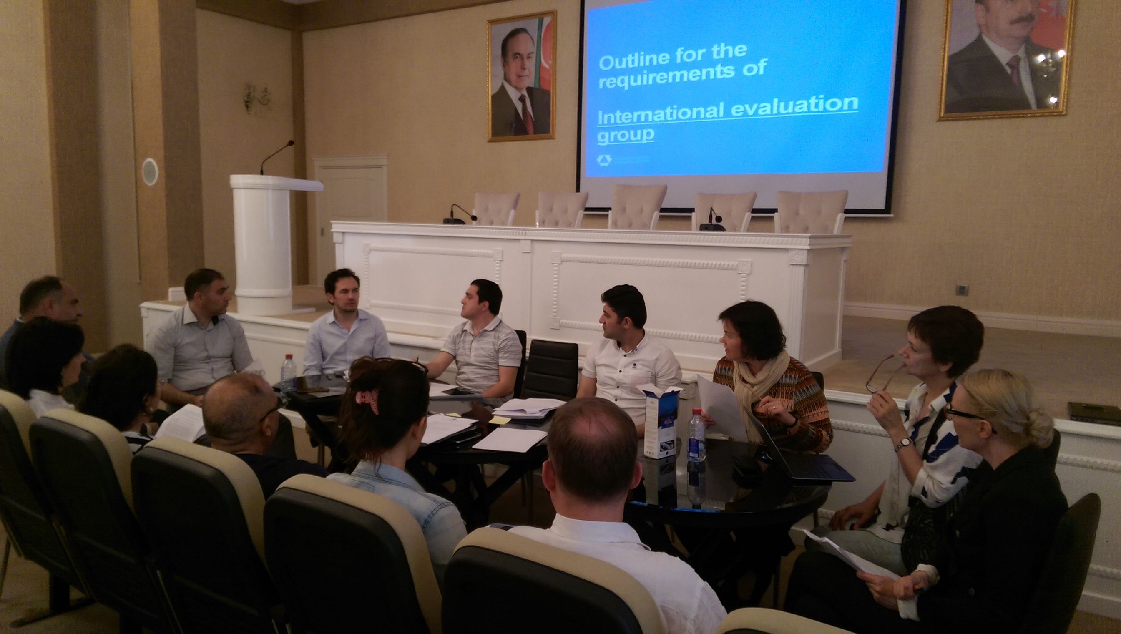
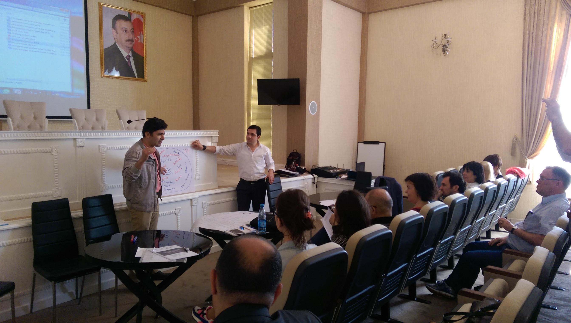

Drafting in Quba

Slide 17
Basic principles for drafting
Institutional approach with the focus on teaching and learning
Reference to ESG
Local needs and areas for improvement taken into account
Plan-Do-Check-Act cycle
Enhancement lead approach

Slide 18
Focus areas for improvement
strategic management and internal quality assurance procedures
development of learning outcome based study programmes in accordance with the needs of the economy, involvement of stakeholders
student-centred teaching and learning, teaching methods
assessment methods in line with intended learning outcomes; formative assessment of students
research based teaching and learning
internationalisation
academic ethics

Slide 19
The aim of pilot evaluations
to support the strategic management of HEIs,
to provide external feedback to the institutions’ own internal quality assurance procedures,
to inform stakeholders of the compliance of the process and outcomes of teaching and learning to the European standards and guidelines for quality assurance in higher education.

Slide 20
1 Strategic and organisational management
The higher education institution has defined its mission and quality policy/values.
The development plan of the institution is in accordance with the mission statement and quality policy, and takes into account national priorities and society’s expectations.
The institution’s system of governance supports the implementation of the development plan in accordance with the mission statement and quality policy.

Slide 21
2 Study programmes
(applied on 2 samples of study programmes from different academic units)
The design and development of study programmes is in line with educational objectives of the institution, expectations of the society, labour market needs, and the latest research.
The qualification resulting from a programme is in accordance with the national qualifications framework and ECTS principles.

Slide 22
3 Teaching and learning
Teaching and learning takes into account the educational needs of students, provides flexible learning opportunities and encourages active participation of students in creating the learning process.

Slide 23
4 Research and development
The higher education institution has defined objectives for its R&D activities, measures their implementation, and ensures the link between research and education.

Slide 24
5 Academic staff
Academic staff with adequate qualifications ensure the achievement of the objectives and learning outcomes of the study programme, as well as the quality and sustainability of teaching and learning.

Slide 25
6 Students
The shift towards student-centred learning and flexible modes of learning and teaching are taken into account when allocating, planning and providing the learning resources and student support.

Slide 26

Thank you for your attention!

