Slide 1
HE in Finland
Birgitta Vuorinen, Counsellor of Education
Department of Higher Education and Science Policy

Slide 2
Outline
The Ministry of Education and Culture and the Finnish Education System
Steering of HE in Finland
Government programme
HE in Finland
Qualifications framework

Slide 3
Minister of Education and Culture
Permanent Secretary
Internal Auditing
Department for General Education and Early Childhood Education
Director General
Strategic Steering Division
Division for General Education and Early Childhood Education
Department for Vocational
Education and Training
Director General
Department for
Higher Education
and Science
Policy
Director General
Strategic Steering Division
Science Policy Team
Key Project
Team
Administrative Unit
Human Resources
General Administration
In-house Services
Information Management
Division for Art and Cultural Heritage
Director General
Strategic Steering Division
Division for Culture and Cultural Heritage
Division for Copyright Policy and Audiovisual Culture
Department for Youth and Sport Policy
Director General
Strategic Steering Division
Division for Youth Work and Youth Policy
Division for Sport
Finance Unit
Financial Administration
Financial Planning
Auditing
Communications Unit
Secretariat for International Relations

Slide 4
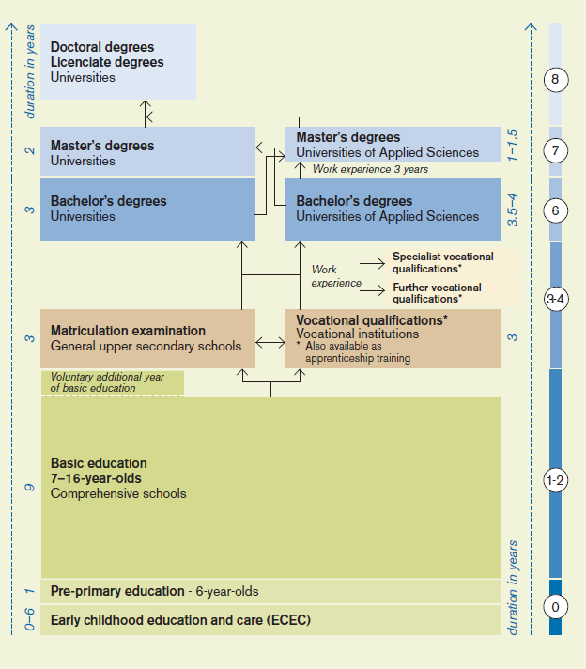
Flexible system
LIBERAL ADULT EDUCATION
Open University education
Open Universities of applied sciences education
Adult education centres
Folk high schools
Summer universities
Study centres
Sports institutes
The education system gives each student great flexibility.
Binding decisions are not expected to be made at an early stage.
The road all the way to tertiary education is untracked, with none of the paths leading to a dead end.
ISCED-classification 2011
0 Early childhood education
1 Primary education
2 Lower secondary education
3 Upper secondary education
4 Post-secondary non-tertiary education
6 Bachelor’s or equivalent
7 Master’s or equivalent
8 Doctoral or equivalent

Slide 5
Outline
The Ministry of Education and Culture and the Finnish Education System
Steering of HE in Finland
Government programme
HE in Finland
Qualifications framework

Slide 6
Steering and funding of HEIs
Legislation and norms
Programme of the Finnish Government
MoE steering
  Negotiations and performance agreements
  Written feedback
  University and Polytechnic visits
  Regional seminars
  Information exchange
State budget
State funding for HEIs
    Universities € 1,8 bn
    Polytechnics € 0,9 bn
    + Public research funding allocated to universities (Academy of Finland & Tekes) € 0,3 bn

Slide 7
Performance Agreements
Structure of the agreement between MoE and HEIs
1. Objectives set for the higher education system as a whole
  Verbal goals formulated in dialogue with HEIs
  Comprise the statutory duties, structural development, quality, competitiveness, effectiveness, internationalization, the viewpoint of staff and students, and the cost-effectiveness and productivity of the activities.
2. Mission, Profile and Focus Areas of the HEI
Key Development Measures
  1-5 projects per HEI linked to the implementation of the HEI's strategy
Financing
  The government core funding in total

Slide 8
Feedback and monitoring
The HEIs are expected to present correct information on their performance and finances in a way that enables their progress be evaluated against the set goals.
  Development is annually monitored through indicators which gauge effectiveness and quality
  The Ministry gives written feedback to the HEIs on their activities and development needs.
  The feedback procedure is used to steer and monitor the implementation of higher education policy objectives during the agreement period.
The Ministry of Education and Culture visits each HEI once on the agreement period
  Discussions with the management, personnel, students and stakeholders
Informal exchange of information is frequent
  Small and large, multilateral and bilateral meetings between HEIs and the MoE

Slide 9
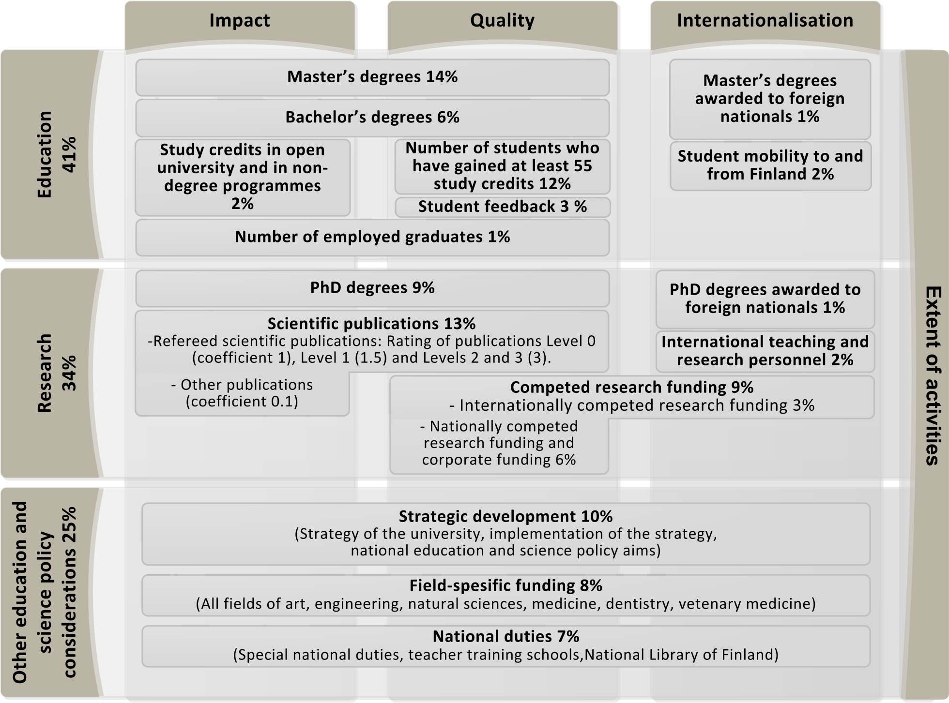
Universities core funding from 2015
Notes:
Vision 2020 for the Finnish universities
Improved quality, Deeper internationalisation, Clearer profiles, Greater efficiency, Stronger impact
The parliament decides on the overall amount of funding available for the universities and polytechnics.
The funding models determine what percentage of the funding is allocated to which performance.
MoE allocates core funding (direct government funding) to universities and polytechnics. Funding is allocated in a lump sum.
Public research funding is a separate part of the budget.
To calculate the core funding, performance indicators are used. HEIs are funded based on their achieved perfomance outputs (not the targeted outputs).
Funding for the year 2015 is calculated in 2014, using the average performance achieved by the institution between 2011-2013.

Slide 10
Universities' core funding formula review 2017
Review accepted by the government April 2016, will take effect 2017
Based on proposal of the joint working group between the Ministry and Finnish universities
Focus on review of the model - not large-scale reform
Share of the strategic funding and share of employed graduates increased
Professional specialisation studies and credits based on cooperation agreements incorporated into the funding factors
Revision of some calculation criteria's
  Students who have performed at leas 55 study credits will be revised to take into account those students who begin at the January and who graduate during the calculation year
  Calculation of the publication forum data will be revised: stronger role to quality of refereed publications
Funding allocated to universities in a lump sum
All indicators calculated using 3-year averages

Slide 11
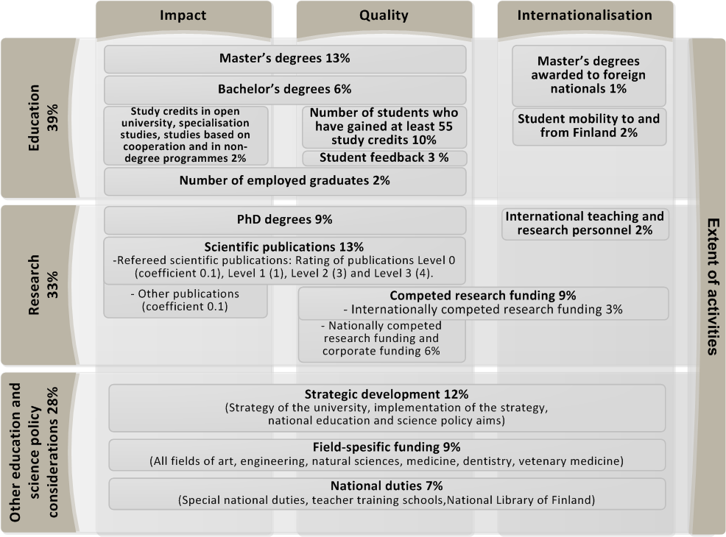
Universities core funding from 2017
Notes:
Vision 2020 for the Finnish universities
Improved quality, Deeper internationalisation, Clearer profiles, Greater efficiency, Stronger impact
The parliament decides on the overall amount of funding available for the universities and polytechnics.
The funding models determine what percentage of the funding is allocated to which performance.
MoE allocates core funding (direct government funding) to universities and polytechnics. Funding is allocated in a lump sum.
Public research funding is a separate part of the budget.
To calculate the core funding, performance indicators are used. HEIs are funded based on their achieved perfomance outputs (not the targeted outputs).
Funding for the year 2015 is calculated in 2014, using the average performance achieved by the institution between 2011-2013.

Slide 12
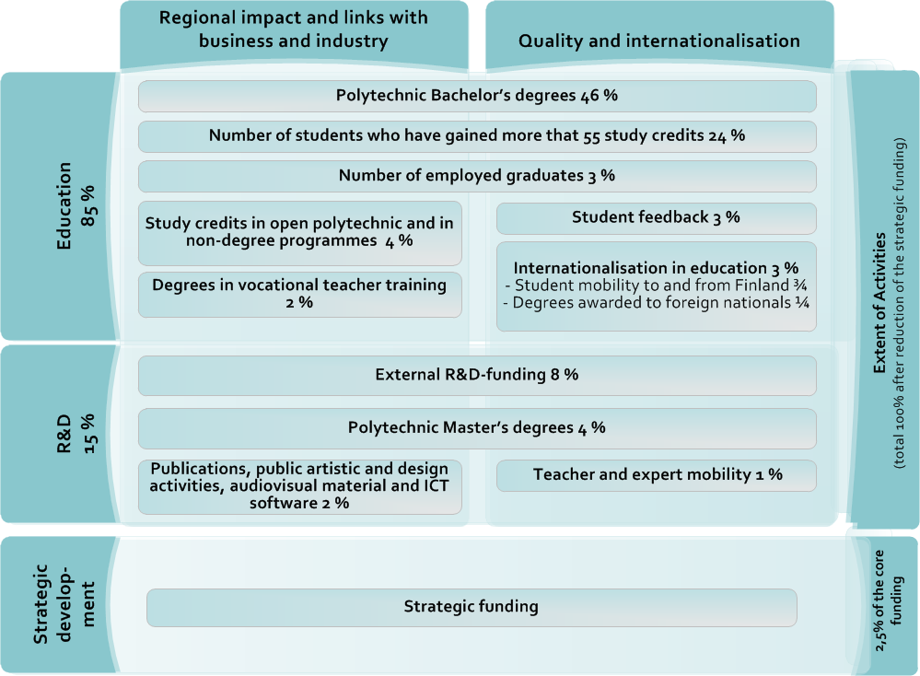
Universities of Applied Sciences’ core funding from 2015
Notes:
Strategic funding to be part of the basic funding: principles for allocating strategic funding
Strategic funding the main incentive for structural developments

Slide 13
UAS' core funding formula review 2017 - proposal
Review proposal is currently being prepared in a joint working group of the Ministry and Finnish UAS
  proposal made October 2015, decision making on process
Aim is to review some parts of the model - not large-scale reform
Stronger strategic funding, decreased funding shares from education factors of the model (degrees, 55 study credits)
Added share to employment and open UAS studies
Professional specialisation studies and credits based on cooperation agreements incorporated into the funding factors
Revision of some calculation criteria's
  Removal of the field-specific coefficients from the calculation of degrees
  Students who have performed at leas 55 study credits will be revised to take into account those students who begin at the January and who graduate during the calculation year
  New student feedback survey and collecting time when applying for the degree
Funding allocated to Universities of Applied Sciences in a lump sum
All indicators calculated using 3-year averages

Slide 14
External funding: Academy of Finland and TEKES
Academy of Finland
  Public financing and expert organisation for scientific research
  Competitive funding with external evaluation
  Promotes
  High-quality scientific research
  Diversity and renewal of research
  International co-operation
  Research Councils within Academy of Finland
Tekes – Funding Agency for Technology and Innovation
  Public financing and expert organisation for technological research
  Promotes the competitiveness of Finnish industry and the service sector
  Aims
    To diversify production structures,
    increase production and exports, and
    create a foundation for employment and social wellbeing
  Finances
    R&D in companies, but also in research institutes and universities

Slide 15
Public funding for higher education and research 2016
Universities of applied sciences
858
Ministry of Education and Culture
1823
Universities
50
Academy of Finland
258+56
+ spearhed projects
SRC
State Research Institutions
Other Ministries
228*
Tekes
Business
383
+spearhead projects
8.10.2015
Notes:
Laatinut: A.Mälkki 30.9.2015
Lähteet: Hallituksen esitys 28.9.2015 (HE2016); TULA vnpp (TULA); TK budjettianalyysi 2015 (TK2015)
AMKt (HE2016) 860 M€ (mom 55)
Yliopistot (HE2016) 1823 M€ (mom 50)
KK yht.menot (HE2016) 55 M€ (mom 20)
SA (HE2016) 232 M€ (mom 51) + 70,6 M€ (mom 53) + 55,6 M€ (mom 54 valtuus / STN) = 303 + 56
Tutkimuslaitokset (TK2015 & TULA vaikutus v. 2016)
256 milj € - 28 M€ = 228 M€
Tekes (HE2016) 231 M€ (mom 40 valtuus) + 141,7 M€ (mom 83 lainat) = 370

Slide 16
Outline
The Ministry of Education and Culture and the Finnish Education System
Steering of HE in Finland
Government programme
HE in Finland
Qualifications framework

Slide 17
Government programme 2015-2019
PM Sipilä’s Government Programme May 27, 2015:
Finland of Solutions – a strategic government programme
Vision: Finland 2025 – built together
  Finland as a part of Europe
  Finland of sustainable economy
  Renewing Finland
  Safe Finland
Notes:
Dia 12 New Government programme

Slide 18
Government on
Knowledge and Education
Ten-year objective:
Finland is a country that encourages people to continuously learn something new. Skills and education levels in Finland have risen, promoting the renewal of Finnish society and equal opportunities. Finland is in the vanguard of education, skills and modern learning techniques.
Government-term objectives:
Learning environments have been modernised and the opportunities offered by digitalisation and new pedagogical approaches are grasped in learning.
The number of young people who have dropped out of education or working life has fallen. The drop-out rate in education has declined.
Dialogue between educational institutions and working life is more active.
The quality and effectiveness of research and innovation have begun to improve.
Education and research have become more international and obstacles to education exports have been removed.

Slide 19
Knowledge and Education
Key projects this government term
New learning environments and digital materials to comprehensive schools
Reform of vocational upper secondary education
Acceleration of transition to working life in higher education
Access to art and culture will be facilitated
Cooperation between higher education institutions and business life will be strengthened to bring innovations to the market
Youth guarantee towards community guarantee

Slide 20
Sipilä’s Government:
Acceleration of transition to working life
Measures sought that support earlier start of working life.
Movement within and between different levels of education will be made as flexible as possible.
Accelerated higher education graduation and faster transition to working life is encouraged.
The entrance examination process to higher education institutions will be reformed.
“A third term” will be introduced in higher education institutions.
Cooperation between the upper secondary level and higher education will be increased.
Qualification requirements in the public sector will be updated.

Slide 21
Sipilä’s Government: Cooperation between higher education institutions and business life strengthened to bring innovations to the market
The effectiveness and commercialisation of research results will be strengthened. The profiles and respective responsibilities of higher education institutions and research institutes will be clarified and cooperation between them will be increased. Knowledge and expertise will be pooled in competitive centres of excellence.
  Higher education institutions’ and research institutes’ proposals on their respective responsibilities. Faculties’ and research units’ closer cooperation.
  Regional centres of excellence and powerful hubs representing specific fields will be provided with financial support.
  Account will be taken of the effectiveness and commercialisation of research results in the steering of public research, development and innovation funding, as well as in incentives channelled towards research institutes and higher education institutions.

Slide 22
Outline
The Ministry of Education and Culture and the Finnish Education System
Steering of HE in Finland
Government programme
HE in Finland
Qualifications framework

Slide 23
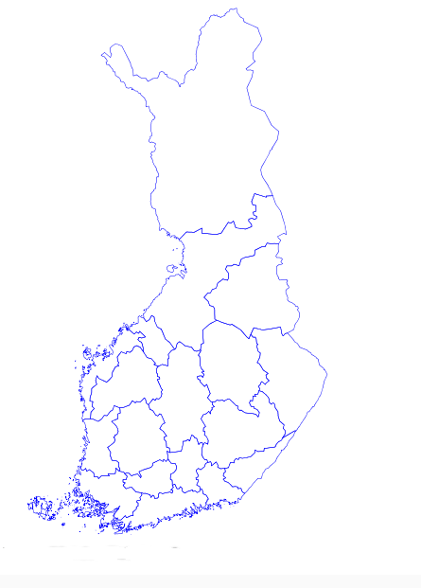
HEIs and locations in Finland in 2015
Kemi: Lapin amk ja Humak amk ja Tornio: Lapin amk
Oulu: Oulun yliopisto, Oulun amk
Ylivieska: Centria amk
Rovaniemi: Lapin yliopisto, Lapin amk
Kokkola: Centria amk, yliopistokeskus (JY, OY, VY)
Oulainen: Oulun amk
Kajaani: Kajaanin amk, yliopistokeskus (ISYO, OY, LY, JY)
Pietarsaari: Åbo Akademi, Centria amk, Novia amk
Saarijärvi: Jyväskylän amk
Jyväskylä: Jyväskylän yliopisto, Jyväskylän amk
Iisalmi: Savonia amk
Vaasa: Vaasan yliopisto, Helsingin yliopisto, Åbo Akademi, Hanken, Vaasan amk, Novia amk
Kuopio: Itä-Suomen yliopisto, Savonia AMK, Humak amk
Pieksämäki: Diak amk
Seinäjoki: Seinäjoen amk, yliopistokeskus (TTY, TaY, HY, VY, Taideyliopisto)
Joensuu: Itä-Suomen yliopisto, Karelia amk
Varkaus: Savonia
Ilmajoki: Seinäjoen amk
Savonlinna: Itä-Suomen yliopisto, Mikkelin amk
Kankaanpää: Satakunnan amk
Mikkeli: Mikkelin amk, yliopistokeskus (Aalto, HY, LTY)
Pori: Satakunnan amk, Diak amk, yliopistokeskus (Aalto, TTY, TaY, TY)
Heinola: Haaga-Helia amk
Rauma: Satakunnan amk, Turun yo
Imatra: Saimaan amk
Tampere: Tampereen yo, Tampereen teknillinen yo, Tampereen amk
Lappeenranta: Lappeenrannan teknillinen yliopisto, Saimaan amk
Turku: Turun yo, Åbo Akademi, Turun amk, Diak, Humak, Novia amk
Kouvola: Kymenlaakson amk
Salo: Turun amk
Forssa, Tammela, Hattula, Valkeakoski ja Riihimäki: Hämeen amk
Lahti: Lahden amk, yliopistokeskus (Aalto, HY, LTY)
Kotka: Kymenlaakson amk
Hämeenlinna: Hämeen amk
Porvoo: Haaga-Helia amk, Laurea amk
Raasepori: Novia amk
Lohja: Laurea amk
Pääkaupunkiseutu: Helsingin yliopisto, Aalto yliopisto, Hanken, Taideyliopisto, Arcada amk, Haaga-Helia amk, Humak amk, Diakonia amk, Laurea amk, Metropolia amk,
Hyvinkää: Laurea; Järvenpää: Diak; Nurmijärvi: Humak

Slide 24
Similarities with other European HE systems
HEI’s are responsible for the curricula of their programmes
Degree system is based on
  Bachelor’s –Master’s degree structure
  Student work-load based European credits
  Definition of learning outcomes and core content of the programmes
  Individual study plans
  Diploma supplements
  Towards fewer and broader Bachelor’s programmes in universities
Topical issues
  Employability
  Joint programmes with international partners
  Promoting mobility and internationalisation (Mobility window/ Internationalisation at home)
  Student centered learning – good learning environment
  Good support services

Slide 25
Significant recent reforms
University reform 2007-2009
Greater autonomy, stronger financial and administrative status, independent legal persons, greater latitude with finances
  Universities are better able to operate with the surrounding society
  Stronger community relations – e.g. external members of the board
Reform did not change
  The freedom of research, art and education, academic decision-making
  The government’s responsibility for funding the public duties of the universities
Universities of Applied Sciences reform 2011-2014
Independent legal persons (limited companies), new funding model, new operating licenses including updated educational responsibilities
  more flexibility to better react and response to the needs of the surrounding society, stronger strategic competence, profiling, focus area choices, stronger leadership and ability to decision making
  Quality and effectiveness of teaching and RDI, international competitiveness
The responsibility for core funding entirely transferred to the state
Reform of state research institutes and research funding
Structural reforms, research funding reforms
  Mergers, consortiums, deeper co-operation, strategic research funding instrument
Notes:
Dia 9 about the HE reforms

Slide 26
Finnish education and research system in comparison
Innovation Union Scoreboard 2015 Open, excellent and attractive research system | U21 Ranking of National Higher Education Systems 2015 | OECD Quality of scientific production | INSEAD, WIPO and Cornell University Global Innovation Index 2015 Human capital and research | WEF and INSEAD The Networked Readiness Index 2015 | INSEAD, WIPO Global Innovation Index 2015 Government Effectiveness | OECD PISA average scales in reading, mathematics, and science
1. Netherlands | 1. United States | 1. Switzerland | 1. Finland | 1. Singapore | 1. Finland | 1. China
2. Sweden | 2. Switzerland | 2. Netherlands | 2. Korea rep. | 2. Finland | 2. Singapore | 2. Singapore
3. Denmark | 3. Denmark | 3. Denmark | 3. Denmark | 3. Sweden | 3. Denmark | 3. Hong Kong
4. U. Kingdom | 4. Finland | 4. Iceland | 4. Sweden | 4. Netherlands | 4. Sweden | 4. Korea Rep.
5. Luxembourg | 5. Sweden | 5. Sweden | 5. Singapore | 5. Norway | 5. Norway | 5. Japan
6. Belgium | 6. Canada | 6. Belgium | 6. Switzerland | 6. Switzerland | 6. Switzerland | 6. Finland
7. France | 7. Netherlands | 7. United States | 7. U. Kingdom | 7. United States | 7. Canada | 7. Estonia
8. Ireland | 8. U. Kingdom | 8. U. Kingdom | 8. Austria | 8. U. Kingdom | 8. Netherlands | 8. Canada
9. Finland | 9. Singapore | 9. Canada | 9. Australia | 9. Luxembourg | 9. New Zealand | 9. Poland
10. Austria | 10. Australia | 14. Finland | 10. Germany | 10. Japan | 10. Hong Kong | 34. Sweden
26

Slide 27
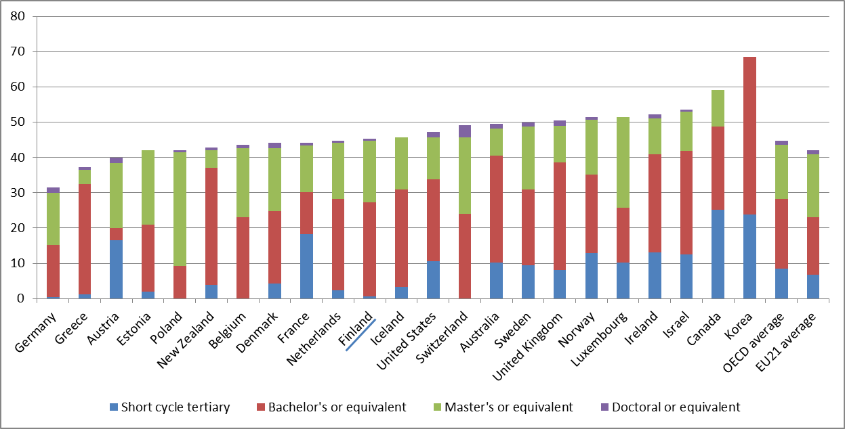
Tertiary education level for 30-34-years-olds in 2014
Source: OECD Education at a Glance 2015.

Slide 28
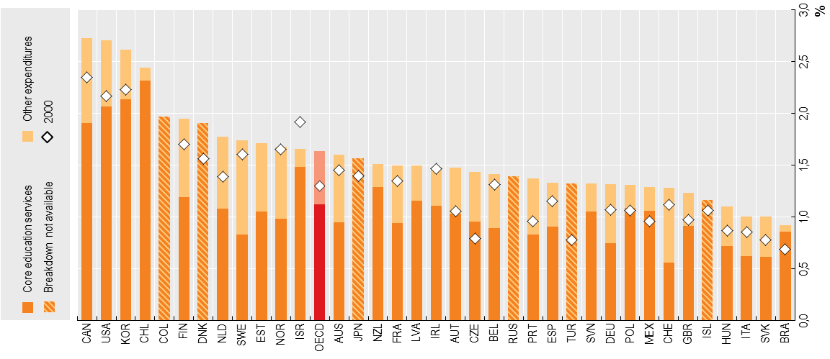
Spending on higher education, 2011
As a percentage of GDP
Source: OECD Science, Technology and Industry Scoreboard 2015

Slide 29
Finnish HE system - review
Strengths | Weaknesses
Several important reforms have already been made, including an autonomy reform and new acts for universities and for UAS | Few internationally top-ranked HEIs
An important step towards a more transparent funding stream for UAS has been taken | Existence of barriers towards transfer across the dual system for students
Reforms > Strengthened academic leadership | Low level of foreign recruitment of academic staff at HEIs
Increased connection to the surrounding society through inclusion of external members of the HEI boards | Scattered HEI landscape with comparatively many HEIs, some of which are quite small
A few mergers between HEIs have contributed to slightly fewer HEIs | Small subjects exist at many HEIs
Est. of Aalto University has received significant attention internationally and is seen as a success | Low level of internationalisation in the system as a whole
Well-developed innovation system; an innovation leader according to Innovation Union scoreboard | Underdeveloped level of cooperation between universities and UAS
High performance of the schooling system; highly raked in international tests | Legal barriers towards deeper cooperation and mergers between universities and UAS
Strong connection bt. UAS and regional business | The innovation system does not contribute sufficiently to commercialisation of knowledge and creation of new jobs
The regional coverage of UAS, and to a lesser extent universities, is good | Long study times
Technopolis Group 2015

Slide 30
The number of higher education institutions
 | Universities | UAS | Population | HE students 2012 (1000) | HEIs/million inhabitants | HEIs/ thousand students
Finland | 14 | 24 | 5,5 | 308,9 | 6,9 | 0,12
Denmark | 8 | 16* | 5,7 | 275,0 | 4,2 | 0,09
Irland | 7 | 14** | 4,6 | 192,6 | 4,6 | 0,11
The Netherlands | 14 | 37 | 16,9 | 793,7 | 3,0 | 0,06
Switzerland | 12 | 9*** | 8,2 | 269,6 | 2,6 | 0,08
*University colleges and Academies of Higher Education; **Institutes of technology; *** 7 public, 2 private yksityistä.
Source: Technopolis Group: Considerations for a future proof system for higher education and research in Finland

Slide 31
Outline
The Ministry of Education and Culture and the Finnish Education System
Steering of HE in Finland
Government programme
HE in Finland
Qualifications framework

Slide 32
Preparation of the qualifications framework
Development Plan for Education and Research 2007–2012: A national framework based on the description of competence produced by qualifications and other learning will be prepared by 2010.
An extensive preparatory committee (NQF Committee) appointed by the Ministry of Education, term from 1.9.2008 to 30.6.2009.
Consultation process on the committee proposals 8–10/2009 (86 opinions were submitted).
The framework was endorsed; proposals for changes concerned details.
The report formed a basis for the Government Proposal to Parliament for an Act on the National Framework for Qualifications and Other Learning.
The Finnish Parliament has not enacted an Act/Law
A revised Government Proposal will be given to the Parliament in autumn 2016.

Slide 33
Involvement of stakeholders
The Finnish NQF process has been organised to include a broad range of stakeholders (strong ownership from the start).
The Committee was chaired by the Ministry of Education and consisted of the following representatives:
  The Ministry of Justice, Ministry of Internal Affairs, Ministry of Employment and the Economy, Defence Command Finland (Ministry of Defence)
  Finnish National Board of Education
  Confederation of Unions for Professional and Managerial Staff in Finland, Confederation of Finnish Industries, Central Organisation of Finnish Trade Unions, Association of Finnish Local and Regional Authorities, Finnish Confederation of Professionals
  The Association of Vocational Adult Education Centres, Rectors' Conference of Finnish Universities of Applied Sciences, Vocational Education Providers in Finland, Finnish Association of Principals, The Finnish Council of University Rectors, Finnish Adult Education Association, the National Union of University Students in Finland and the Union of Finnish upper secondary students.

Slide 34

Key content of the Government Proposal (1)
Enacting an Act on the National Framework for Qualifications and Other Learning
  The qualifications included in the Finnish national education and qualifications system will be classified into eight levels on the basis of their respective learning outcomes.
  Provisions on the descriptors of the requirements levels and placement of qualifications, syllabi and other competence modules at different levels will be laid down by Government Decree.
The National Framework for Qualifications and Other Learning will describe the learning outcomes required by Finnish qualifications and competence modules by means of criteria agreed through European co-operation, in terms of knowledge, skills and competences: a holistic description of learning will be given.

Slide 35
Key content of the Government Proposal (2)
In the first phase, the framework will only encompass the qualifications specified in the legislation of the educational administration and other administrative sectors.
The framework is not intended to include (in this phase):
  continuing education or other education not leading to a qualification
  any procedures and requirements used by various authorities to grant rights to practise a profession or perform certain work duties
  any competence modules extending or consolidating qualifications that fall outside the qualifications system.
The intention is to expand the qualifications framework into a wider framework for learning at a later date.
The Act would subsequently apply to extensive competence modules comparable with qualifications. Laying down provisions on the framework will not:
  affect the contents of existing qualifications
  harmonise the contents of qualifications placed at the same level
  change the eligibility for further studies provided by different qualifications.

Slide 36
Key content of the Government Proposal (3)
The Ministry of Education and Culture will be responsible for:
  development of the framework
  preparation of legislative amendments related to the framework
  consultation with other ministries and stakeholders during the legislative preparation phase.
The mapping of the development and updating needs of the framework in co-operation with stakeholders will be integrated into the existing forms of stakeholder co-operation and preparation of the qualifications structure proposals.
The Ministry of Education and Culture has designated the Finnish National Board of Education as Finland’s national co-ordination point in 2008.

Slide 37
Draft Decree: descriptions of the requirements levels and placement principles
The descriptors are based on the EQF and specified from a national perspective.
The level descriptors are general and should be further specified by field in the national core curricula and qualification requirements and other curricula.
The qualifications and syllabi will be placed in the framework according to their learning outcomes in such a way that although a qualification may include elements from several requirements levels of the framework, it is placed at the most suitable level overall (the principle of ‘best fit’).

Slide 38
Draft Decree: descriptions of the requirements levels and placement principles
Qualifications or competence modules placed at the same level may focus on different dimensions of learning.
All qualifications of a certain type would primarily be placed at the same level in the framework.
Instead of placing individual qualification modules separately in the framework, these will be placed at the same level as the entire qualification.

Slide 39
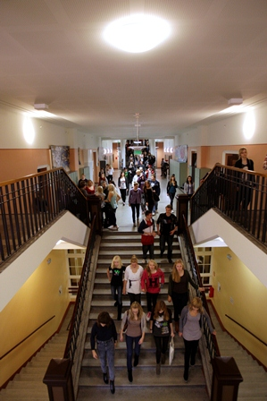
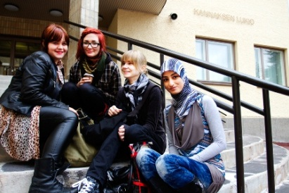





Thank you!

