Slide 1
Welcome to Finland!
Marja-Liisa Saarilammi, FINEEC

Slide 2
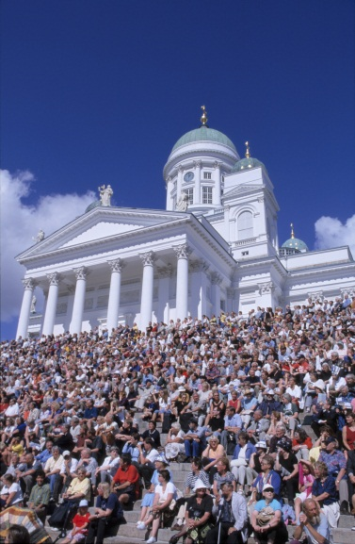
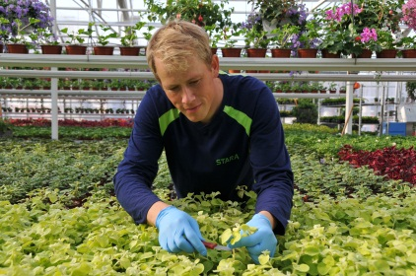
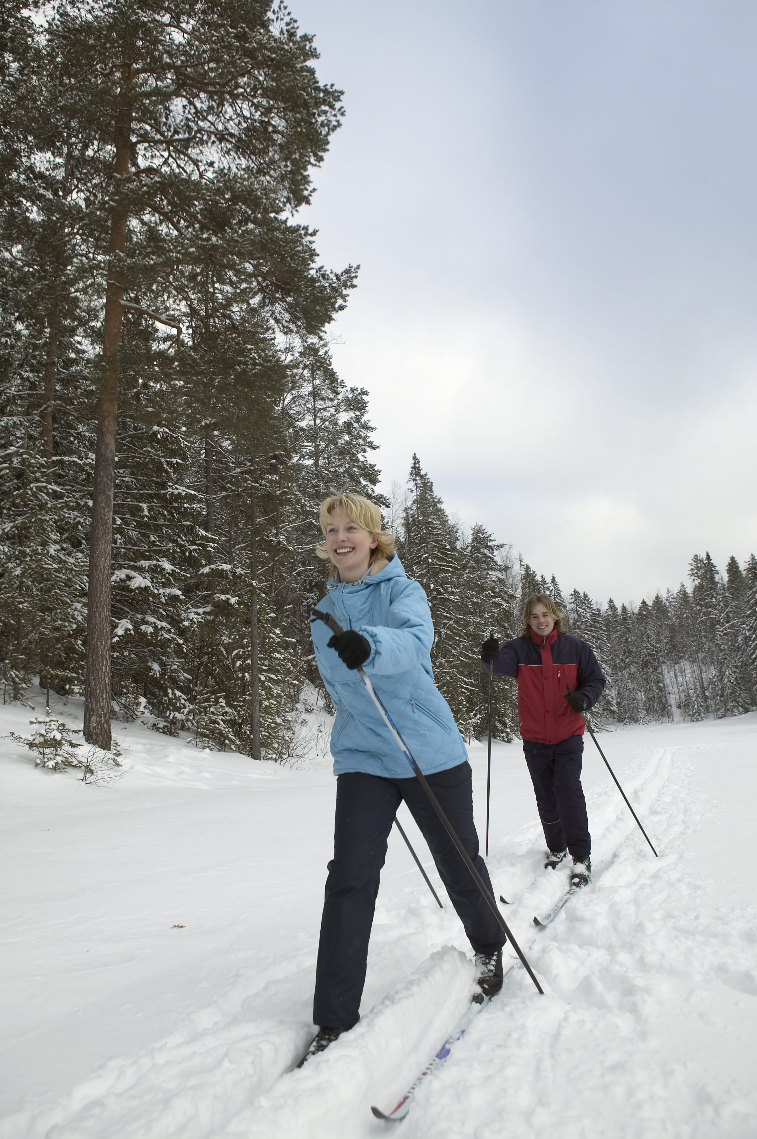

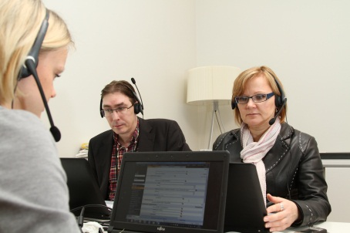
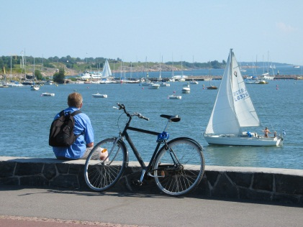
Finland in brief
    population 5.4 million (18 inhabitants / sq. km)
    two official languages: Finnish and Swedish
    foreigners: 4.8 % of the population
    education level of the working age population:
      13 % basic education
      45 % upper secondary education
      42 % tertiary education
Statistics Finland 2015, Education at a Glance 2015,
City of Helsinki media bank
Notes:
fifth biggest country in Europe by land area
Population density Helsinki xxxx Enontekiö 0,25 persons/km2
Economic structure, employed persons, 1st q 2011
Xxxxxx persons have Sámi as their mother tongue (xxxxxofficial language
Romany & sign-language xxxxxxx
ISOIMMAT ELINKEINOT
Miscellaneous sevices, 35%
Trade and hotel 15%
Manufactoring, 14%
Financial and business services, 13%
Transport and communication, 10%
Construction and energy, 8%
Agriculture and forestry, 5%
Manufacturing
Metal and engineering products, 48%
Other manufactured items, 22%
Forest products, 16%
Food and textile goods, 14%
Kaitaisen hallitusohjelmassa
Suomen kaksikielisyys on rikkaus ja voimavara
Eri uskonnot ja yhteisöt ovat arvokkaita moraalisen kasvun kannalta
Hallitus toimii määrätietoisesti rasismia ja syrjintää vastaan
Viittomakielisten oikeuksien toteutuminen ja mahd. viittomakielilaki
Saamen kielen elvytystoimet, pysyvä toimintamallia
Suomen peruskouluissa evankelis-luterilaisen uskonnon opetukseen osallistui vuonna 2009 noin 500 000 oppilasta eli 93 % peruskoululaisista. Elämänkatsomustiedon oli valinnut 16 000 eli 3 % oppilaista. Ortodoksista uskonnonopetusta sai 7 000 oppilasta (1,3 %), muiden uskontojen opetusta 9 000 eli 1,7 % oppilaista. Muslimiperheiden lapsia on tällä hetkellä arviolta 1,3 % peruskoululaisista.
3-4 % , over 200 000 migrants
Biggest nationality groups: Russians, Estonians, Swedes and Somalis
About 25 000 migrant pupils/students in general education
Municipalities (342) are responsible of providing pre-school and basic education, also to migrant pupils; In 71 municipalities 12 000 students and 52 languages. Additional funding available for teaching of mother languages.

Slide 3
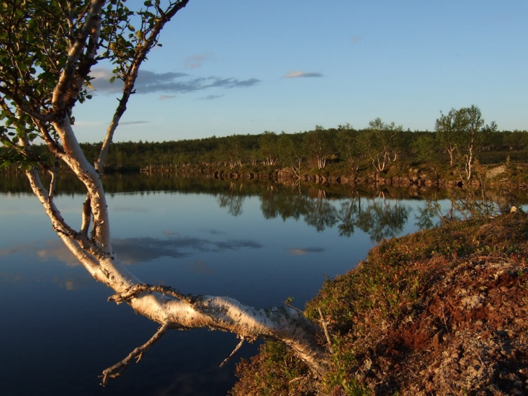
What makes us special?
Midnight Sun
Finnish sauna
Clean lakes
Wild nature
Ski resorts & routes
Finnish design
Real Santa Claus
Cultural issues
– low hierarchy,
straightness, strict timetables
picture: Matti Kajaste

Slide 4
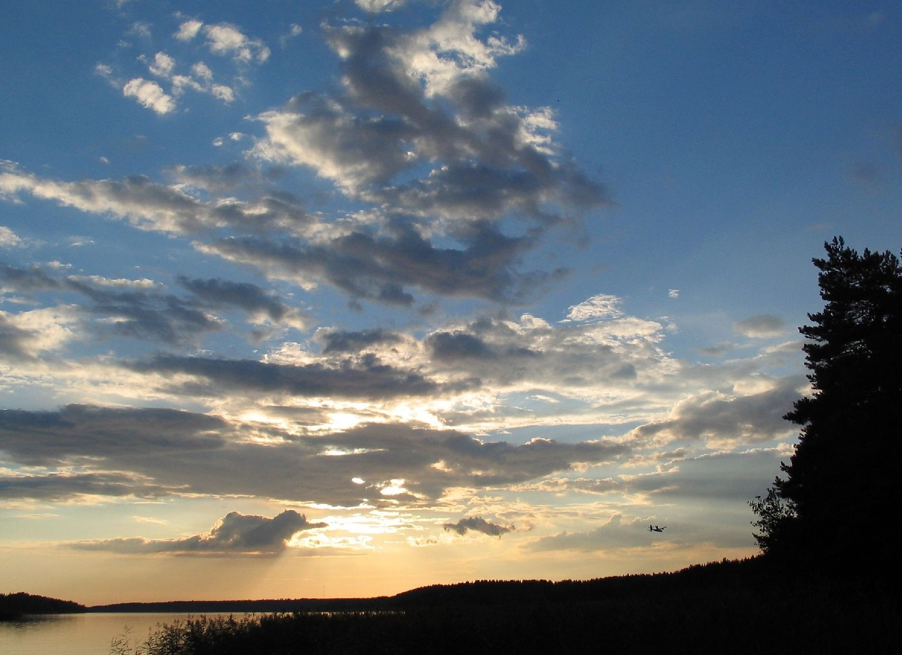
The sky is blue and white and full of stars.
So is my young heart full of thoughts.
I will not tell anyone about my heartaches.
Only the dark forest and bright sky hear my sorrows.

Slide 5
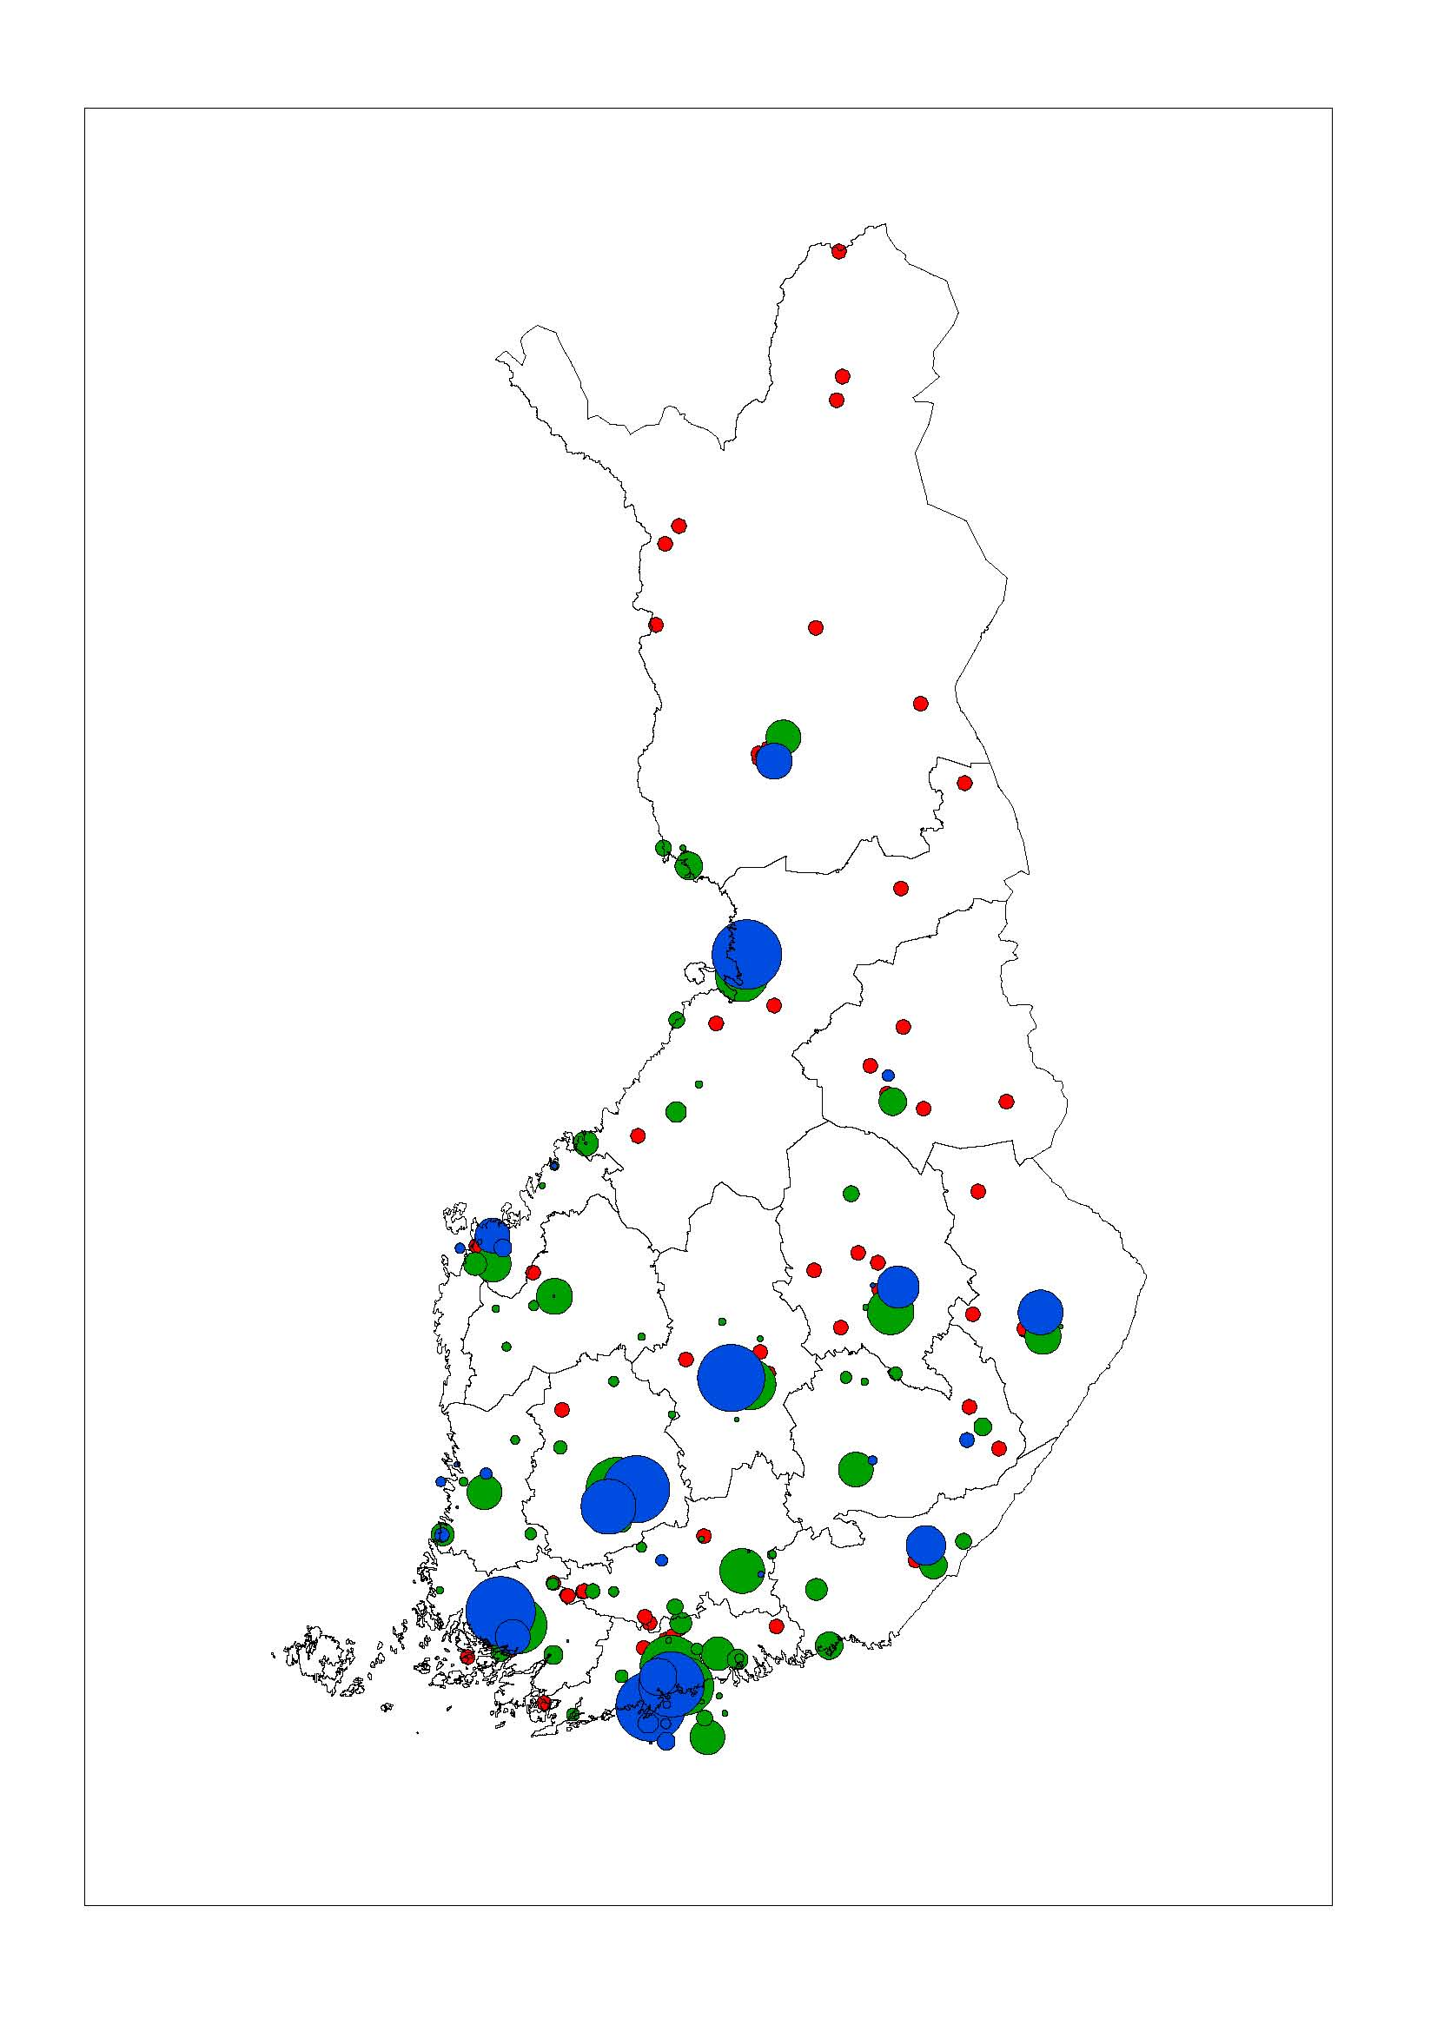
Higher education facts about Finland
University (blue)
UAS (green)
Research institute (red)
14 universities
  Student enrollment 174 000, of which 18 000 doctoral students
  All institutions legislated by the state; state funding 64%
  Bachelor’s, Master’s and Doctor’s degrees
24 universities of applied sciences (UAS)
  Student enrollment 130 000
  Core funding from the state + external funding;
  all legislated by the state
  Regional development tasks
  Bachelor degrees (vocational and professional degrees)
  (Professional) Master’s degrees in selected fields
Entrance examinations
Tuition free system
  charging tuition fees to citizens of non-EU/EEA countries

Slide 6
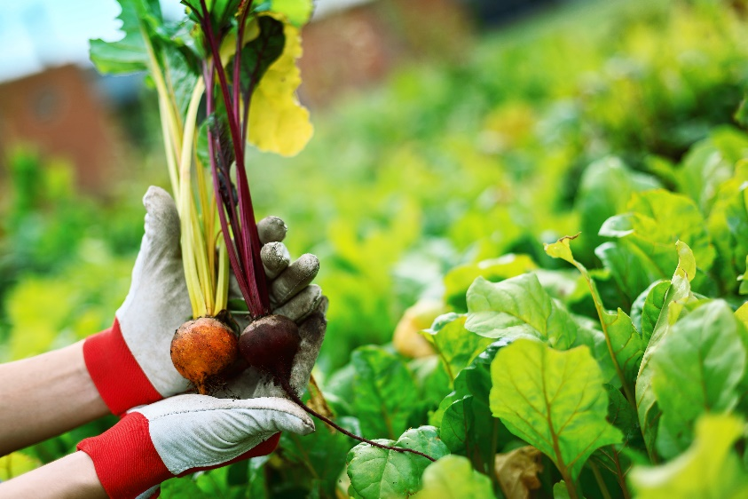
The Finnish HEIs enjoy extensive autonomy
HEIs are built on the freedom of education and research
The HEIs organise their own administration and design the contents of degree programmes
FINEEC’s role in evaluations / enhancement-led approach

Slide 7

University of Helsinki
Main tasks: research, teaching and societal interaction
The biggest university in Finland: 35 000 degree students
8 200 employees, including 4 500 researchers and teachers
Current topic: By year 2017 cuts of 980 employees

Slide 8
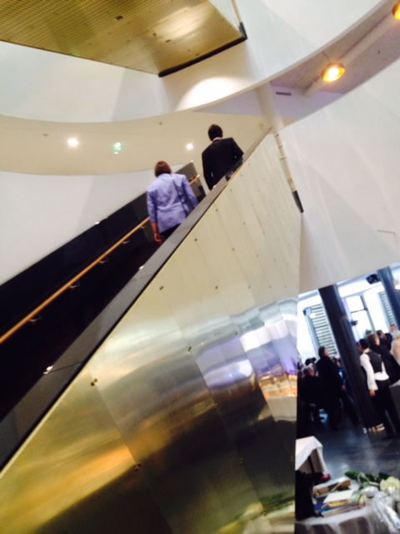
DIAK - Diaconia
University of Applied Sciences
Special national duty
Diak educates professionals and experts for the church and society.
The value-based university
Love one’s neighbour, social justice, open interaction and effective work of high quality.
Strategic intention
A world where no one is left alone
Notes:
Diak is in charge of more than 90% of UAS education leading to qualification for posts of church social work and youth work in the Evangelical Lutheran Church of Finland.
Diak works actively to promote social cohesion, public health and the foundations of education. Sustainable wellbeing in communities and service systems in all of Finland and Europe as well as globally.

Slide 9

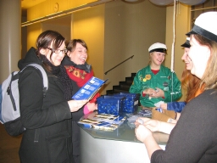
Student unions
SYL and SAMOK
The organisation is led by students and works to promote students’ interests
Official representative of right of students
Task: to improve educational,
financial and
social benefits
Student unions have a
strong role in
the Finnish society.

