Slide 1

Institutional development and evaluation
09. June 2016

Slide 2
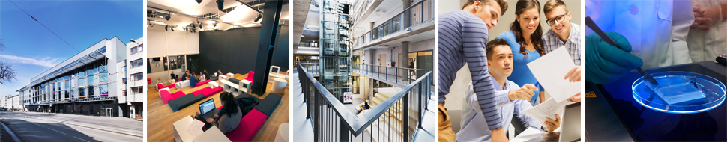
Topics:
Tallinn University in numbers
Internal quality assurance system
Impact of external QA system
TU Development Plan 2015 – 2020

Slide 3
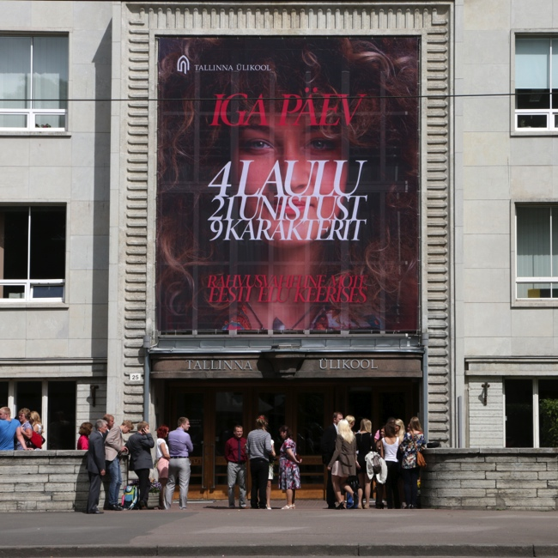
University in numbers
Number of employees (full-time) | 923
incl. academic staff | 453
percentage of foreign lecturers and researchers | 9.4%
Number of students | 9,485
incl. professional higher education studies | 692
incl. bachelor studies | 5,648
incl. master studies | 2,767
incl. doctoral studies | 378
percentage of foreign degree students | 5.5%
Number of students who participated in continuing education | 14476
* December 2015

Slide 4
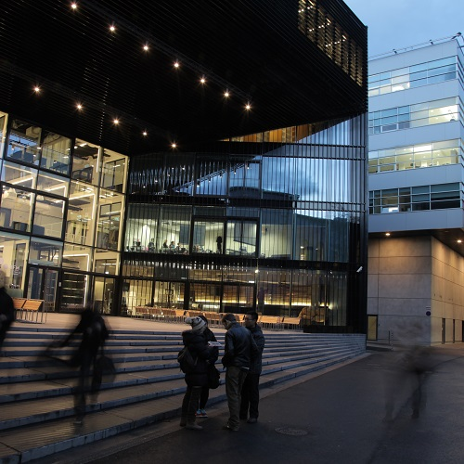
University in numbers
Number of study programmes | 136
incl. bachelor and prof HE studies | 55
incl. master studies | 67
incl. doctoral studies | 14
Finances
Operating revenue (million euros) | 33,4

Slide 5
Quality as a core value
„QUALITY is a parameter that characterizes all university activities. In TU, quality is treated as an agreement based on international standards of different fields and ideals. The university members involved in a field agree on the quality of different university fields of activity and its indicators, the ways of achieving it, and the methods of assessment by including the involved parties and considering the trends in the European higher education and research area.
All members of the university are responsible for the quality of their activity and its development.“
TU Academic Charter

Slide 6
TU quality system
QUALITY – Core value
Strategic planning and self-evaluation
Institutsional accreditation
Quality assessment of study programme groups
Stakeholders´ satisfaction
Feedback surveys
Recognition of excellence
Internal audits
Quality agreements by universities
Targeted evaluation of research

Slide 7
Internal quality assurance system

Slide 8
Strategic planning and self-evaluation
TU Development Plan
Development Plans of academic units
Strategies for sub-areas
Annual action plans for university and units
Annual report of the university
Action reports of units

Slide 9
Everything starts from goals
What you measure is what you get
You are what you measure
You get what you measure

Slide 10


Slide 11
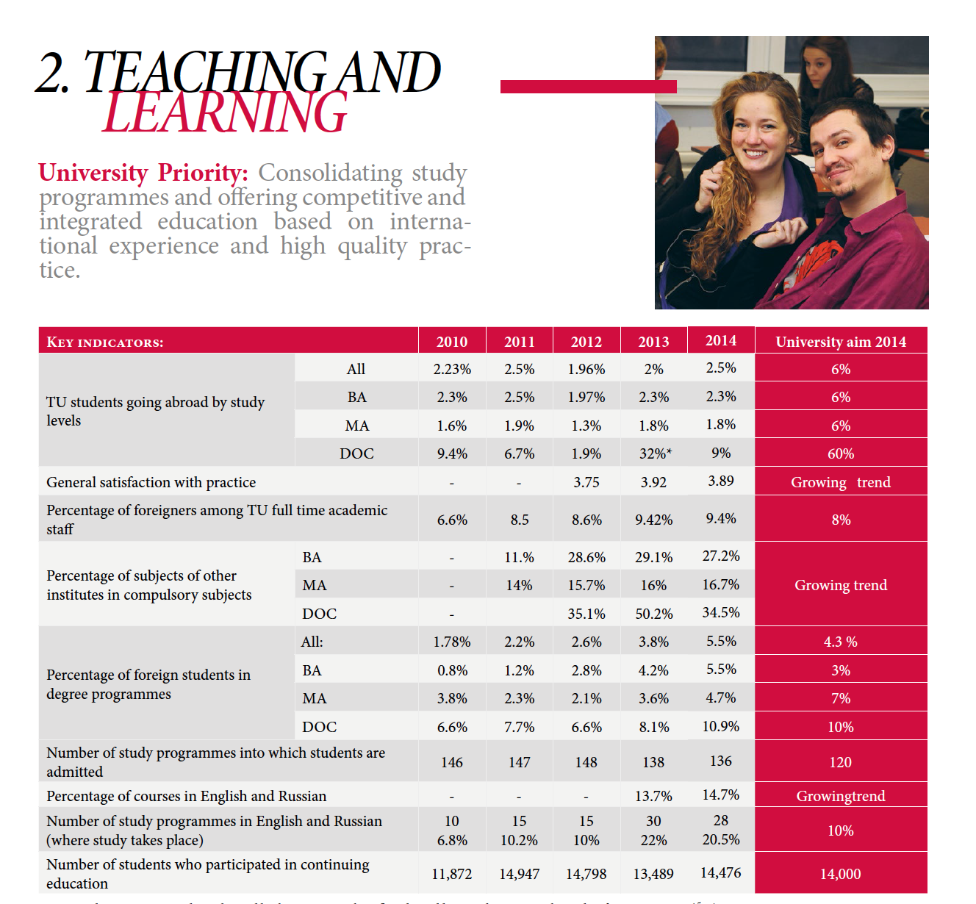

Slide 12
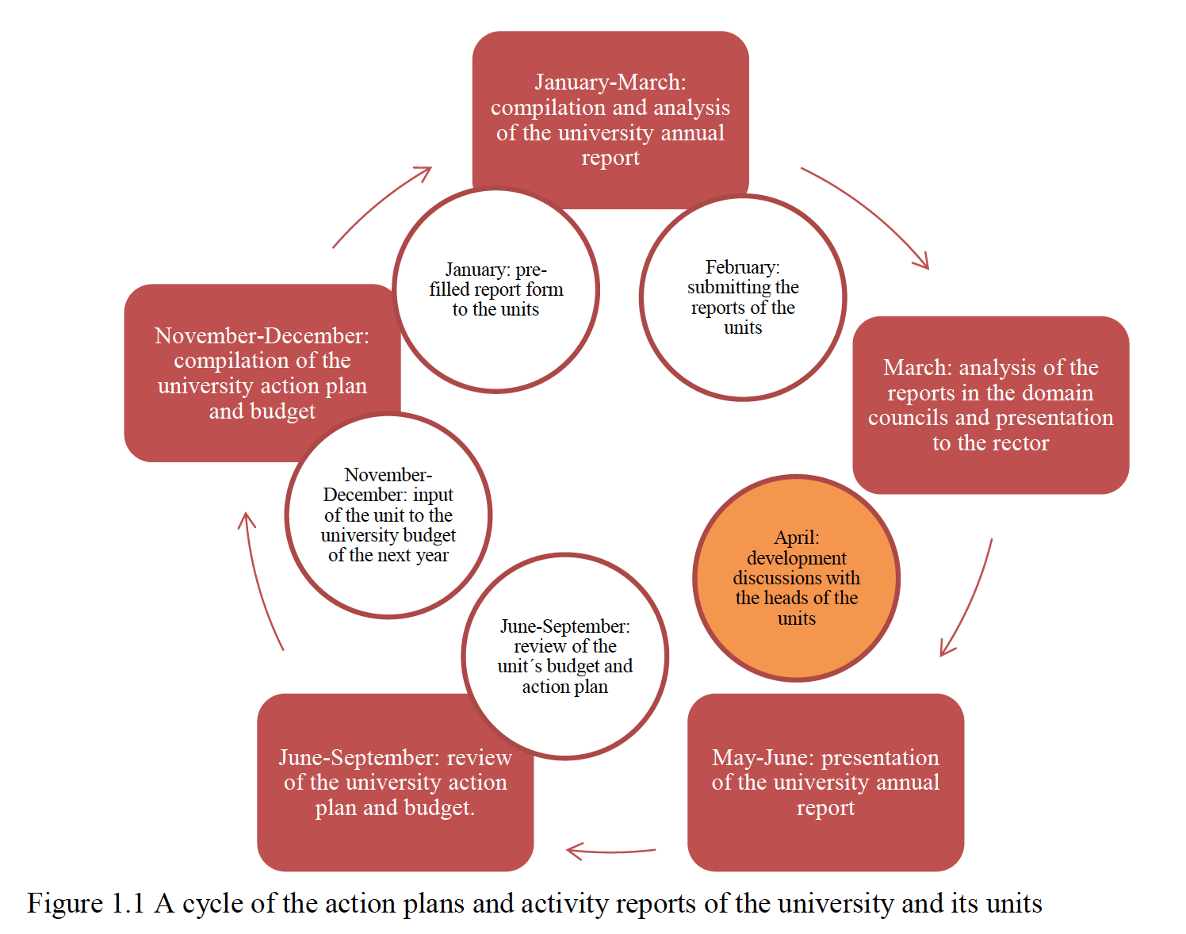

Slide 13
Satisfaction of stakeholders
University level
Unit/study programme level
TU employees satisfaction survey
TU students survey about satisfaction with the study process
TU graduates survey about satisfaction with the study programme and studies in general
Alumni survey about the career, competences, cooperation
Teaching staff feedback to the study programme
Practise supervisors feedback to the practise
Employers feedback to the graduates and study programmes

Slide 14
Recognition of excellence
TU values and recognizes all components of academic work
  Best publications (peer-review)
  The Enterpreneurial Research Fellow/Unit (results)
  The most valued member of the teaching staff (students feedback)
  The most valued in-service trainer

Slide 15
Thematic audits and risk management
Internationalisation
Partnership
Following the budgeting rules
Project management
Etc…

Slide 16
Impact of external QA system
Impact of external QA system

Slide 17
Institutional self-evaluation
The recommendations from assessment panel
Development Plan 2015 -2020

Slide 18
The structure of self-assessment
Requirement:TU documents
What are the goals?
How is it regulated?
Description of the process
Strengths and development areas
Does the process meet the requirements?
Results
Does the process make the goals achievable?
What results prove achieving the goals and meeting the requirements?
What are the strengths according to the conclusions?
What are the development areas according to the conclusions?
What conclusions has the university done?

Slide 19
IA assessment panel commendations
Recognition of the need to restructure in order to develop cohesion, interdisciplinarity, rationalisation of support staff
Well-qualified and highly competent support staff in key positions
Internationalisation, including language skills. Throughout the course of the visit the team rarely had need for the interpreter; such was the high quality of the staff and students with whom we met.
Staff development procedures currently funded by the Primus project. There is careful and evident planning of staff development available across the institution.
….

Slide 20
IA assessment panel recommendations
Focus on the future structure of the University in order to develop a coherent framework and interdisciplinarity
Develop systems across the university that will ensure a quality provision that is universal and consistency of practice and systems
Develop a comprehensive alumni network by the creation of dedicated web space and by the creation of a complete database.
Assess the nature of risk in the University and develop contingency plans in accordance with the risk register’
Seek ways to develop a true postgraduate culture
Increase the efforts to develop a long-term research profile

Slide 21
TU Development Plan 2015 -2020

Slide 22
TU starting point for strategic planning (1)
Institutional accredition (2012 – 2014)
Self-evaluation
Analysis of operational environment (2012 – 2014)
Analysis of national and international strategies
Discussions with partners and members (2014)
The recommendations from assessment panel
Changes in the of higher education and science (eg financing)
Analysis of the TU Development Plan 2010 – 2014 results

Slide 23
TU starting point for strategic planning (2)
Key challenges:
  The need for more focused profile and clear specialization
  The deepening internationalization
  The growing potential in interdisciplinary studies and research
  The continuous quality enhancement and sustainable development

Slide 24

TALLINN UNIVERSITY 2020

Slide 25



TALLINN UNIVERSITY IS IN ITS ACTIVITY:
INTER-
DISCIPLINARY
INTER-
NATIONAL
DEMANDING,
SUSTAINABLE

Slide 26
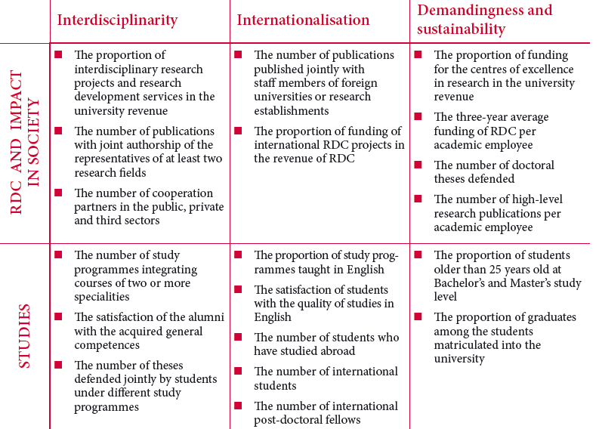
Key indicators

Slide 27
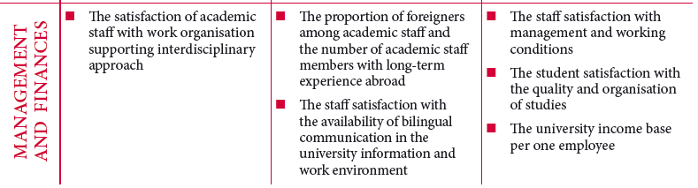
Key indicators

Slide 28
Welcome!
Narva Rd 25, 10120 Tallinn
ESTONIA www.tlu.ee/en

