Slide 1
Quality audit as an effective tool in establishing quality management at the university of helsinki
Aimo virtanen and nina aremo

Slide 2
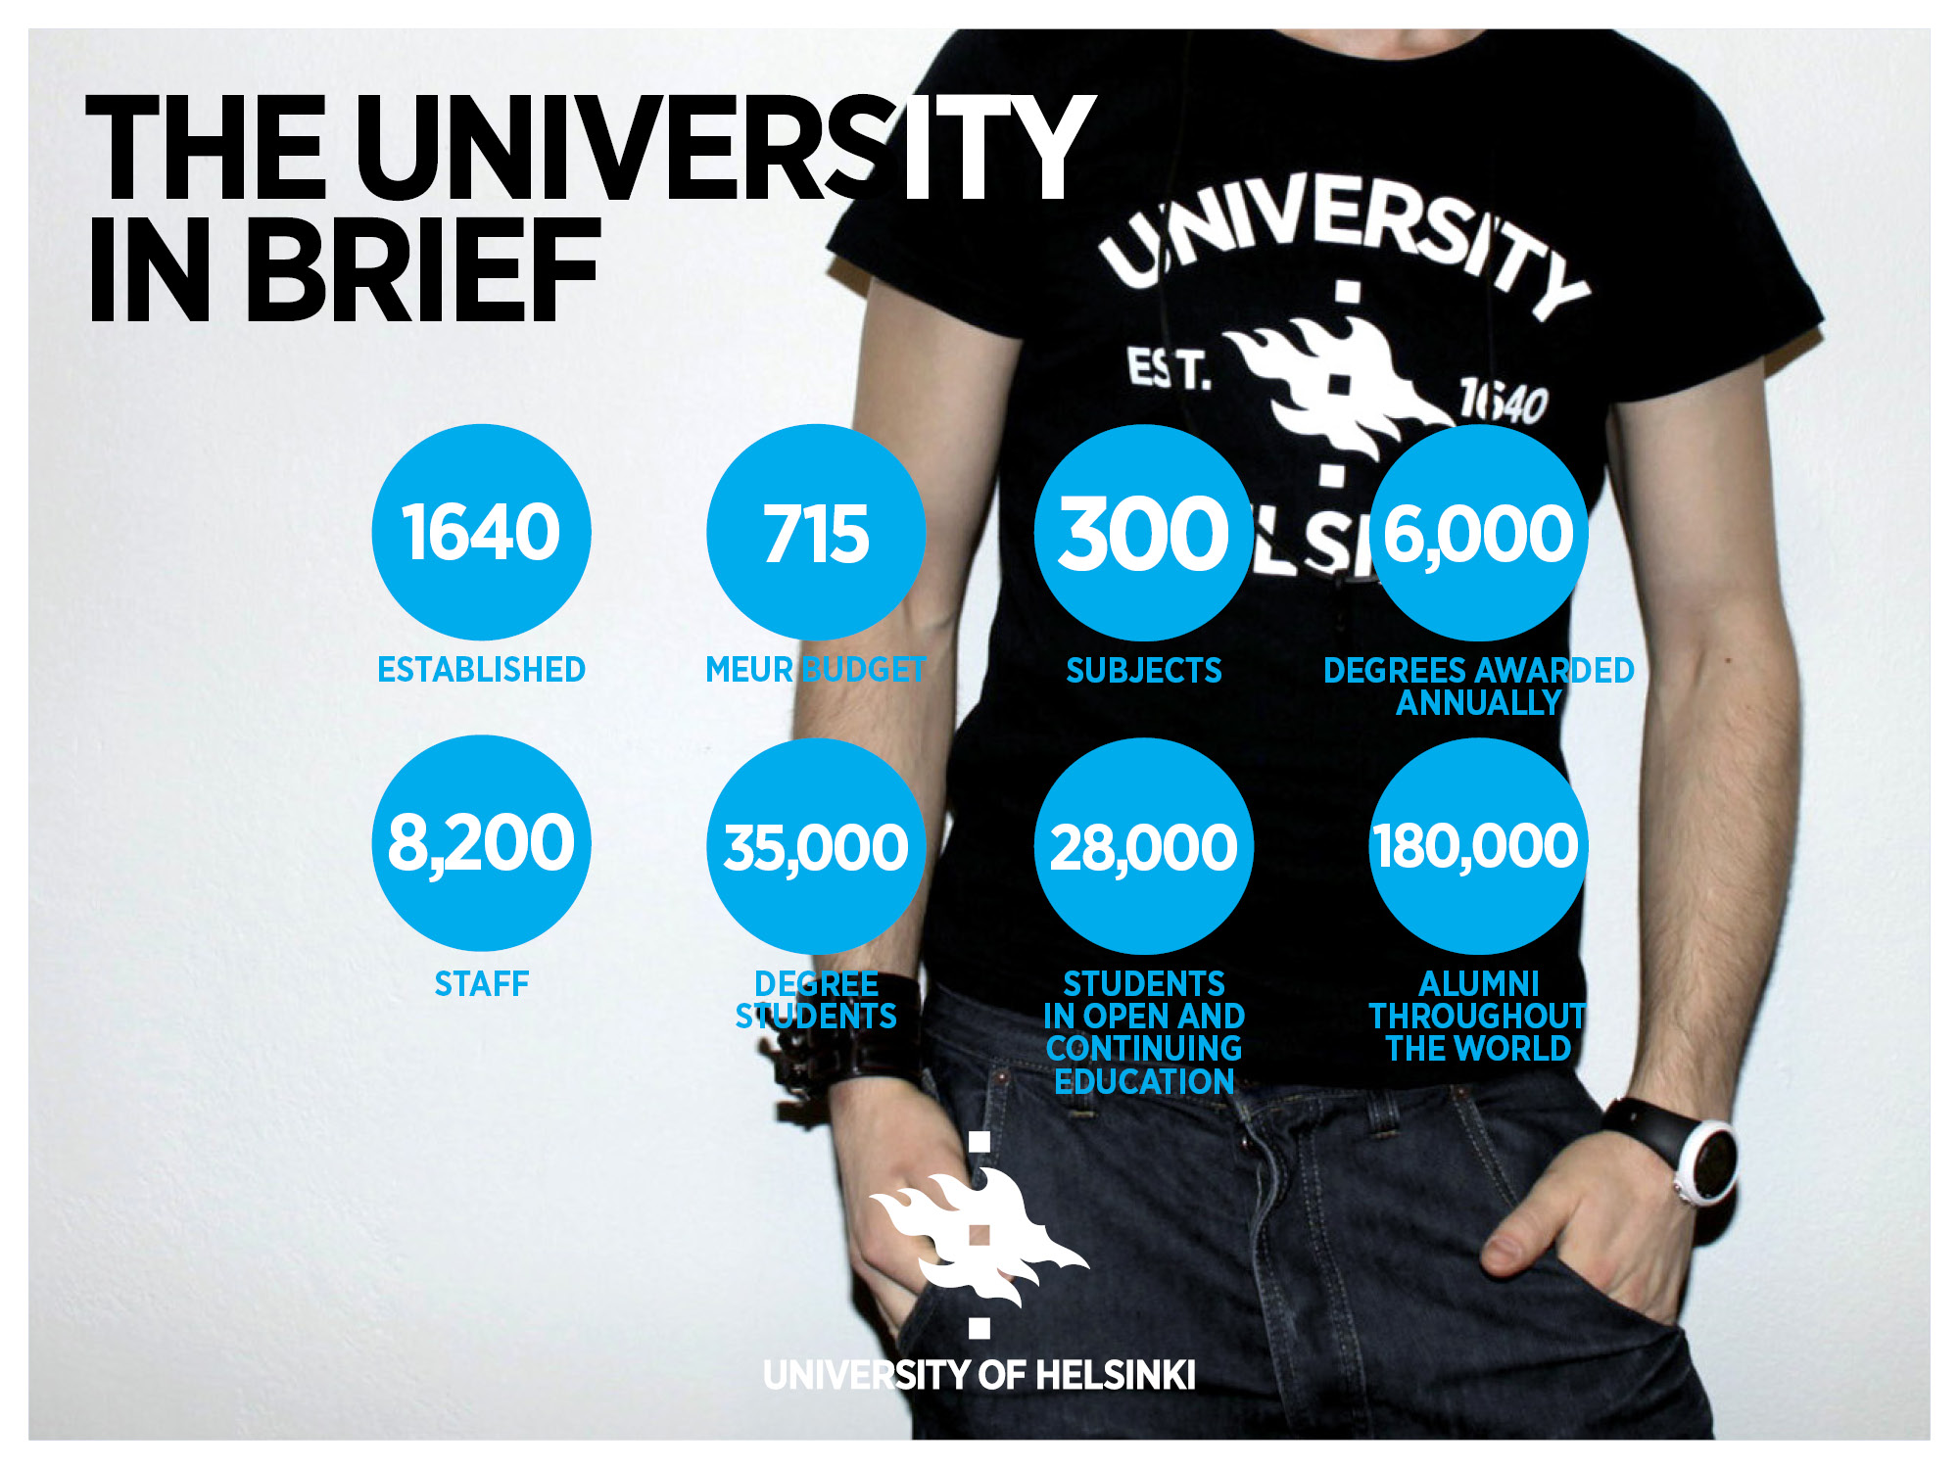
Short bios
Aimo Virtanen, Quality Manager, Central Administration
1998–2004 Planning Officer, evaluations and quality assurance
1998–1999 International benchmarking of administration (University of Helsinki, Universities of Amsterdam, Stockholm and Oulu)
2000 International library assessment of the UH
2004 International follow-up of libraries and information services, UH
2004– Quality Manager
2004–2005 Evaluation of administration, UH
2006–2008 and 2013–2015 Primary responsibility (together with Helena Immonen) for the Quality Assurance Audit by the Finnish Higher Education Evaluation Council (FINHEEC) and the Finnish Education Evaluation Centre (FINEEC), UH
Nina Aremo, Quality Specialist, Central Administration Phil. Lic. 2009 in Organic Chemistry, University of Helsinki
Quality Specialist at the University of Helsinki 2015–
Quality Coordinator at the Faculty of Science 2006–2015
Project Manager of the Project: Quality Management in Laboratories
Member of the Quality Management Steering Group (LAAVA) of the University of Helsinki, 2007–

Slide 3
Quality management at the University of helsinki

Slide 4


Slide 5
Quality Assurance Organisation at the UH
THE BOARD
Rector
1st Vice-Rector
Quality Assurance Steering Group
Experts in operational sectors
Quality Manager
Quality
Specialist
Contact persons
in the faculties
and independent
institutes

Slide 6
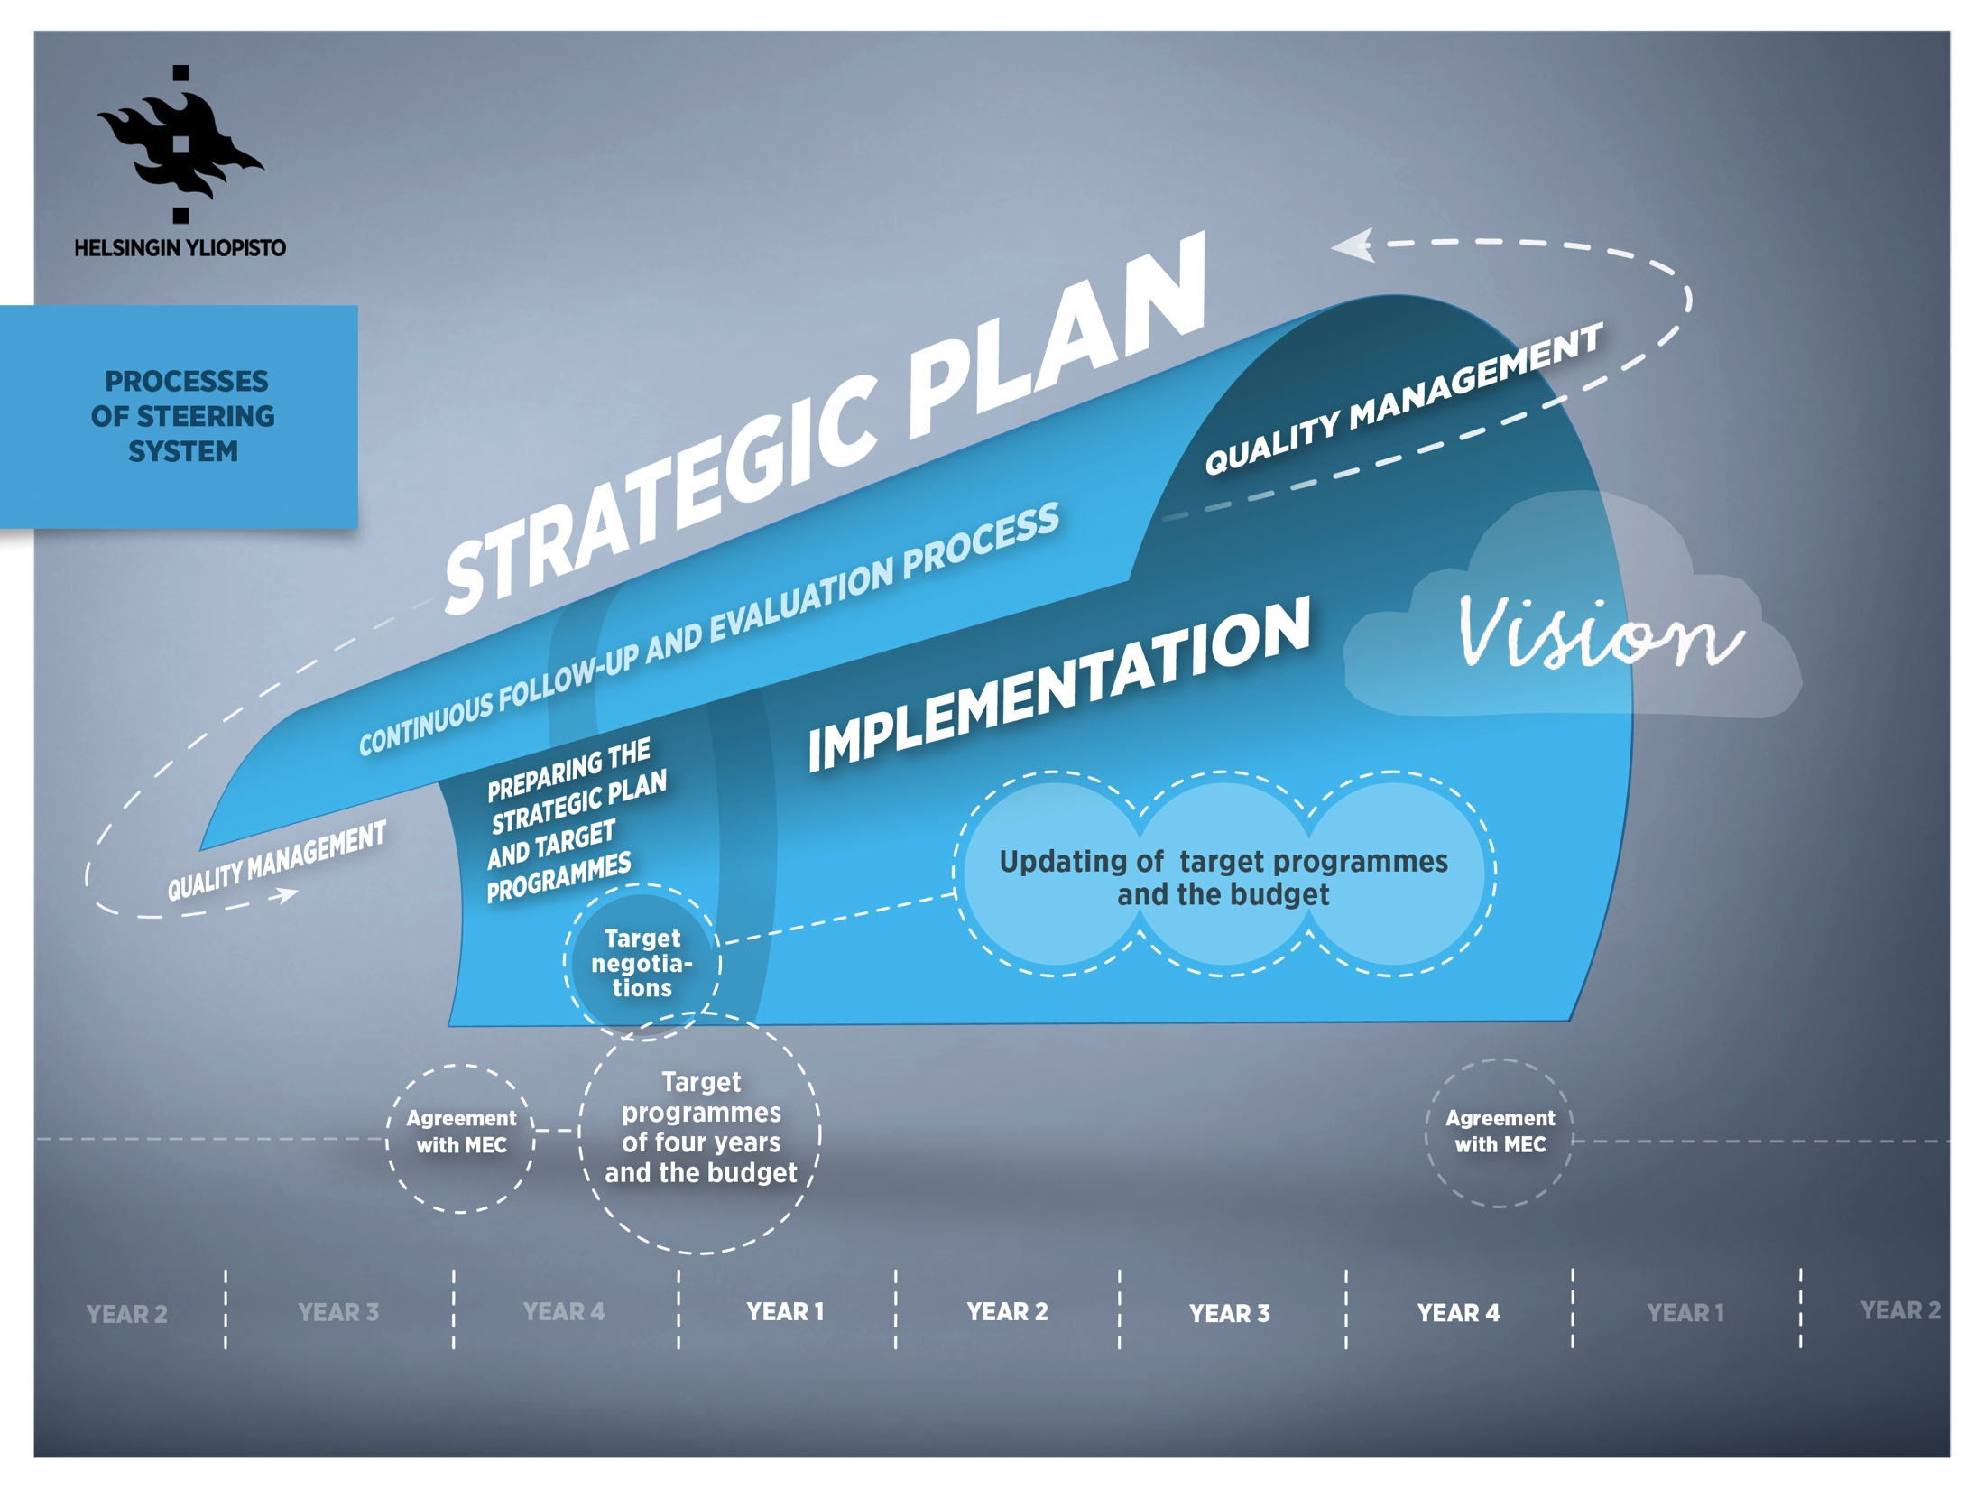

Slide 7
The audit process

Slide 8
fineec audit
Enhancement-led
Cover all university functions not only education
HEI recognizes the strengths, good practices and areas for need of development

Slide 9

University of Helsinki audit process
Audit agreement
15 January 2014
Audit team appointed
25 March 2014
Audit material by
the University of Helsinki
20 June
2014
Preparations for the site visit
– 5 October 2014
Site visit
6–9 October 2014
FINEEC’s/ Higher Education Board’s decision on the result
&
Publication of the report
February 2015
Concluding seminar at the University of Helsinki
March 2015
Information and discussion event
10 September 2014

Slide 10
Preparation for audit
Updating Operations Manuals and constructing them as a consistent network and a part of Flamma-intranet
Visits to faculties, to departments, to independent institutes and to sectors of central administration (Vice rector, acting as a chair of Quality management steering group, Quality Manager and Quality Expert)
Introductory events to prepare members of academic community to the audit process
Quality training courses, tailored for different groups of staff and students

Slide 11
Audit material
An international audit team (6 + 2 FINEEC’s project managers) received:
Basic material
  Organisation chart
  Overall strategy
  A diagram and concise description of the quality system
  The HEI’s institution-level quality manual
  Information about the chosen degree programmes
Self-evaluation report (50-70 pages)

Slide 12
Purpose of the site visit
  To get an overall picture of the University of Helsinki and how the quality of education, research and societal interaction is maintained and developed.
  To verify and supplement the observations made based on the Helsinki University audit material.
  An interactive event that supports the development of the operations of the University of Helsinki.

Slide 13
Question marks
How to introduce the audit team the nature of our University’s quality system?
Some members of the international team were not very convinced of our honest desire to combine the processes of steering and quality management; their intention was to have more or less independent or separate systems
It is not very easy to assure the team of a quality system concerning totally new or activities under construction (an example was doctoral education at the faculty of arts)

Slide 14
Self-evaluation process

Slide 15
Practical implementation at UH
Self-evaluation report
0.1
Central Administration Section
Workshops 8 in different focus,
15-25 participant/workshop
Total 150 participants
Self-evaluation report
0.2
Quality Experts
Samples of Degree Programmes
Units,
Academic Affairs Council,
QASG
Evaluation and feedback
University Leadership,
Unit’s quality coordinators
Open commentation on intranet
Students and Staff
Self-evaluation report
Final version

Slide 16
Challenges in self-evaluation (1)
Focus on evaluation not on description (separated sections in each chapters).
How to be honest but not too critical?
To notice shortcomings in procedures.
To give a signal of improvements in activities.
If defects are not noticed, they cannot be corrected.
Reliability is the most important principle and a challenge on both sides, on the audit teem’s and on the HEI’s.

Slide 17
Challenges in self-evaluation (2)
The mastery of quality concepts, such as quality policy, quality culture, quality management, quality assurance, quality work.
The professional quality concepts are necessary to be able to speak exactly with colleagues, e.g. at this Forum; but is it necessary to learn each of those for anyone working at a HEI ?
At the UH quality management is tightly integrated in the management or steering system and is a part of our normal daily work.
On the other hand, a recommendation given by the audit panel was that the UH should make a quality system more visible and develop an overall ”blueprint” for the architecture of it.

Slide 18
Benefits of the self-evaluation for UH (1)
Everybody at the University has had the possibility to participate to the self-evaluation process.
The self-evaluation report has been distributed and widely read throughout the University.
The report is used as a tool for further development.
The best practices will be employed throughout the University.
The quality culture has been renewed clearly, and the commitment to promote it has increased.

Slide 19
Benefits of the self-evaluation (2)
The self-evaluation is a splendid tool for
  analysing operations
  opening up processes and
  finding out blind spots
Differences in processes between units emerged clearly
The self-evaluation process forces us to work together
  to find out the language to discuss about basic quality concepts and
  to search for better ways to operate

Slide 20
Benefits of the self-evaluation (3)
The self-evaluation helps the management, staff and students
  to understand and learn the best practices, adapted from a modell applied in other units
  to notice that different practices between different units are not always necessities to strengthen their identities

Slide 21
Benefits of the self-evaluation to the audit team
Opens a basic analysis of the QA system of a HEI.
The audit team can compare the information received in written form with that acquired through interviews.

Slide 22
the finnish audit model
Strengths
Comprehensive
    Enhancement-led
Well-managed by FINEEC
Cooperative
Includes a remarkable involving of members at the University community in the process
Challenges
To combine both evaluation of processes and results together
To convince especially the academic staff on aiming development of core activities
To manage the language issues – a question of special ’Quality language’

Slide 23
The self-evaluation included in the audit
    Motivating
    Knowledge intensive
    An excellent possibility to open activities
    An opportunity to find out good practices and to adapt them

Slide 24
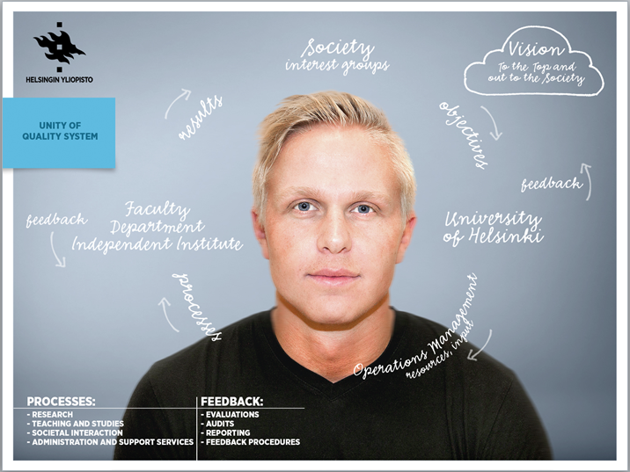
THANK YOU –TACK - KIITOS!

