Slide 1


Main Outcomes of the Twinning Project
AZ-ad-EHEA
Baku 20 June 2017
Helka Kekäläinen, PhD
Heli Mattisen, PhD
Project Leaders

Slide 2
Aims of the Twinning Project
Enhancement of Azerbaijan´s higher education system through its integration with the European Higher Education Area (EHEA).
The establishment of EHEA compliant quality assurance system that will facilitate mobility within the EHEA, support the recognition of qualifications and increase employability of graduates.
To assist the development of Bologna related policies and the implementation of the EHEA objectives and reference tools by Ministry of Education and other key institutions of the Republic of Azerbaijan.

Slide 3
Co-operation for Sustainable Results
Key figures –
112 trainings/workshops/interviews
- 560 local participants (persons)
- Over 100 active participants 100+ (over 5 participations)
33 European short term experts involved
- 120 missions, 500 expert mission days 500
Study visit to Helsinki and Tallinn, 7 Az experts
Study visit to Brussels, 5 Az experts
Two internships to EKKA and FINEEC, 2Az experts

Slide 4
Translations:
47 legal documents have been translated from Azerbaijani into English
46 documents have been translated from English to Azerbaijani
All translations are available in the project web-site:
www.ehe.edu.az

Slide 5
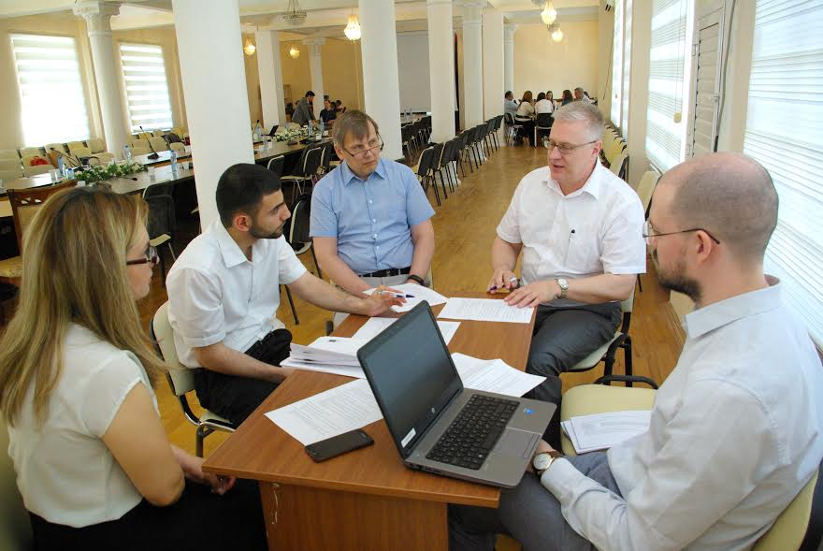
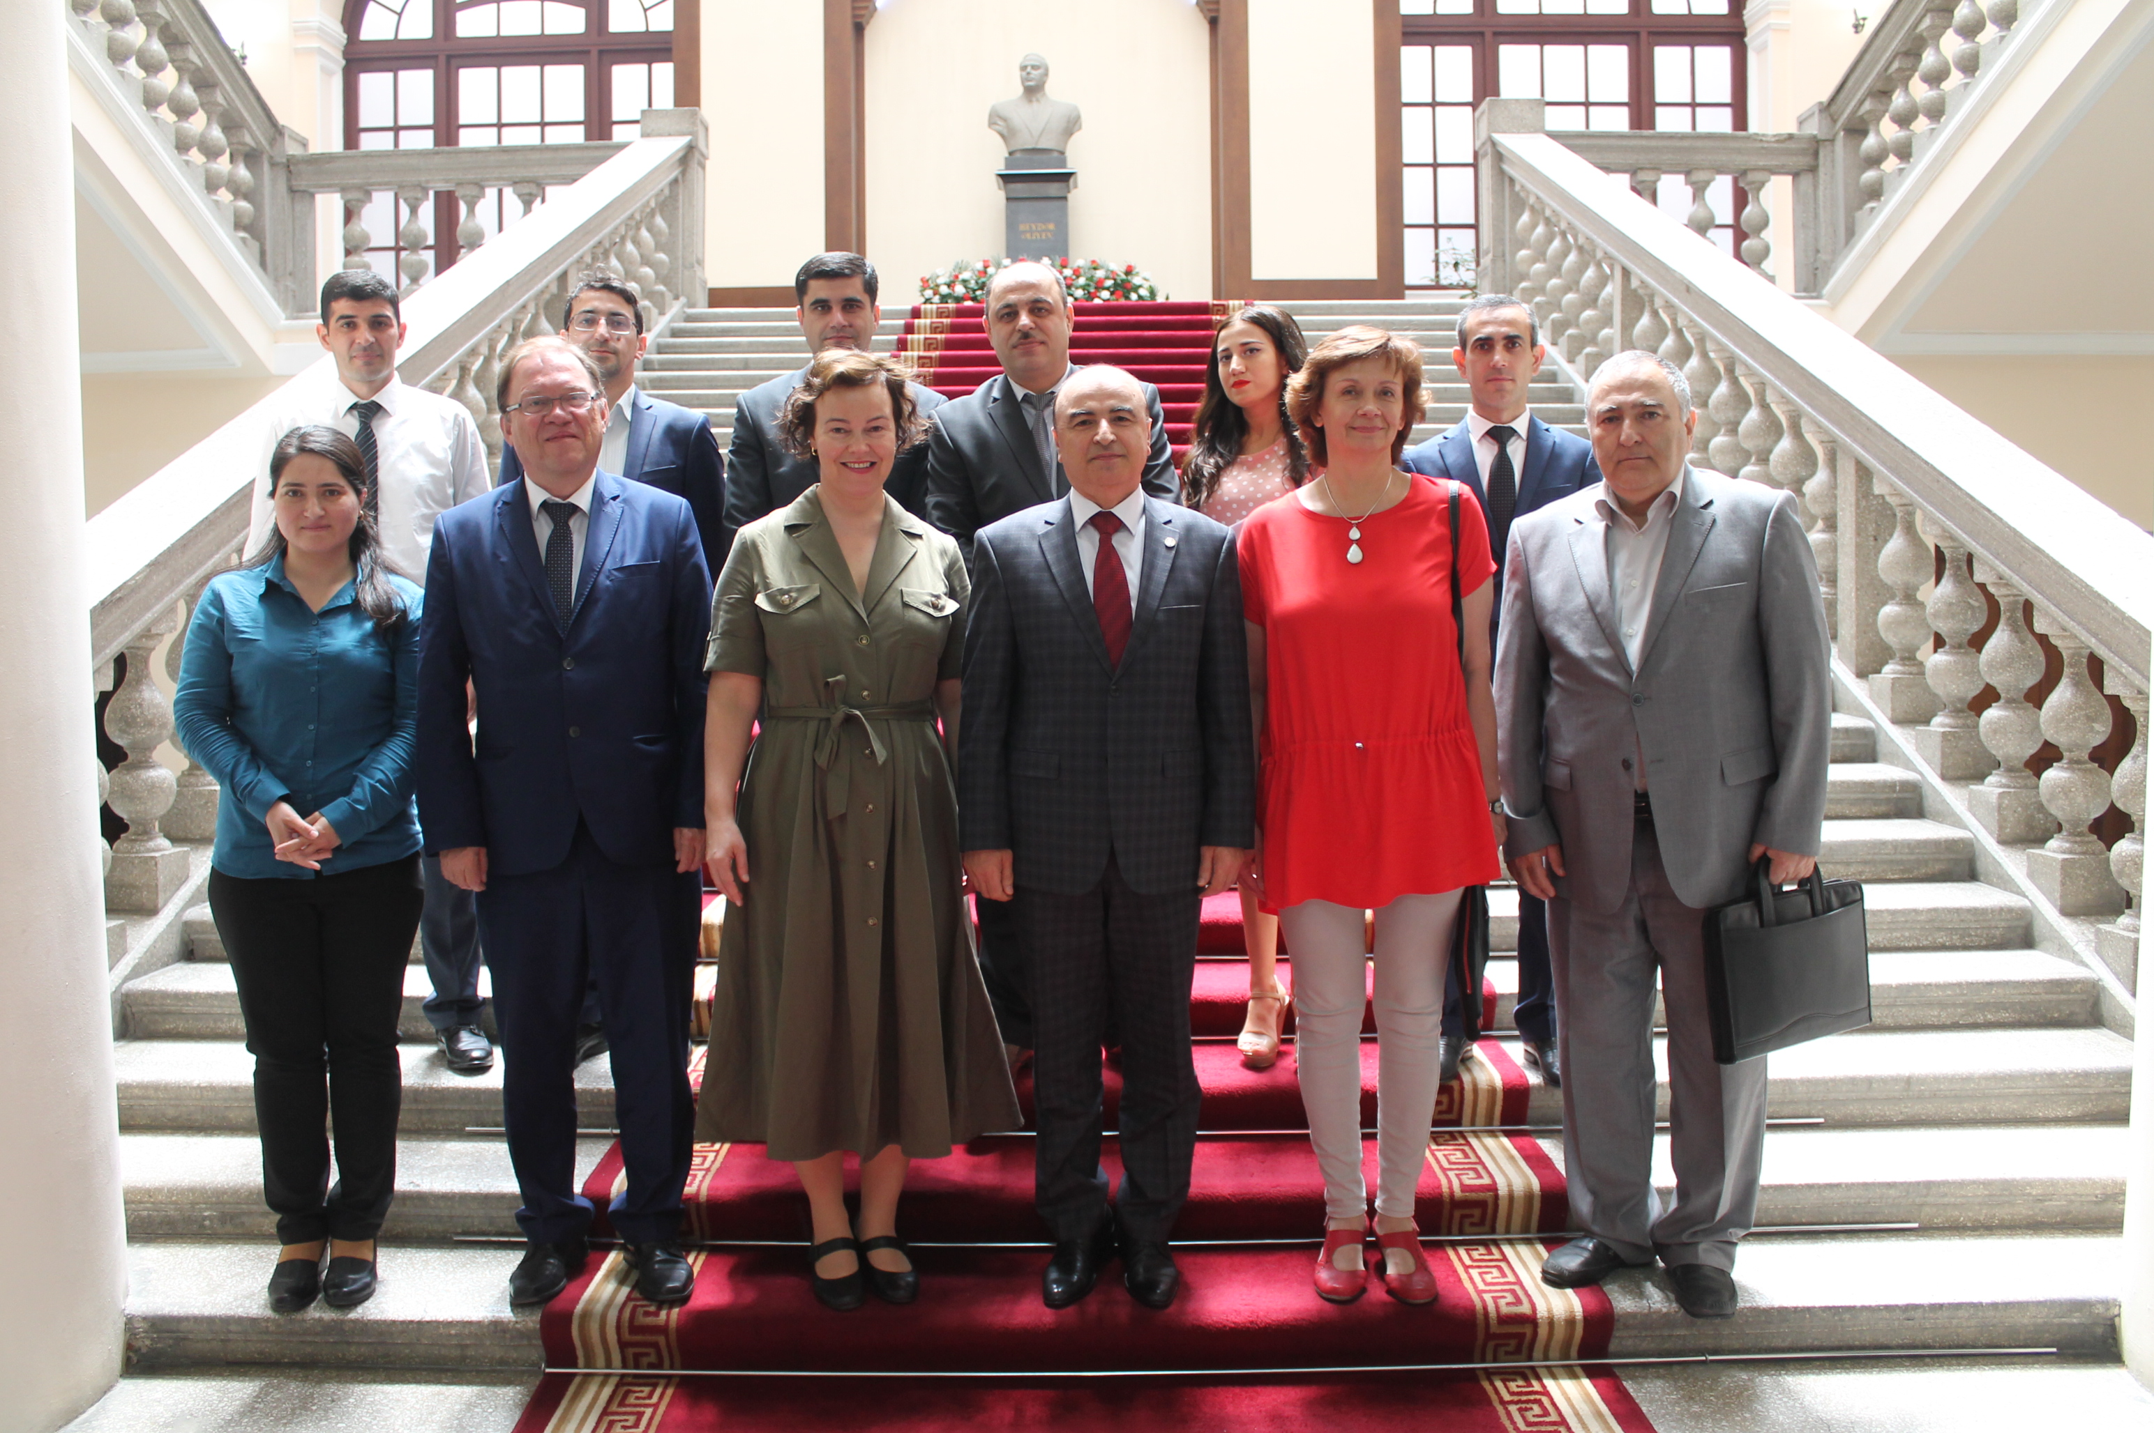
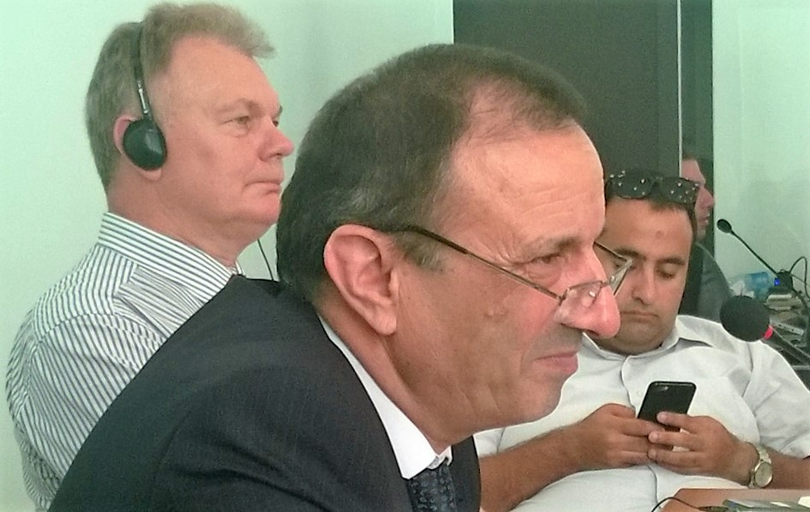
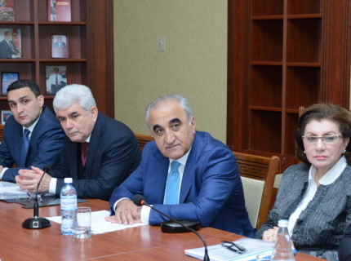
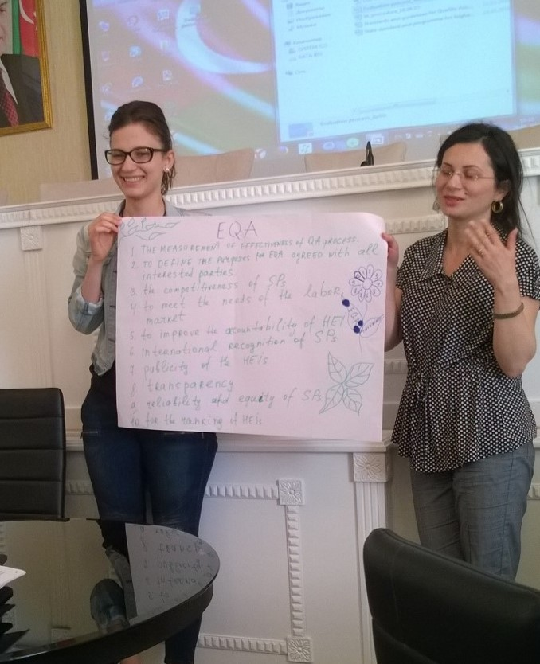
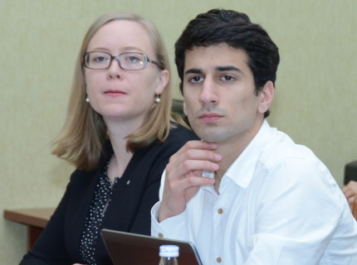
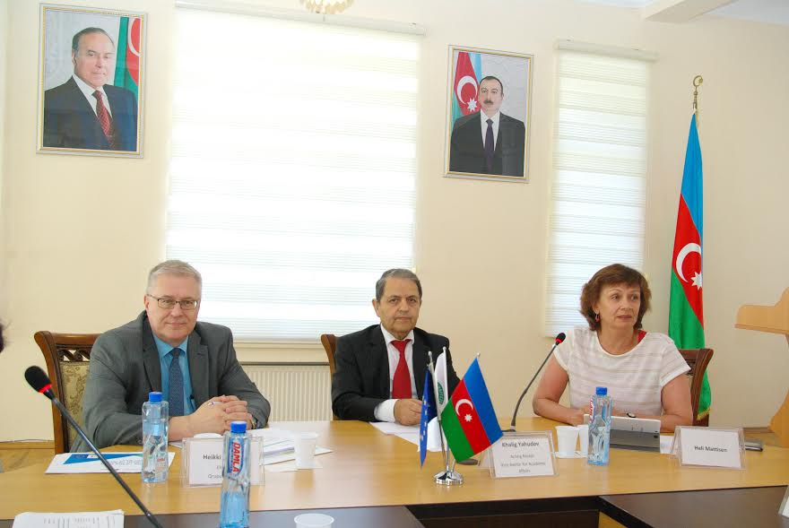
EHEA Twinning project, photos

Slide 6
Mandatory Results 1 - 2
The legal and normative framework for HE is reviewed and concrete recommendations for adapting legislation relevant to QA and the HE sections of the AzQF in Azerbaijan are developed.
The coordination and networking capacity of the MoE and relevant stakeholders is enhanced on the basis of good practice examples in the EHEA.

Slide 7
Mandatory Results 3 - 4
The AzQF sections relevant for higher education are developed in line with the EHEA QF in cooperation with HEIs. A roadmap for the full implementation of the framework in higher education is developed.
Standards and Guidelines for Quality Assurance in HE in Azerbaijan are developed in line with the European Standards and Guidelines for QA and tested with three HE institutions.

Slide 8
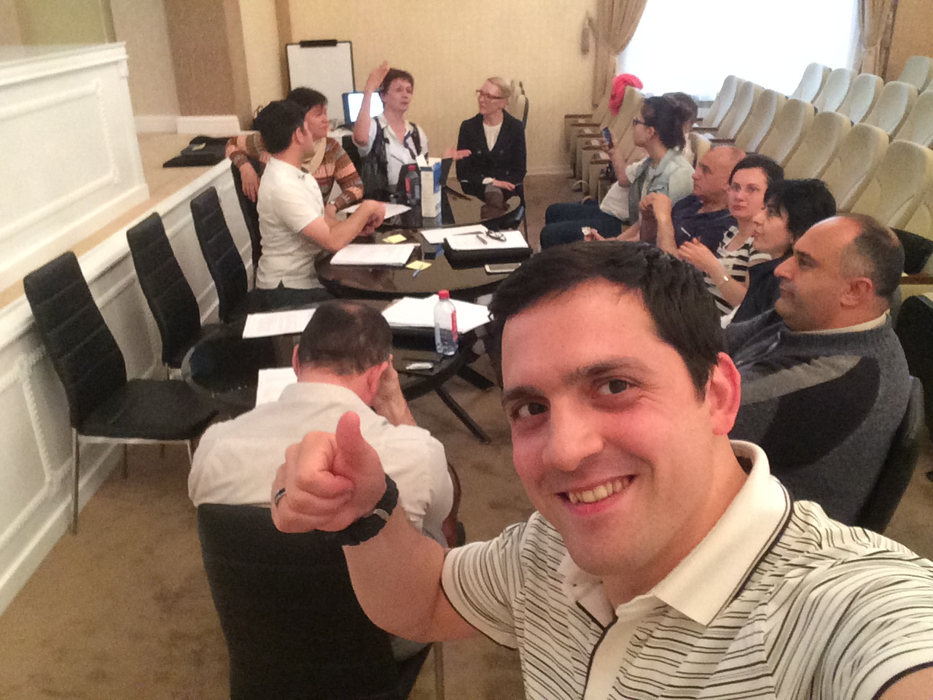
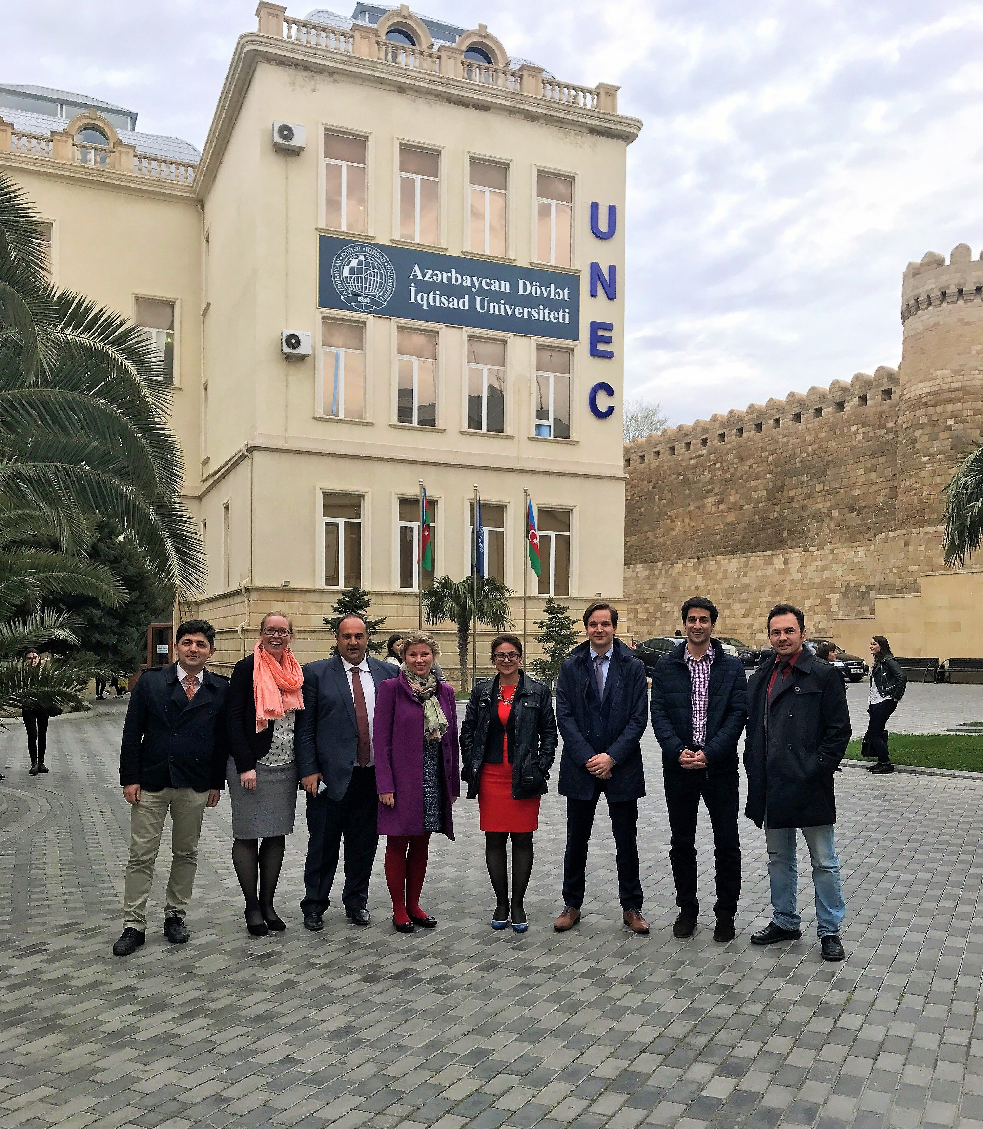
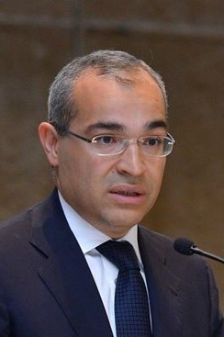
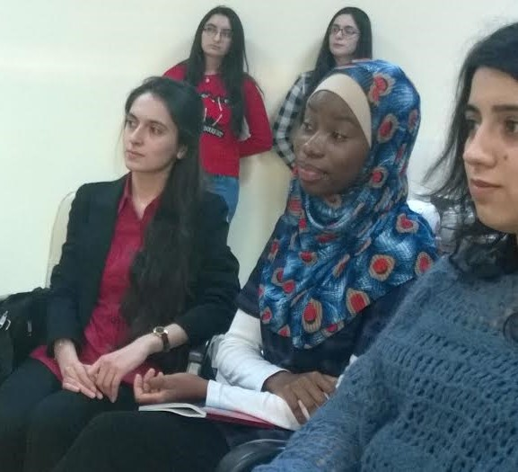
EHEA Twinning project, more photos

Slide 9
Main value of the project – statements of project leaders
Mapping the situation in HE (again ... ☺) in a comprehensive way
Realistic and applicable commendations widely discussed with stakeholders
Supporting collaborative learning in the HE community of Azerbaijan
Supporting some changes in mind-set regarding the autonomy of HEI-s combined with a rigorous, meaningful and improvement led approach in quality assurance

Slide 10
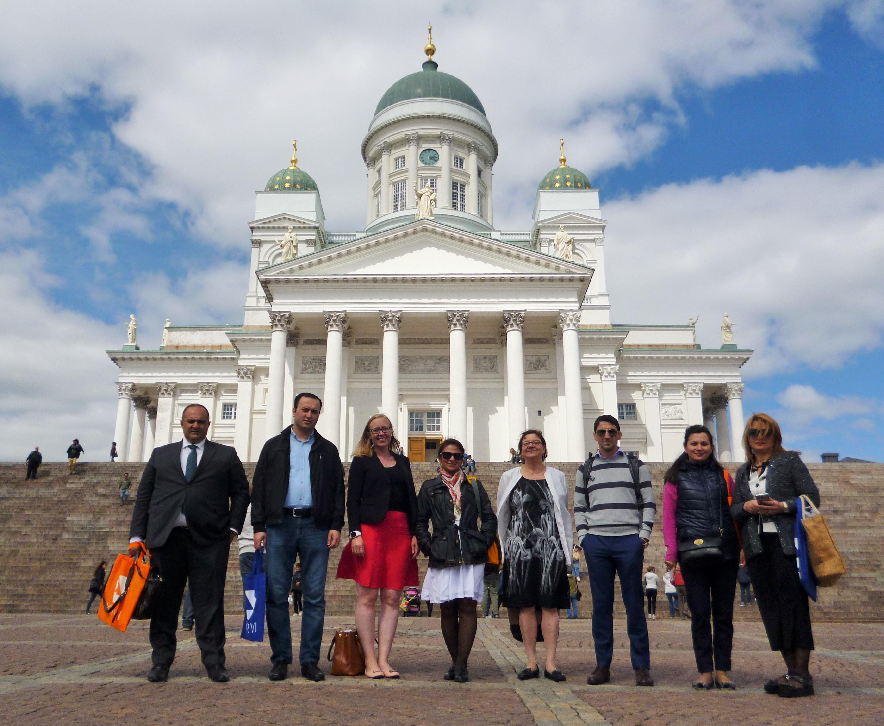
Thank you!

