Slide 1
Hannele Keränen, Quality Manager
PhD candicate in the University of Lapland
Prior positions in Kemi-Tornio UAS (2000 - 2013): Lecturer, Project Manager, Education Manager, Vice Rector and Rector

Slide 2
Elements of our quality system based on CAF model
CONTINUOUS IMPROVEMENT
The expectations of students, stakeholders and partners
Corporate governance
External steering and legislation
4. Partnerships and resources
5. Processes
2. Strategy
3. People
Satisfied students, stakeholders and partners
Arctic competence
Accountability and results
1. LEADERSHIP
INNOVATION AND LEARNING

Slide 3
CAF model
The CAF model enables to understand the cause-and-effect relationships between strategies, procedures, processes and results. The use of the PDCA cycle (plan-do-check-act), on the other hand, illustrates the continuous improvement cycle at all levels of the organisation and in all processes.
Our operations are based on enhancement-led self-evaluation that helps us to identify our strengths, good practices and development targets.

Slide 4
Continuous improvement
The operations of Lapland UAS are based on our values i.e. trust, open-mindedness and a sense of community.
Quality work is part of our personnel’s daily activities and the students’ learning. In practice, this shows as commitment to common operating principles, achieving the objectives set and continuous development.
The Lapland UAS quality culture is based on the active and open interaction and shared values of the personnel, students and partners. The culture is promoted by means of feedback, assessments and internal audits as well as awards and acknowledgements.
The Lapland UAS quality culture also expresses the view of good quality shared by the students, personnel and partners.

Slide 5
Leadership

Slide 6
Management commitment to quality
Top management must provide evidence and demonstrate their commitment to the QMS and continual improvement by:
  Communicating the importance of meeting stakeholder expectations and any regulatory requirements
  Publishing the quality policy
  Ensuring that quality objectives are established
  Performing management review
  Providing appropriate resources
Why quality assurance matters?
  Consistency
  Efficiency From control to empowerment and
  Productivity continuous improvement
  Transparency

Slide 7
Leadership
Provides direction for Lapland UAS by developing its mission, vision and values
Manage the UAS, its performance and continuous improvement
Motivate and support people and act as an example by embracing the values
Manage partnerships, relations with political authorities and other stakeholders

Slide 8
Strategy formulation (2013)
Employee participation supported by strategy agents
Strategy workshops of the Board and the management
Feedback from the units
CVVVV
CVVVV
CVVVV
CVVVV
CVVVV
CVVVV
Analysing existing strategies, food for thought for the new strategy
CVVVV
Drafting the new strategy
Feedback workshops
Finalizing the strategy
Decision making
February
March
April
May
June
Involvement of external stakeholders
Strategy questionnaires for employees and students
Summary for the management
Feedback from the student union

Slide 9
Managing the organisation
Line management with development functions in matrix
  Matrix function co-ordinates strategic development projects (internal collaboration, long term objectives), line management is in charge of meeting the objectives set in the unit level performance agreements (annual objectives)
Fixed-term contracts of the management (80 %)
On-going management training

Slide 10
Leadership and internal quality assurance
Internal quality assurance:
  ‘Internal quality assurance’ means for us all activities within the continuous improvement cycle (i.e. assurance and enhancement activities)
  Quality assurance is an integrated part of the line and matrix management supported by two QA professionals, Quality Manager and Quality Coordinator
  The quality system is reviewed by the management once a year
  The management system is also reviewed by the employees through a survey, which is conducted biennially
    Based on the feedback, the management structure was streamlined in 2015 and a 360 feedback review was conducted in 2016

Slide 11
Strategy

Slide 12
Strategic planning (implementation)
Strategic planning is a management activity that is used to set priorities, focus and allocate resources, strengthen operations, ensure that employees and other stakeholders are working toward common goals, establish agreement around intended results, and assess and adjust the organisation's direction in response to changes.
Strategic planning produces decisions and actions that shape and guide what an organization is, who it serves, what it does, and why it does it, with a focus on the future (vision and mission).
Effective strategic planning articulates not only where an organization is going and the actions needed to make progress, but also how it will know if it has reached the expected results.

Slide 13
Strategy and internal quality assurance
Unit level performance agreements (plan) support the allocation of financial resources to strategic actions (do)
Agreements include also annual targets for performance indicators
Follow-up of the indicators ongoing through an on-line ”dashboard” (check) and a national database https://vipunen.fi/en-gb/
Follow-up of the strategic actions biannually through performance reviews and management review (check)
Actions taken if the achievement of the objectives set in the perfromance agreement is unsatisfactory (act), management get-away-days and strategy workshops to review long term innovation and change

Slide 14
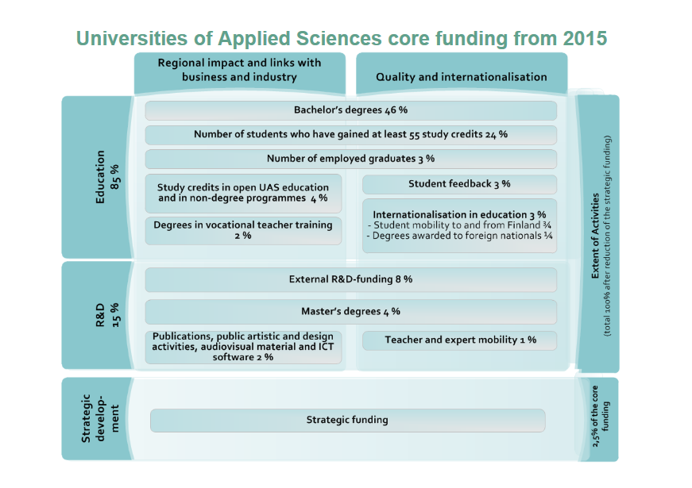
Limited company, but public funding
Notes:
Core funding for universities of applied sciences is provided by the State. The State share of core funding is 100%.
Universities of applied sciences apply for core funding in addition to separate funding for joint, national, development and regional projects. They may also apply for competitive RDI funding from national and international sources of funding.

Slide 15
People

Slide 16
People
Competent personnel is our most important asset
Our human resource management policy lays foundation for equal treatment, empowerment, reward and recognition of our personnel and also for providing a safe and healthy working enviroment
One of the most important area of strategic development related to our personnel is to develop a working culture that continually seeks to improve collaboration and teamwork
  This area of development has been taken into account in integrating our core processes i.e. teaching and learning and RDI activities

Slide 17
People and internal quality assurance
A long-term plan for competence and career development on a unit level and also on an individual level based on development discussions and competence survey (plan)
Briefing of the employees (new employee briefings, personnel infos, team briefings), training and developing competences in line with the strategy, common procedures for managing human resources (do)
Assessing the impacts of training and other development actions through biennial employee survey (check) and annual development discussions (check). Students feedback is also taken into account when assessing the needs for training and competence development
Based on assessments, individual and institutional development needs are aligned (act)

Slide 18
Partnerships and resources

Slide 19
Partnerships
Working life oriented education and RDI activities which support the regional development are based on systematic development and maintenance of strong partnerships. Affiliates are categorized as strategic partners, key partners, partners and case-by-case partners.
With strategic partners and key partners we make partnership agreements that ensure the continuous reciprocal cooperation and common development plans.
The challenge in managing partnerships is the vast amount of partners.

Slide 20
Partnerships and internal quality assurance
Internal quality assurance related to strategic and key partners are based on partnership agreements (plan) and development plans (plan and do), which are evaluated annually (check). Agreements with mobility partners are also evaluated annually.
With RDI partners internal quality assurance is part of the responsibilities of the project steering groups (check)
A common partnership feedback system has been established in the autum 2016 (check)
A joint event is held with the partners in every three years to exchange ideas and to communicate the socio-economic and environmental impact of the development activities (act)

Slide 21
Resources
Resources include
  Managing finances, information and knowledge, technology and facililities
  Managing resources include delegating and decentralising responsibilties and balansing then with central controlling and co-ordinating by the unit of finance and general administration and the unit of internal services.

Slide 22
Resourses and internal quality assurance
Integrated to the annual planning process (plan)
Monitored by performance data and return-on-investment (ROI) metrics (check)
Feedback from employees and students is gathered through surveys (check).
Based on the results development actions are taken (act).

Slide 23
Processes

Slide 24
Core operations
Education
  Bachelor’s degrees as full time studies and/or adult education
  Master’s degrees
  Specialisation studies and other complementary education
  Open UAS
Research, development and innovation activities (RDI)
  Innovation programme
International activities
Regional development

Slide 25
Processes (1)
Leadership
The expectations of students, stakeholders and partners
Corporate governance
External steering and legislation
Unit
Unit
Unit
Unit
Unit
Satisfied students, stakeholders and partners
Arctic competence
Accountability and results
Teaching and learning
RDI activities
Internal services
Innovation and learning

Slide 26
Processes (2)
The core processes (teaching and learning, RDI activities) are those relating to the mission and vision of Lapland UAS and are critical to the delivery of expected outcomes/results
Management processes steer Lapland UAS
Support processes (internal services) deliver the necessary resources

Slide 27
Teaching and learning
The expectations of students and employers
Strategy
External steering and legislation
Qualified graduates
Employability
Competence and problem-based curriculum
Student-centered teaching, learning and assessment

Slide 28
Internal quality assurance of teaching and learning
Curricula development (plan): management reviews (matrix), stakeholder involvement and feedback (employers, students, graduates)
Teaching and learning (do + check): reviewing the implementation plans of the study units, streamlining based on continuous feedback, study unit feedback and annual feedback
Monitoring key indicators (check and act)
Annual reviews of the curricula, stakeholder involvement through development discussions and feedback days (act)

Slide 29
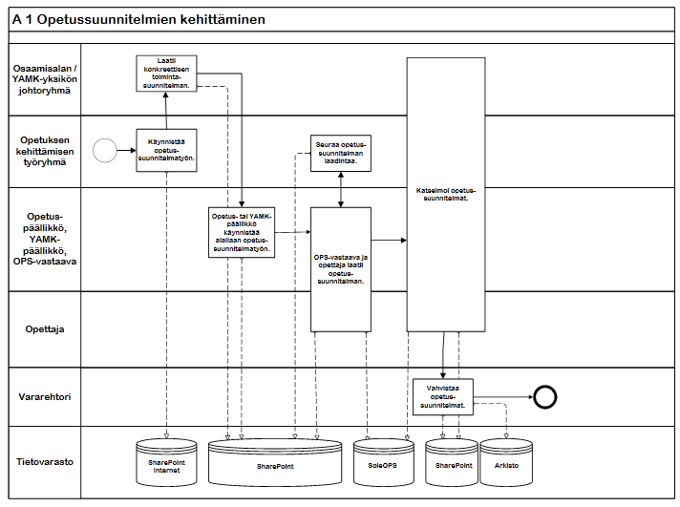
Process flowchart: an example

Slide 30
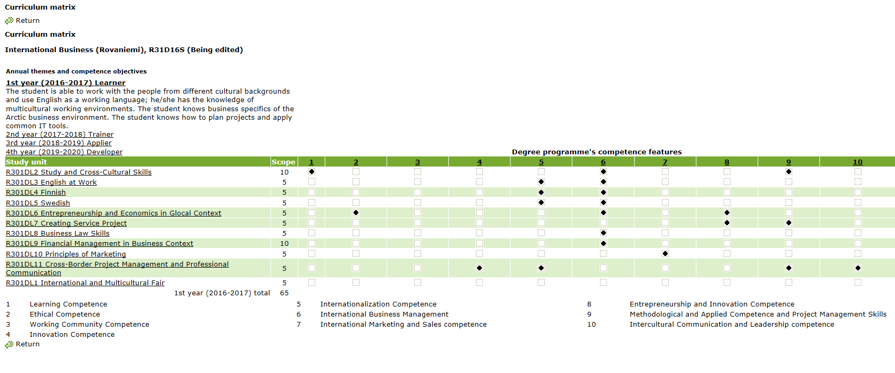
Competence and probem-based curriculum (1)

Slide 31
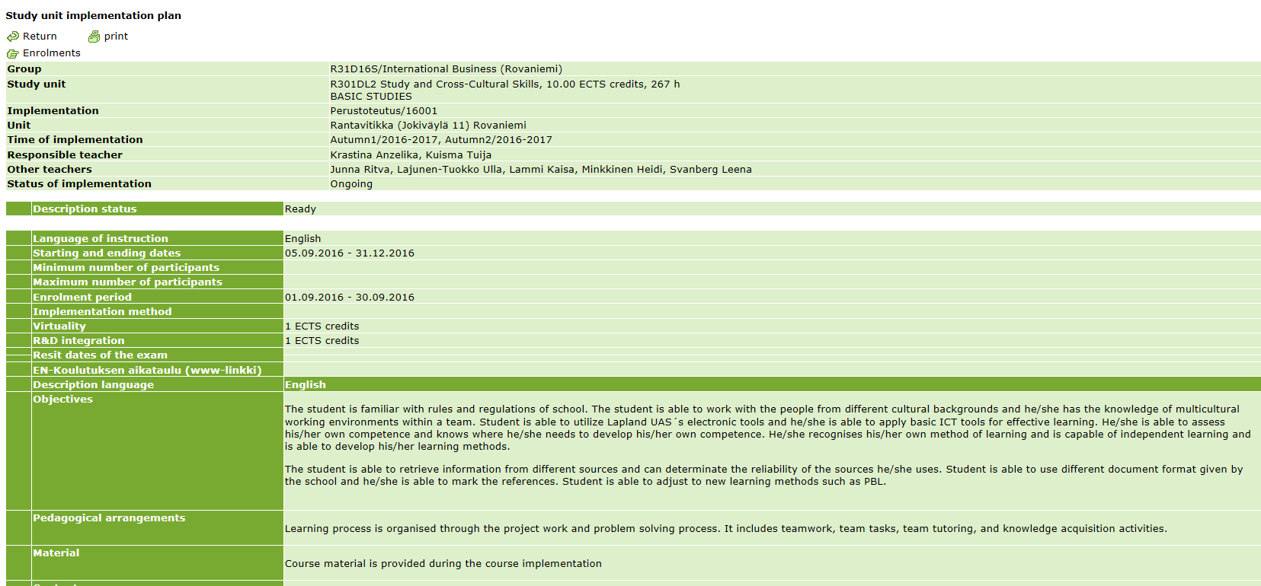
Competence and probem-based curriculum (2)

Slide 32
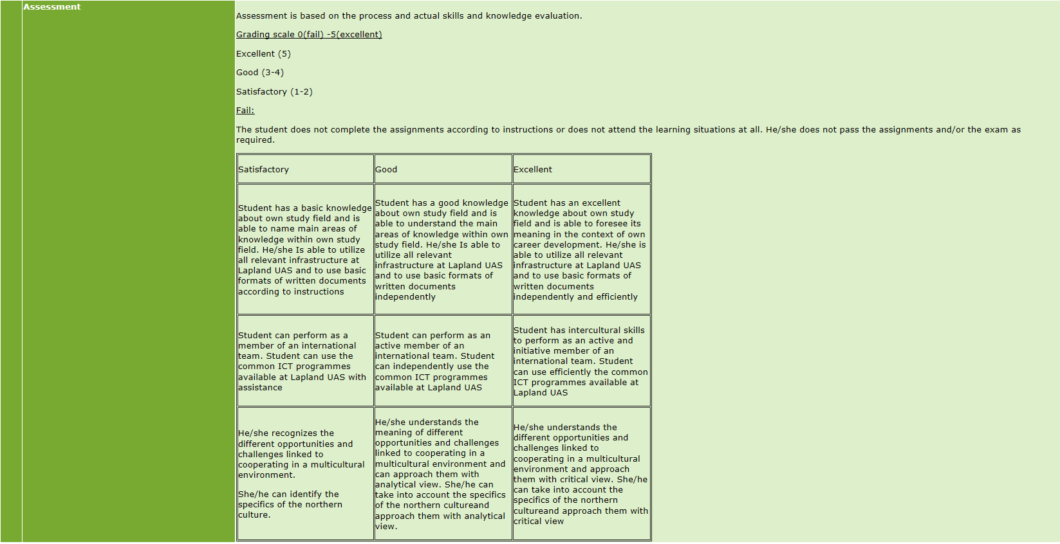
Competence and probem-based curriculum (3)

Slide 33
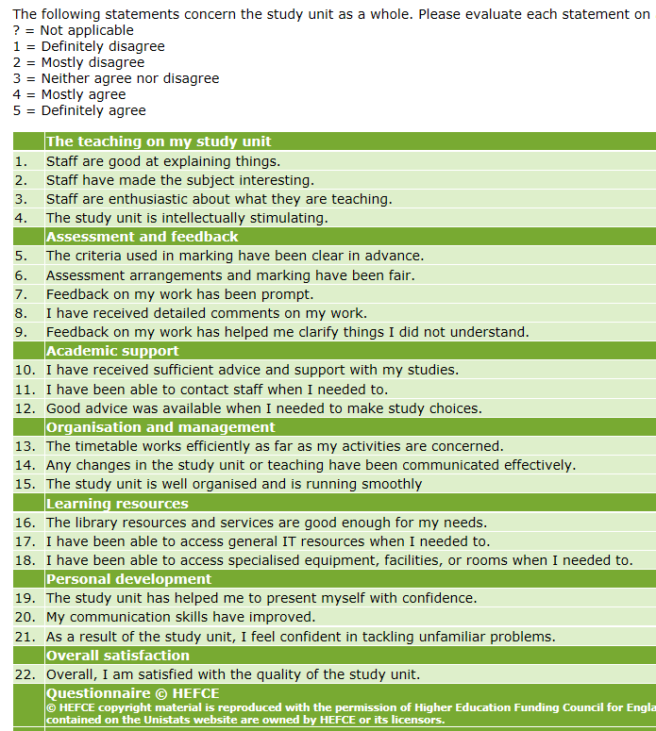
Study unit feedback

Slide 34
RDI activities
The expectations of the region
Strategy
External steering and legislation
Satisfied partners
Competent students
Arctic competence
Arctic vitality
Developing the region through RDI projects
Supporting students’ learning through integrating RDI projects to teaching and learning

Slide 35
Internal quality assurance and RDI activities
RDI project planning (plan):
  Recognition and appointment decision (green light for the planning of the project)
  Peer review and a statement (no or go for the project application)
  Approving the application (management commitment to the project plan)
RDI activities (do):
  Project reviews (self-assessment by the project manager, statement by the RDI manager)
  Steering group meetings and assessment
Project assessment and evaluation (check & act): project workshop (impact of the project, new project ideas, new products or services)

Slide 36
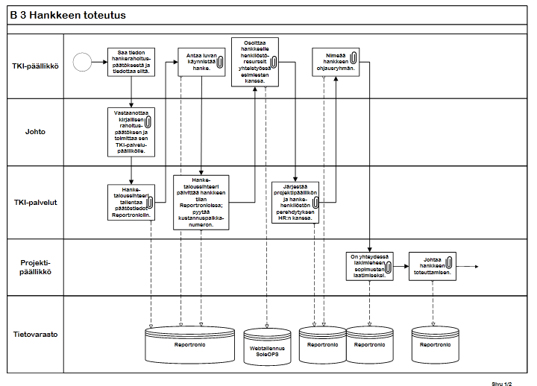
Process flowchart: an example

Slide 37
Results

Slide 38
Learner-oriented and other key stakeholder-oriented results
Perception measurements:
  The overall image of Lapland UAS, opinion surveys for different stakeholders
  Involvement and participation of different stakeholders
  Transparency (internal and external communications)
Process performance measurements:
  Processing time, waiting time, number of complaints, initiatives

Slide 39
People results
Perception measurements:
  The overall image of Lapland UAS as a workplace, motivation of the personnel
  Results regarding the perception of the leadership and management systems
  Results regarding satifcation with working conditions
  Results regarding motivation and satisfaction with career and skills development
Process performance measurements:
  Sick leave, staff turnover, number of complaints, skill development related indicators

Slide 40
Social responsiblilty results
Perception measurements:
  Societal impact at the local, regional, national and international level
Performance measurements:
  Monitor and improve the performance related to social responsibility, such as number of conferences and seminars, services for organisations and businesses, participation in other organisations (such as board membership, other national and international responsibilities)

Slide 41
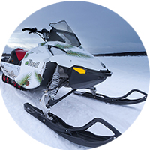
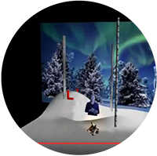
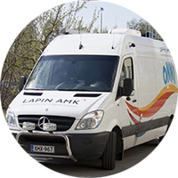
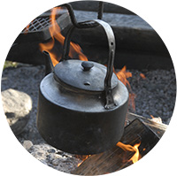
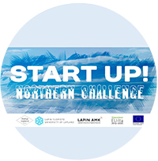

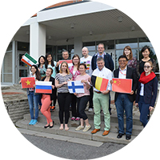

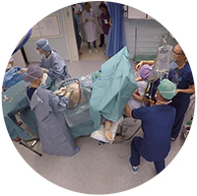
Research, Development and Innovations
Welfare Vehicle
Onni
SmartSet
-studio
Innovative
Distance Learning
Solutions
eSled
Pitching
-videos
Boosting
Start-ups
Tornio
International
Summer School
Innovation
assistants
Nursing
Simulations

Slide 42
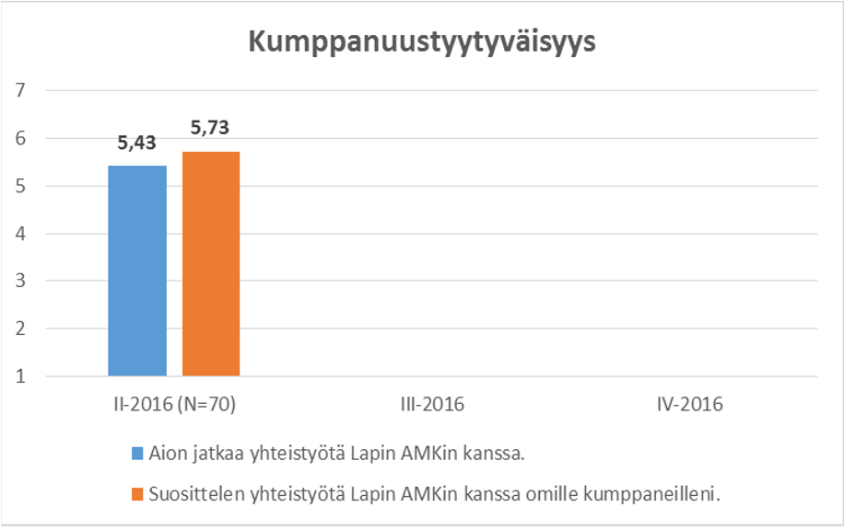
Partnership satisfaction index
I intend to continue my co-operation with Lapland UAS
I recommend co-operation with Lapland UAS

Slide 43
Key performance results
External results: outputs and outcomes
  The amount of graduates
  The employment rate of graduates
  RDI volume
  Volume of business services
  Publications
Internal results: level of efficiency, quality
  Number of students gaining 55 credit units
  Number of students dropping out
  Student feedback
  Internationalisation (mobility, the amount of international students)
  RDI study unit points
  Virtual study unit points

Slide 44
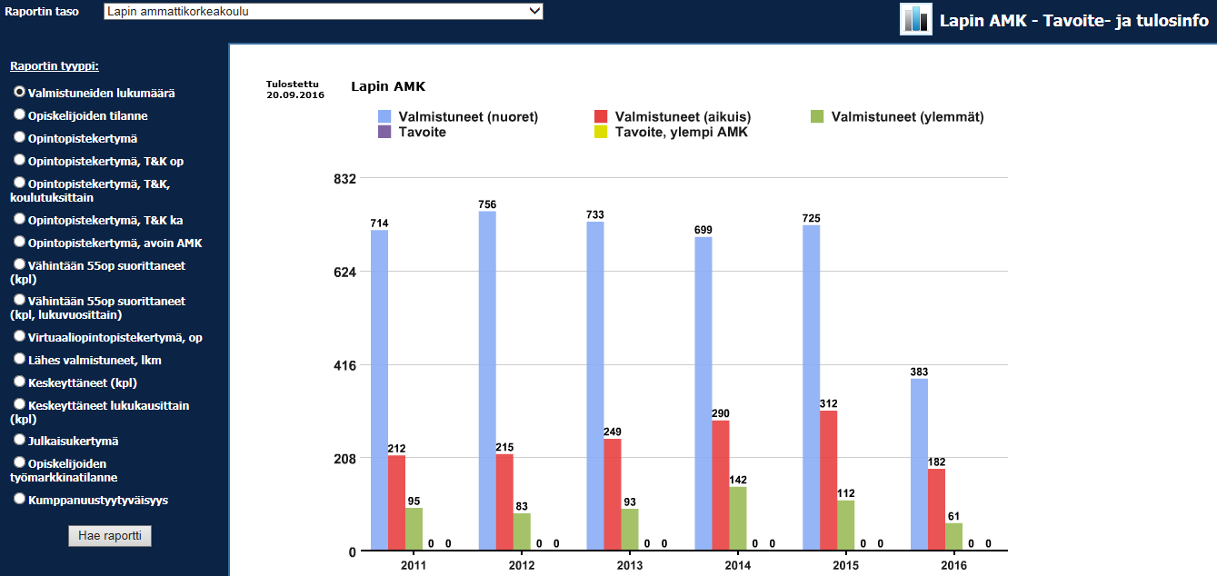
On-line dashboard

Slide 45
Projects Volume
Research, Development and Innovations
External Funding of R&D. 2009-2015, €
Ongoing projects: 84 (August 2016)
Research staff work years: 93 (2015)
International projects: 11

Slide 46
Internal evaluation and enhancement tools

Slide 47
Management reviews and internal audits
Management reviews are a management tool to be used to assess how successfully our quality system supports strategic and operative management
Internal quality audits are a management tool to be used for verifying objective evidence of processes, to assess how successfully processes have been implemented, for judging the effectiveness of achieving any defined target levels, and to provide evidence concerning reduction and elimination of problem areas. Internal quality audits report both non-conformances and corrective actions and highlight areas of good practice. In this way other units/teams/programs may share information and amend their working practices as a result, and contribute to continuous improvement.

Slide 48
Management review
Unit level audits
Degree program level audits
Process audits
Leadership
The expectations of students, stakeholders and partners
Corporate governance
External steering and legislation
Unit
Unit
Unit
Unit
Unit
Satisfied students, stakeholders and partners
Arctic competence
Accountability and results
Teaching and learning
RDI activities
Internal services
Innovation and learning

Slide 49
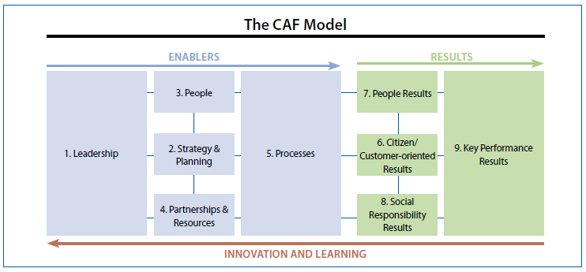
Self-evaluation
How mission and vision are communicated through strategy?
How strategy is implemented?
What kind of results we have accomplished? How do we measure excellence?
How people and processes are managed?
Implemen-tation plans in practice
How strategy takes into account stakeholders expectations and changes in the environment?
Cost-benefit analysis of the way we measure excellence

Slide 50
Continuous improvement maturity
Dimensions (principles of excellence):
Results orientation, performance management
Customer focus
Leadership and constancy of purpose
Management by processes and facts
People development and involvement
Continuous learning, innovation and improvement
Partnership development
Social responsibility
Level 1: Ad hoc & static (no evidence or just some ideas)
Level 2: Reactive (some weak evidence, related to some ideas)
Level 3: Structured and proactive (Some good evidence related to relevant ideas)
Level 4: Managed and focused (strong of very strong evidence related to most or all areas)
Cotinuous improvement (Excellent evidence, compared with other organisations, related to all areas)

Slide 51

^{I'm fire. I'm ice.}
^{I'm a storm. I'm calm.}
^{I'm strong and sensitive.}
^{I have the Northern Factor}

