Slide 1
CO-OPERATION BETWEEN HEI’S AND LABOUR MARKET
14.7.2016, Baku
Prof. Kauko Hämäläinen

Slide 2
Objectives of presentation
To support MoE and Higher Education Institutions to Meet the Requirements of Employers and Graduates for the labour market
To share good practices of the roles of stakeholders from Finland and to compare to practices in Azerbaijan

Slide 3
Content of presentation I
Why stakeholders are needed
Defining different stakeholders
Interests of labour markets / ministeries
Role of students
Succesful use and problems of using stakeholders

Slide 4
Content of presentation II
Work-oriented higher education
  Role of teachers, students and working life representatives
  Developing competences and qualifications
  Examples from universities of appleid sciences

Slide 5
STAKEHOLDERS IN HIGHER EDUCATION
Labour markets: needs of labour markets, planning training programmes, common projects, staff training, working exeperience for students
Local authorities: expectations for local development
Other educational organizations: co-operation (for instance in programme development) , benchmarking
Students: programmes, teaching, guidance, social support
Ministries: national needs, future perspectives

Slide 6
Fields of co-operation
On-the-job learning and job mentoring
Trainer co-operation
Teacher’s and trainer’s working life periods
Expert co-operation
Excursions to working life
Project co-operation

Slide 7


ROLE OF WORKING LIFE
OFFERING REAL LIFE CONTEXT AND PROBLEMS TO BE SOLVED
WILLING TO KNOWLEDGE SHARING AND LEARNING; TRUST
MOTIVATION TO EVALUATE LEARNING OUTCOMES
TIME AND COMMITMENT
ACCESS TO RESOURCES AND LEARNING FACILITIES
SHARING NEW, DIFFERENT KIND OF PROFESSIONAL NETWORKS FOR HIGHER EDUCATION
PARTNERSHIPS IN A LONG PERSPECTIVE.

Slide 8
CO-OPERATION WITH STAKEHOLDERS FROM BUSINESS AND INDUSTRY
Assessing of training programmes and quality of staff
Planning training programmes
Common research projects
Improving stakeholder’s procedures
Developing higher education procedures
Implementing results

Slide 9
Interests of Ministeries/Administration
Connection to funding
Feedback for legislation and regulations
Support to develop legislation
Changing educational policy
Developing professional development and research
Dissemination of good / best practices

Slide 10
The Use of Stakeholders in Evaluations
Negotiation the scope of the evaluation
Selection the criteria on which it will be judged to be successful
Taking part in the evaluation teams
Interpreting the results
Utilitation of the results

Slide 11
Stakeholders are Needed in Evaluations
To prevent the guilt protection of peer-reviews
To enhance relevance, ownership and utilization of evaluations
To encourage dialogue within interest groups
Have different knowledge / standpoint of the institute / programm to be evaluated
  E.g. administers, working life, students, teachers

Slide 12
Problems in Using Stakeholders
Conflicting interests of different groups
Asymmetric power and strenght of voices of groups, e.g. administrators, researchers and students
Building trust between different stakeholders take time
Stakeholders bring with them their own value commitments

Slide 13
Role of Stakeholders in
Self-assessment Process I
Self-assessment with stakeholders has four main components:
Systematic data gathering
Systematic data analysis that leads to valid conclusions
Reflective processes that involve all people and groups in the organisation
Decision-making for ongoing improvement connected to the outcomes of a self-assessement process.

Slide 14
Role of Stakeholders in
Self-assessment Process II
Self-assessment with stakeholders enables an educational organization to find out:
what outcomes, learners are achieving and how well
the value of the outcomes to stakeholders including learners
the effectiveness of processes in contributing to these outcomes.

Slide 15
Conditions for Succesful Use of Stakeholders
Informing and motivating stakeholders
Proper training of them
Providing financial means, also in terms of timing
Guaranteeing balanced confrontation of points of view

Slide 16
WORK-ORIENTED
HIGHER EDUCATION
Role of teachers, students and working life representatives

Slide 17
STUDENT CENTERED LEARNING
EXPLORE, DISCOVER, CREATE, LEARN
STUDENT HAS AN ACTIVE ROLE IN LEARNING AND ARE RESPONSIBLE FOR THEIR OWN LEARNING
AUTENTHIC LEARNING ENVIRONEMTS, E.G. REAL LIFE LEARNING ENVIRONMENT
MEANINGFUL LEARNING CONTEXTS; MOTIVATION
INDEPENDENT WORK, GROUP WORK, NETWORKS
COMMUNICATION
SELF EVALUATION
  NEED FOR FEEDBACK AND EVALUATION OF LEARNING OUTCOMES

Slide 18
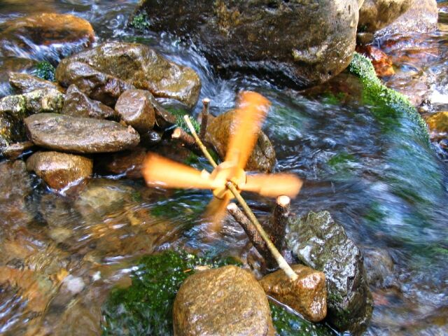


GUIDANCE
SUPPORT
SELF EVALUATION
TIME AND PROJECT MANAGEMENT
LEARNING SKILLS
THEORY AND PRACTICE COMBINED
NETWORKS
NEW SKILLS
PROBLEMS TO BE SOLVED
ETC.
WORKING LIFE AND STUDENT
TEACHER

Slide 19
TEACHERS ROLE IN WORK ORIENTED HIGHER EDUCATION
PERSON AS A TEACHER
  IS SKILLED AS COMMUNICATING
  HAS A POSITIVE ATTITUDE TOWARDS STUDENTS
  RESPECTS ALL STUDENTS
EXPERT ON CONTENT KNOWLEDGE
  IS COMPETENT OF USING RELEVANT INFORMATION FROM SPEALICED LITERATURE
  HAS THROUGHT KNOWLEDGE FROM HIS/HERS SUBJECT
  HAS KNOWLEDGE FROM NEW DEVELOPMENTS FROM HIS/HERS SUBJECT

Slide 20
TEACHERS ROLE IN WORK ORIENTED HIGHER EDUCATION
FASILITATOR OF LEARNING PROCESSES:
  DEVELOPER (E.G. ACTIVATING EDUCATIONAL MATERIALS)
  COUNCELLER (E.G. GIVING FEEDBACK)
  EVALUATOR (E.G. ASSESSING LEARNING RESULTS, ABLE TO DESIGN TESTS FOR VARIOUS LEARNING ENVIROMENTS)
  ORGANISER (E.G. CO-OPERATION WITH COLLEGUES AND WORKING LIFE PARTNERS)

Slide 21
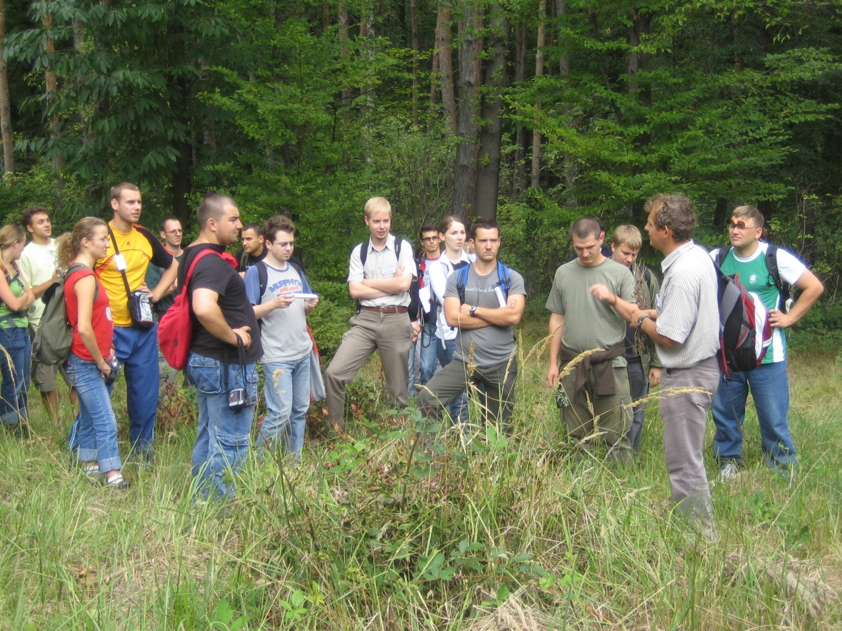
INNO-FOREST 2005 – 2007 ( example from Savonia UAS)
Integrating Innovation and Entrepreneurship Research in Higher Forestry Education
100 students,
100 enterprises
from 14 countries
The main objective was to develop methods and tools for knowledge transfer among research, education and enterprises.
PBL-process as a part of enterprise’s innovation process

Slide 22
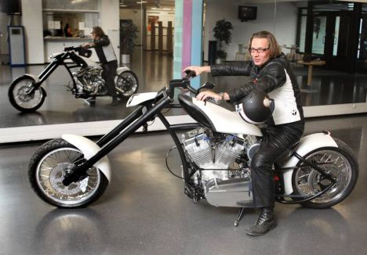

  A MOTOR BIKE PROJET (SAVONIA UAS)
WAS SELECTED AS A QUALITY UNIT 2010-2012 (FINHEC)
MULTIDISPILINARY STUDENT GROUP DESGIGNED A MOTOR BIKE
BUSINESS STUDENTS, ENGINEERING STUDENTS, DESING STUDENTS WORKED TOGETHER PART OF THEIR OWN CURRICULUM
WORKING LIFE PARTNERS WAS INVOLVED WITH THE PROJECT; TECHNICAL ADVICE, DESIGNING ETC.
TEAHCERS FROM VARIOUS DISCPLINES WORKED TOGETHER, TEACHINF THE THEORY BASED ON A REAL LIFE PROBLEM
INNOVATIVE NETWORKS DEVELOPED THE QUALITY OF LEARNING AND MOTIVATION OF STUDENTS.
LEARNING AND R&D ACTIVITES WERE CONNECTED

Slide 23
Developing competences and qualifications
Examples from UAS sector

Slide 24

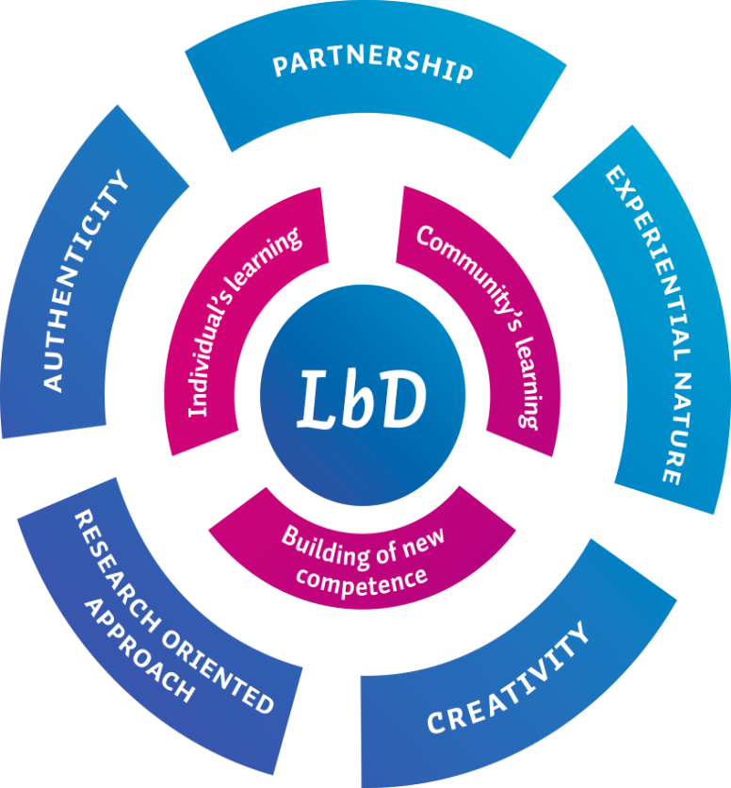
Learning by Developing (LbD) model
Focuses on practical projects
Cooperation with real-life
companies and organizations
Students learn through
practical experience:
  Participate in societal and
  business development
  Create innovations
  Entrepreneurial projects
  Act in international
  environments

Slide 25




Roles in Lbd
Members of community of practice are changing their ways to work.
Working groups (professionals and students) are promoting the change.
Experts from working life are enabling the change.
Teachers are facilitating and counseling working groups.

Slide 26
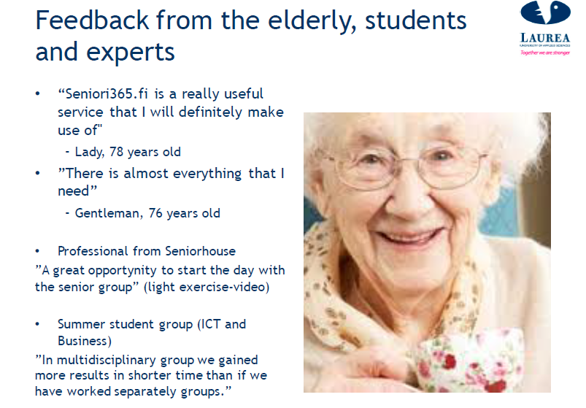

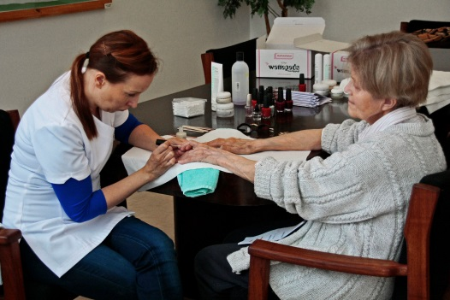
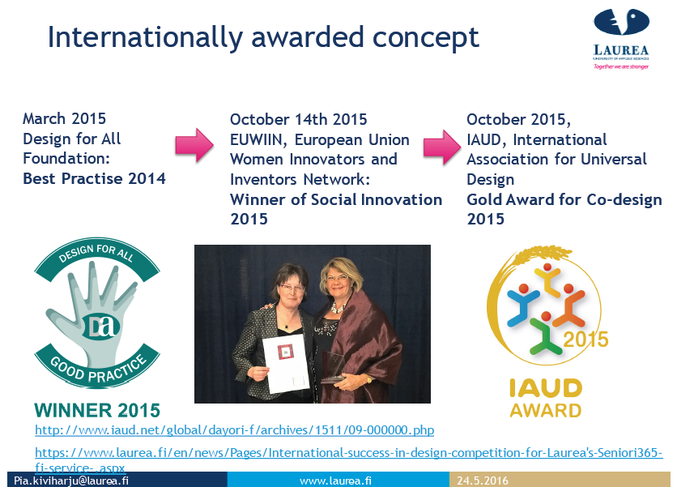
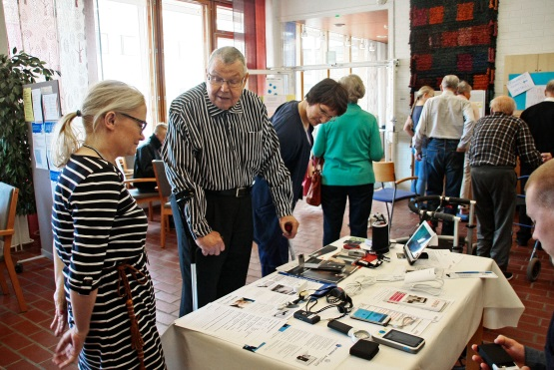
Case: www.seniori365.fi

Slide 27
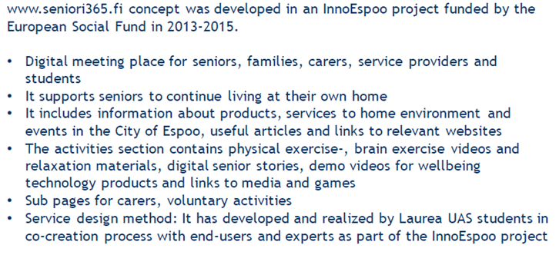

Slide 28
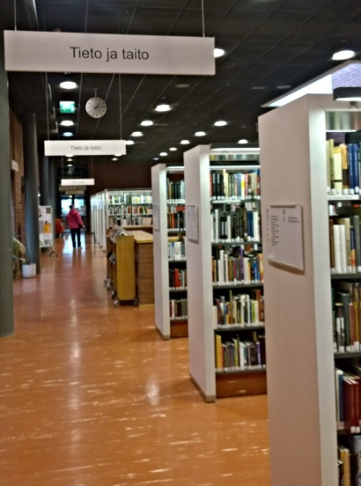



Conclusion
Learning by Developing (LbD)
  Learning has a clear objective and takes place through the process of generating new competence
  Based on development projects (for the world of work)
  LbD signifies learning based on real life, an investigative approach and face-to-face encounters, leading to innovations
  Different experts participate through different roles - based on partnerships between lecturers, students and experts from the working life
  Platform for demonstrating the student’s competence
  Is a platform for regional, national and international cooperation
  Needs to be strategic choice
  The outcomes are seen as new innovations (products, services, processes, models and working life cultures) and new competences.

Slide 29

ICT co-operation and Digitalisation in UAS sector (by Turo Kilpeläinen)
Basic driver
ICT education in UAS; basic studies in co-operation
  Student Centered Learning is in a key focus when planning education
Pedagogy
  Put together the best possible resources for learning new competences.
Learning & RDI tools and methods
  Digital learning environments
  Practical RDI environments, real co-operation with businesses
Digital learning and co-operation means, e.g.
  new mode of teaching and learning
  willingness to change the way the curriculum is put into practice
  Strong co-operation between UAS sector and the different players.
Systems and structures
  Joint planning systems and support structures ( especially education administration)
Technology
  Joint, shared platform for technology (eg. open platforms).

