Slide 1
Archimedes Foundation
Rait Toompere
July 2016

Slide 2
Archimedes Foundation is an independent body to implement Estonian and European Union programmes in the field of training, education and research:
  We coordinate national programmes
  We are the national agency for international cooperation programmes
  We are the implementing agency for the EU Structural Funds
  We evaluate the quality of Estonian higher and vocational education
  We assess foreign qualifications
  Archimedes Foundation was established by the Estonian Government in 1997 to operate in the area of government of the Ministry of Education and Research.

Slide 3
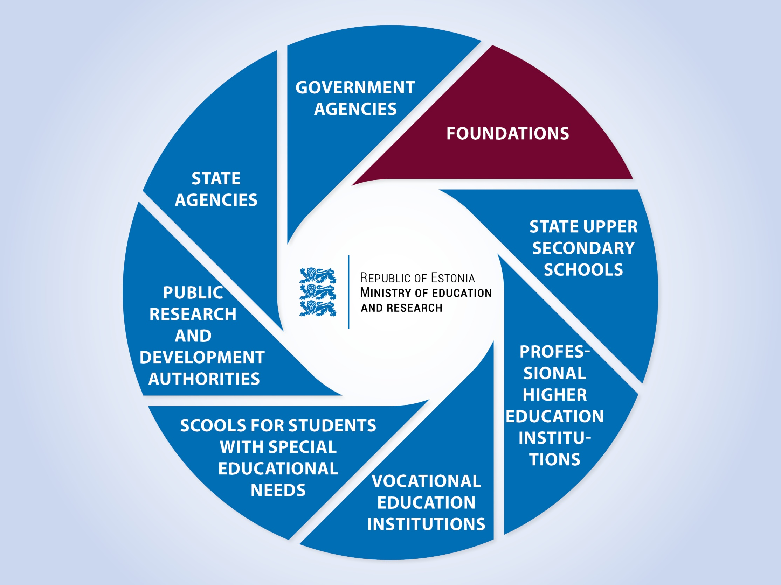

Slide 4
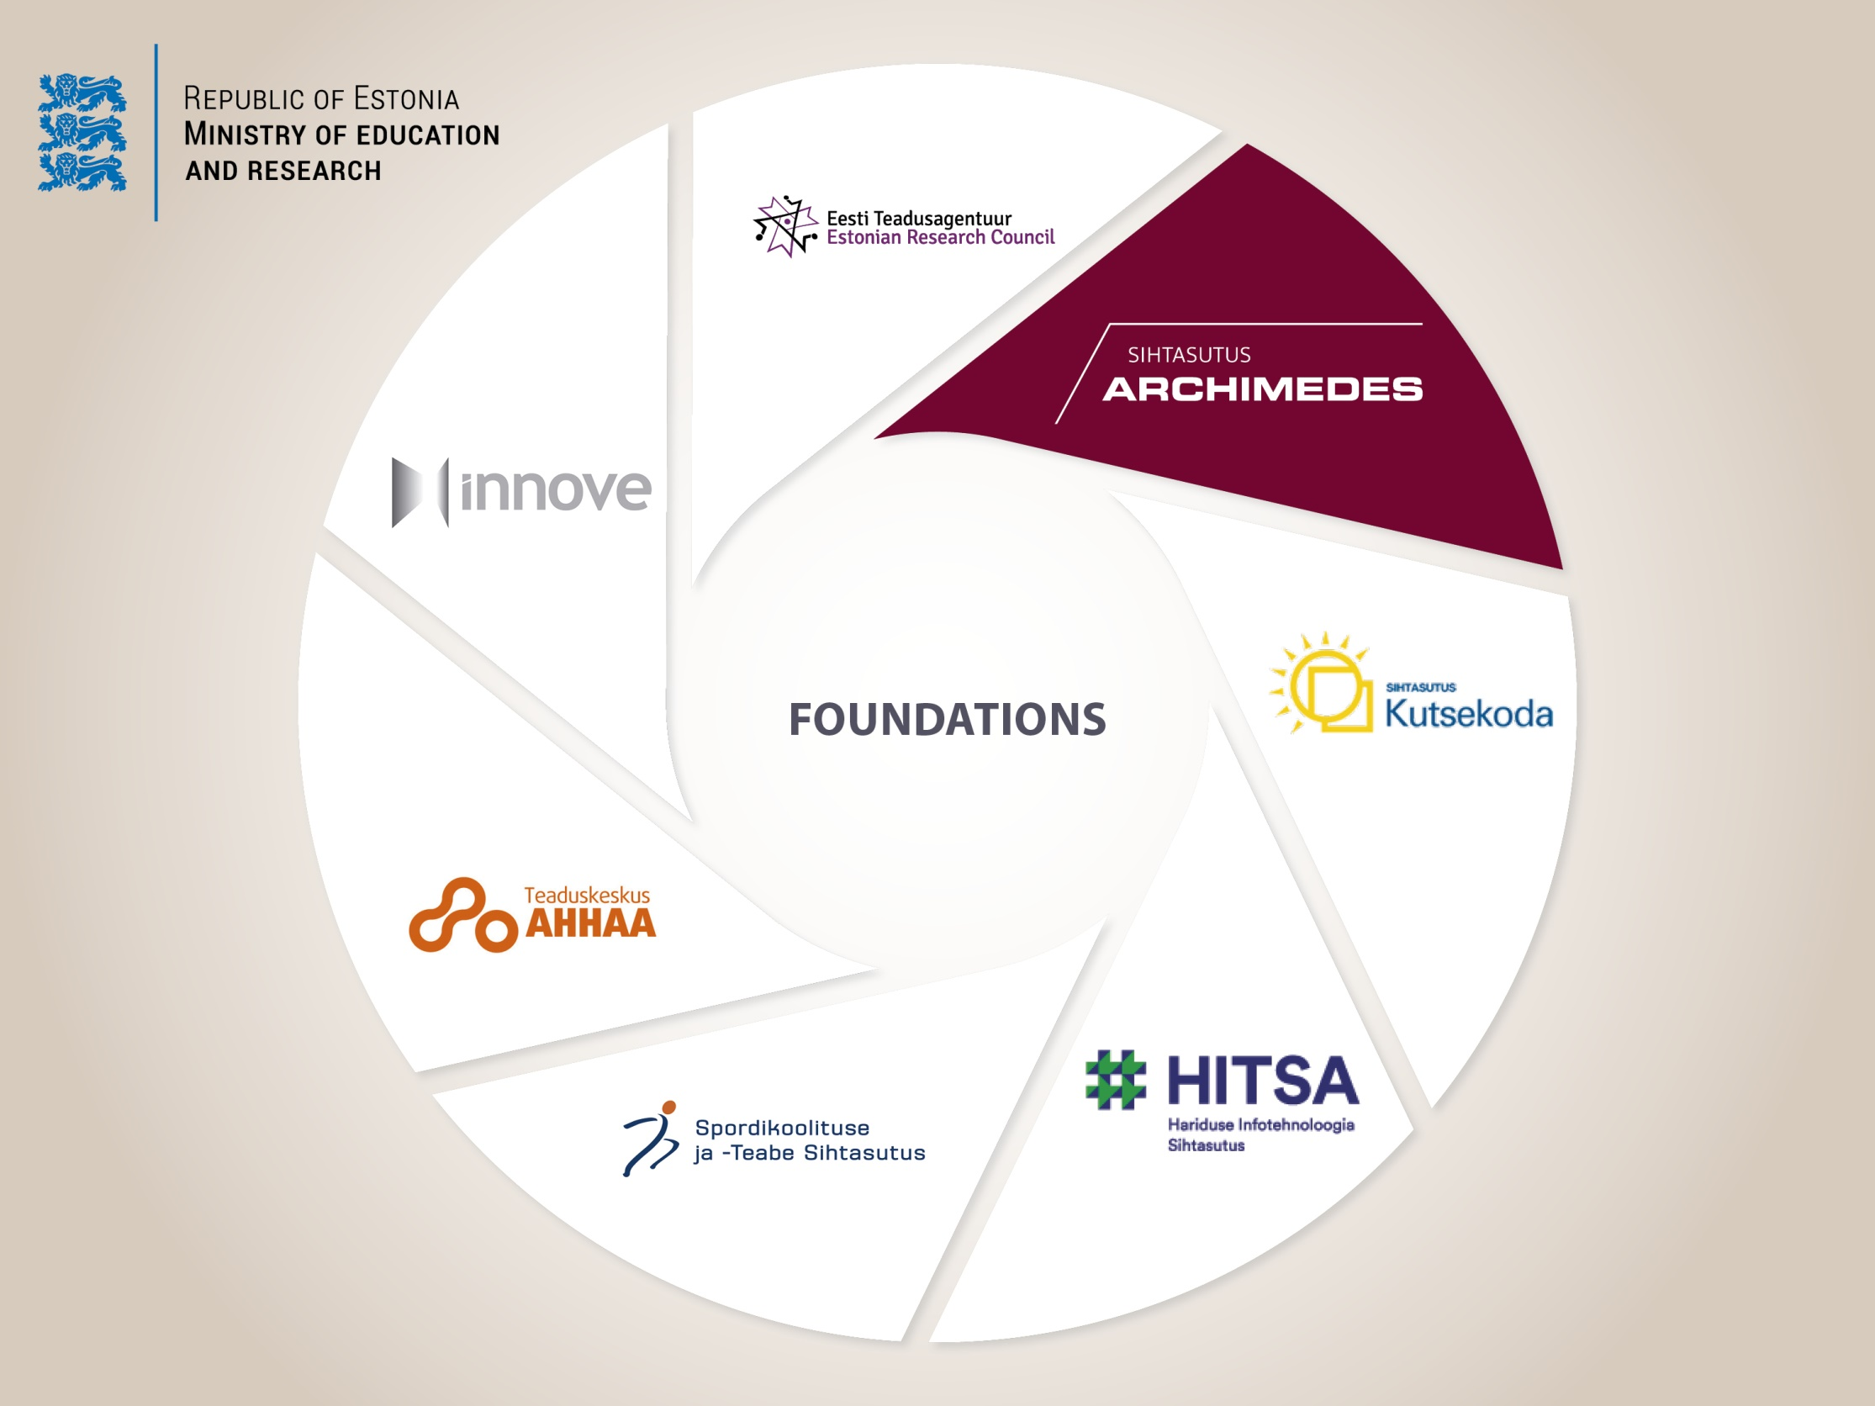

Slide 5
Acts and regulations
We are assigned to work under several legal acts:
  Universities Act
  Vocational Educational Institutions Act
  Institutions of Professional Higher Education Act
  Private Schools Act
  Standard of Higher Education
  Recognition of Foreign Professional Qualifications Act
  2014-2020 Structural Assistance Act

Slide 6
Our role in the society
Our vast experience enables us to offer expert knowledge to stakeholders and national initiators involved in improving the quality and development of the fields of education, research and youth work.
We are recognized for valuing and promoting internationalisation and we represent Estonia in international cooperation with partner organisations and networks.

Slide 7
Our mission
Our mission is to increase the welfare and competitiveness of organisations and people by developing education, research and youth field .

Slide 8
Our strategic framework
On the national level we align our actions with:
  the National Reform Programme "Estonia 2020“
  the National Strategy on Sustainable Development "Sustainable Estonia 21".
  On the international level we are guided by the European Union's economic growth strategy "Europe 2020".
The strategic impact objectives of the measures we implement are set in national and international framework documents, the meeting of these objectives is evaluated by those who set them. In implementing measures and developing our fields of work we are guided by the following development plans:
- Estonian Lifelong Learning Strategy 2020
- Knowledge-based Estonia 2014-2020
- Youth Field Development Plan 2014-2020

Slide 9
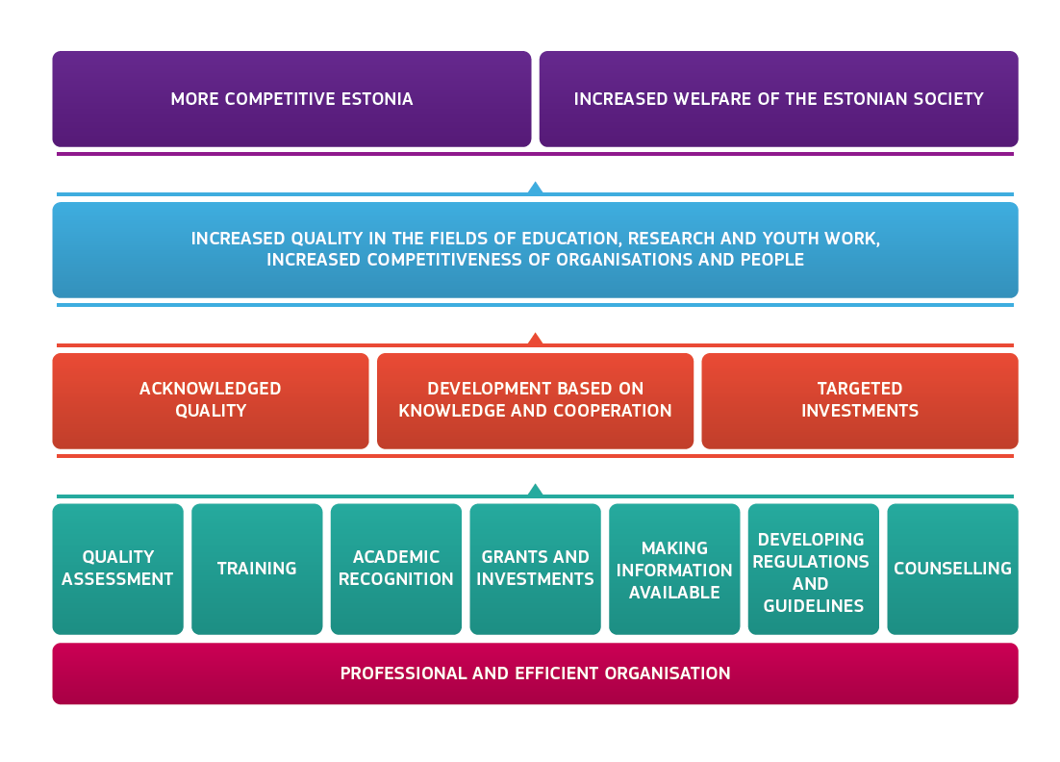
Our goal in society
Estonia's goals
Goals of the fields of education, research and youth work
Our goal in society
Our fields of work

Slide 10

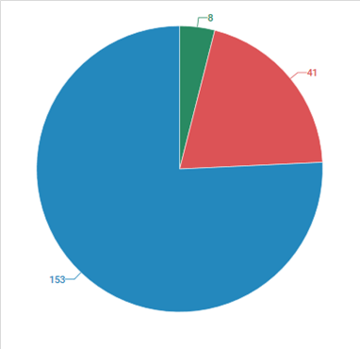
Our goals in society
Main activities: 31.12.2015.
8 – Acknowledged quality
41 - Development based on knowledge and cooperation
153 – Targeted investments
Total: 202 different activities
Notes:
Välishindamine annab tagasisidet kõrgkooli või kutseõppeasutuse juhtimise, toimimise ning arendustegevuste kohta

Slide 11
Acknowledged quality
We have two main directions in the field of acknowledged quality:
Assessment of foreign qualifications;
Evaluations of higher and vocational education in Estonia in order to guarantee the quality of education
Notes:
Välishindamine annab tagasisidet kõrgkooli või kutseõppeasutuse juhtimise, toimimise ning arendustegevuste kohta

Slide 12
Acknowledged quality – statistics
In 2015:
  24 study program group assessments were carried out
  19 assessment decisions were approved by higher education council
  3 institutional accreditations were carried out
  5 institutional accreditation decisions were approved
  In vocational education and training, 56 accreditations were performed in 13 study program groups
  2000 foreign qualifications assessed and 1500 responses given to the written information requests

Slide 13
Development based on knowledge and cooperation
We operate in the fields of education and youth work:
  we are the implementing body of Erasmus+ and administer several national and international support schemes for improving mobility
  We carry out and organize training programmes and councelling
  We are responsible for capacity building in the youth field

Slide 14
Development based on knowledge and cooperation
In 2015:
  We supported the education field with more than 18 million € (Nordplus, EEA/Norway grants, Erasmus+, ESF programmes, Kristjan Jaak, national scholarships)
  We awarded more than 1200 grants and scholarships
  We financed learning mobility activities for more than 3000 individuals
  We organized more than 20 marketing events to introduce Estonian education abroad

Slide 15
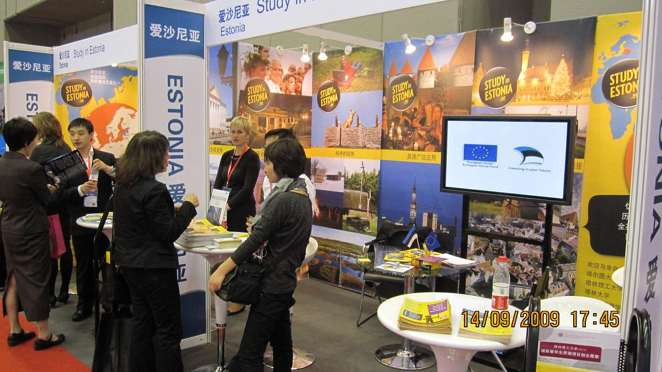

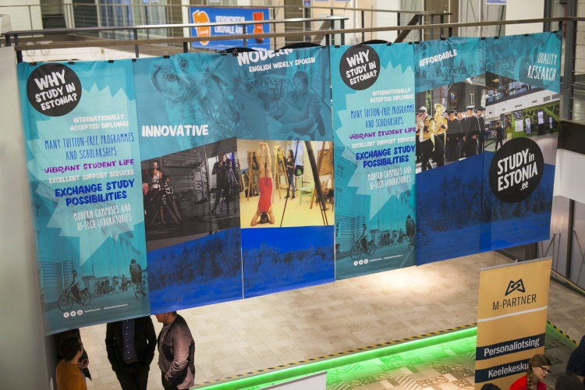
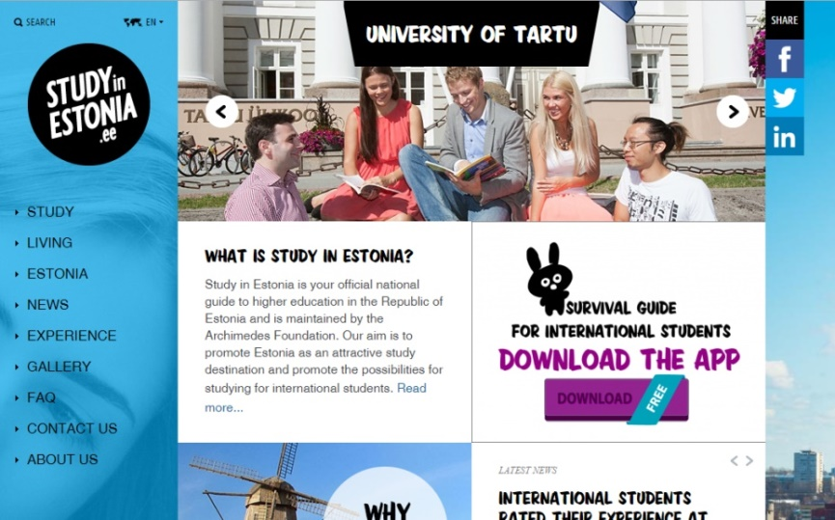
Higher education international marketing
Study in Estonia

Slide 16
Trends in student mobility in Estonia
The amount of students in Higher education institutions decreases ca 5,6% every year.
The amount of mobile students will increase:
  According to „Estonian Lifelong Learning Strategy 2020“ the student mobility has to be 10% by 2018
  According to the higher education international marketing strategy, 10% of the student body in Estonia have to be international degree students by the year 2020 (2015/2016 it is 6,8%)
  The goal of Erasmus exchange studies: 2% of the student body has to be mobile (2015/16 - 2,1%)
From 2012 Estonia hosts more international exchange students than it sends out

Slide 17
Student mobility 2000-2015

Slide 18
International degree students in Estonia
 | 2005 | 2006 | 2007 | 2008 | 2009 | 2010 | 2011 | 2012 | 2013 | 2014 | 2015
admission | 303 | 229 | 258 | 295 | 340 | 457 | 617 | 698 | 824 | 1100 | 1295
growth (%) |  | -24% | 13% | 14% | 15% | 34% | 35% | 13% | 18% | 33% | 18%
studying | 840 | 901 | 885 | 908 | 1072 | 1282 | 1573 | 1876 | 2230 | 2887 | 3476
growth (%) |  | 7% | -2% | 3% | 18% | 20% | 23% | 19% | 19% | 29% | 20%

Slide 19



Image of higher education in Estonia
89% of international students say Estonia is a good country to study
Source: International Student Barometer 2015
International students rate Estonia best place to stay (2nd Portugal, 3rd Austria)
Source: Erasmus Student Network Europe survey 2010
Some of our cooperation partners:
Erasmus Student Network Estonia, Ministry of Foreign Affairs together with its embassies, Estonian Institute etc.

Slide 20
Development based on knowledge and cooperation
In 2015:
  We funded the youth field with more than 3 million €
  We organized trainings for more than 3000 young people, youth workers and youth leaders
  We ran 90 trainings (5 international)
  We gave information about Erasmus+ youth activities to more than 7700 participants
  We sent 185 young people and youth workers to trainings abroad
  We organized cooperation projects for more than 1500 young people with Russian and Estonian background

Slide 21
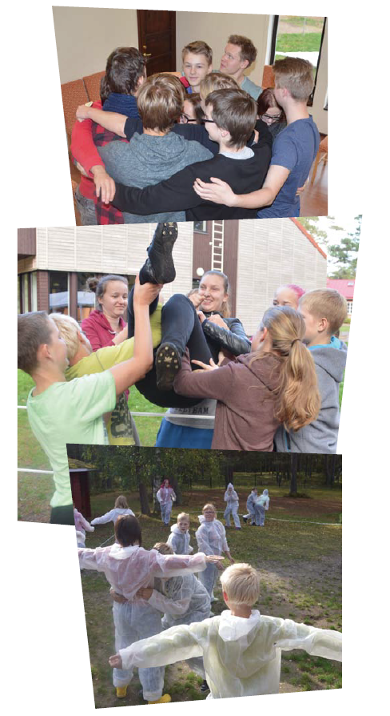
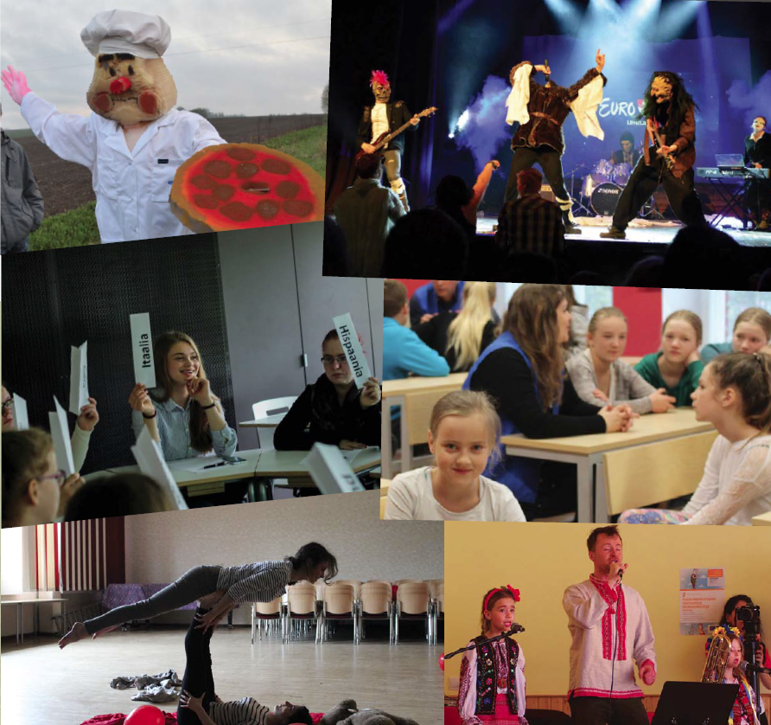
Development based on knowledge and cooperation

Slide 22
Targeted investments
Our Structural Funds Agency is accredited as an implementing agency for the European Union Structural Funds programming period of 2014-2020 by the Government of the Republic in the field of research and development
We apply to the „2014-2020 Structural Assistance Act“ and other acts and regulations in Estonia and in the EU.

Slide 23
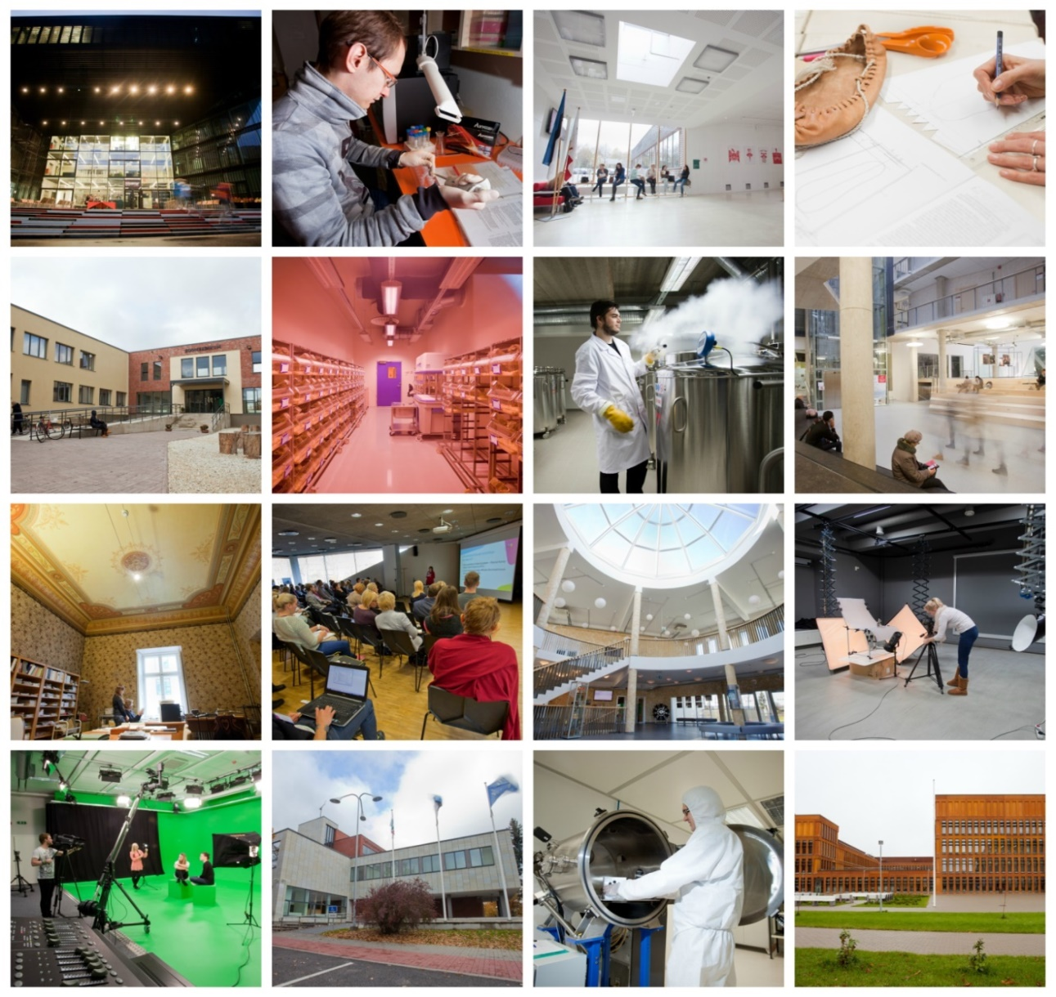
Targeted investments 2007-2013

Slide 24
Targeted investments
  In 2007-2013 the total volume of support was more than 435 million €
  We funded 41 institutions, 668 projects and programmes were implemented, 3728 payment claims were were controlled
  The total volume of support for research and development of the new period 2014-2020 is 339 million €

Slide 25
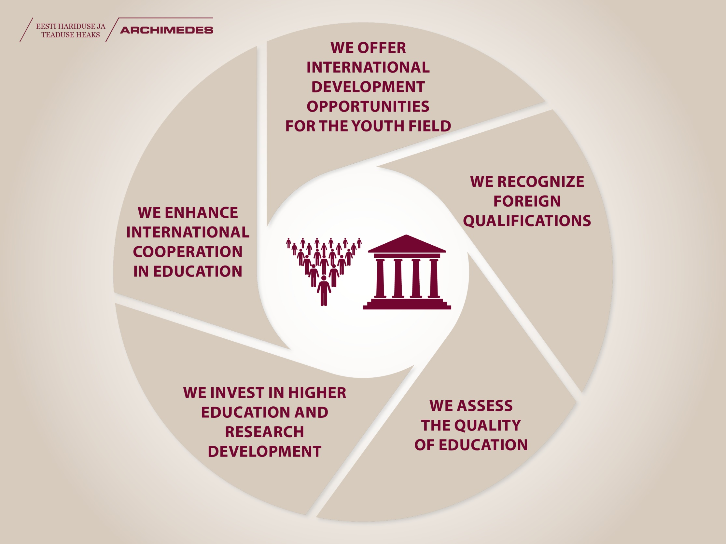

Slide 26






International cooperation

Slide 27
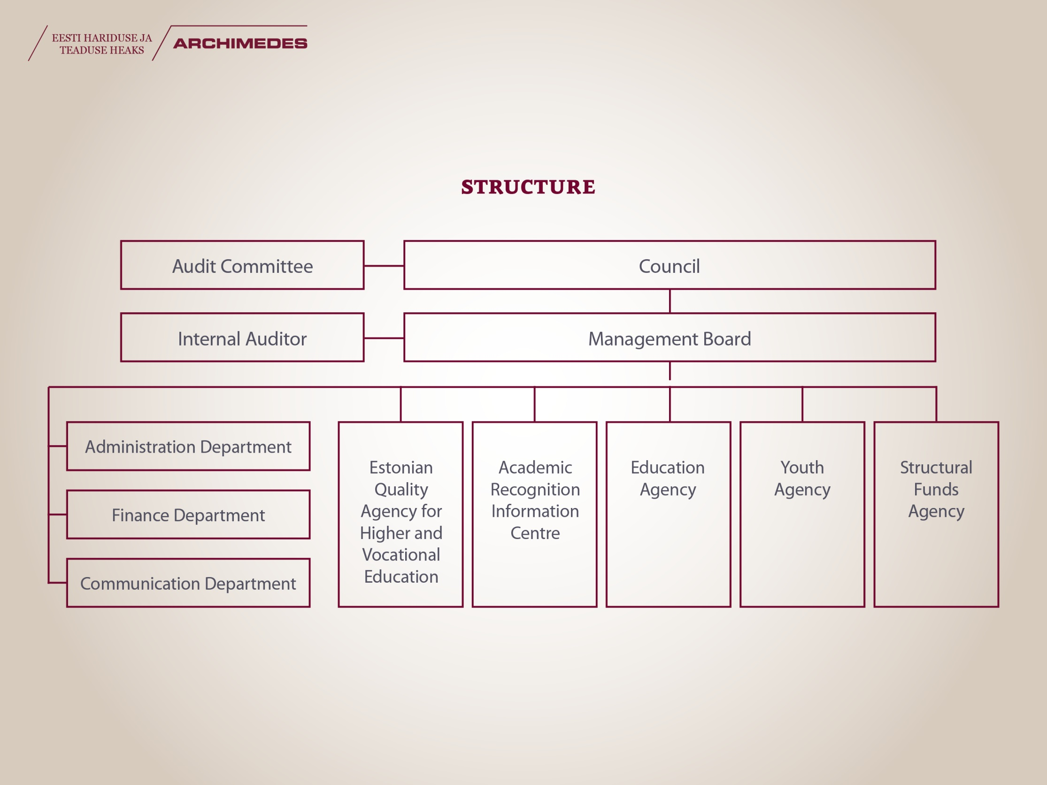

Slide 28

Quality management system
Archimedes Foundation has been issued the quality management system international standard certificate ISO 9001:2000.

Slide 29
Our values
We cooperate with partners and target groups and within the organisation
We support and recognise learning and development, both within target groups and among our own employees
We are professional and rely on our vast experience and knowledge base, we make deliberate decisions and follow regulationas set upon us
We ensure our trustworthiness by being transparent and avoiding conflicts of interest

Slide 30
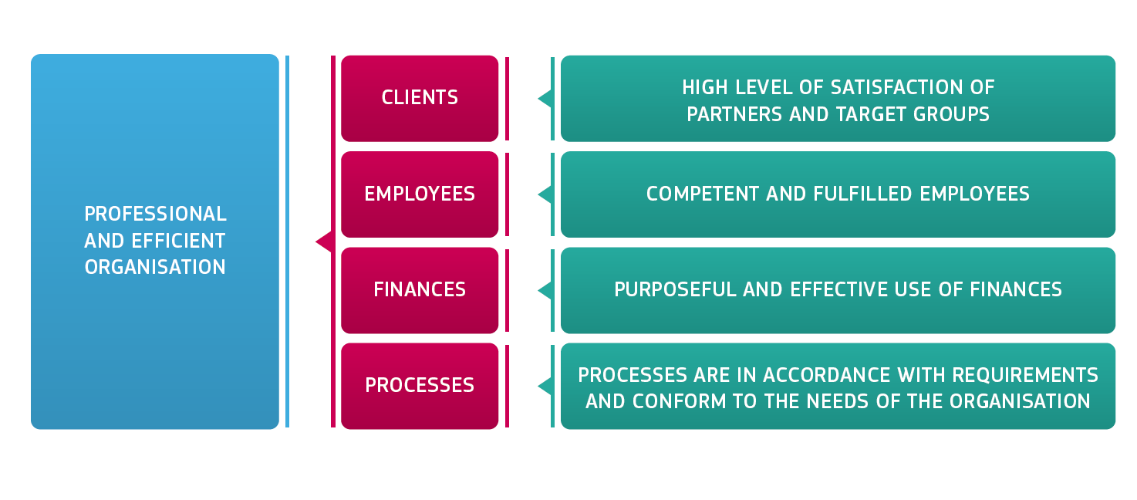
How do we evaluate ourselves?
2012 Federation of Estonian Student Unions: Archimedes Foundation is the student supporter of 2012
2013 Estonian Union for Child Welfare: Archimedes Foundation is the most child friendly organization of 2013

Slide 31

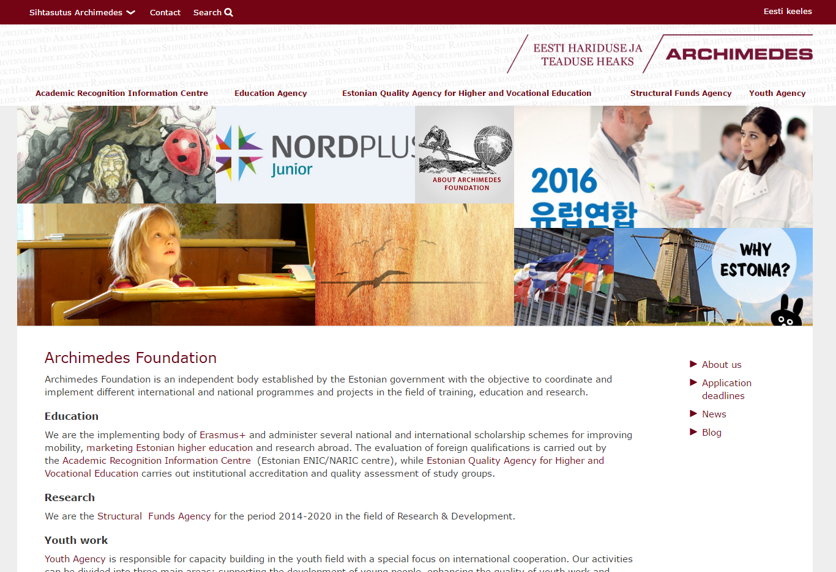
Visit our channels!
www.archimedes.ee
www.facebook.com/Archimedes.ee
www.twitter.com/ArchimedesEE
www.youtube.com/user/sihtasutusarchimedes

Slide 32

Thank you for your attention! Aitäh!
Give me a place to stand and I will move the earth.
Archimedes

