Slide 1

DRAFT Standards for the Accreditation of e-Learning Programs

Slide 2

Pillars of the proposed e- learning
Program accreditation Standards
e- learning program accreditation Standards
Consistency with NAQAAE’s standards for prog acc
Quality of the mode of delivery
NAQAAE standards core values

Slide 3
NAQAAE standards core values
Student centeredness
Credibility & Ethics
Transparency
Fostering employability & entrepreneurship
Community responsibility
Promoting continuous self evaluation and development
Coping with international standards & progress
Quest for excellence

Slide 4
Consistency with NAQAAE’s standards for prog acc
Standards | Domain
Program Mission & Objectives | Administration of the Program
Program Leadership & Organization
Physical &Financial Resources and Supporting Facilities
Academic Reference Standards | Educational Effectiveness of the Program
Program design
Students
Faculty
Teaching &Learning.
Assessment of Learning Outcomes
Enhancement &Development
Indicators of Program Success

Slide 5
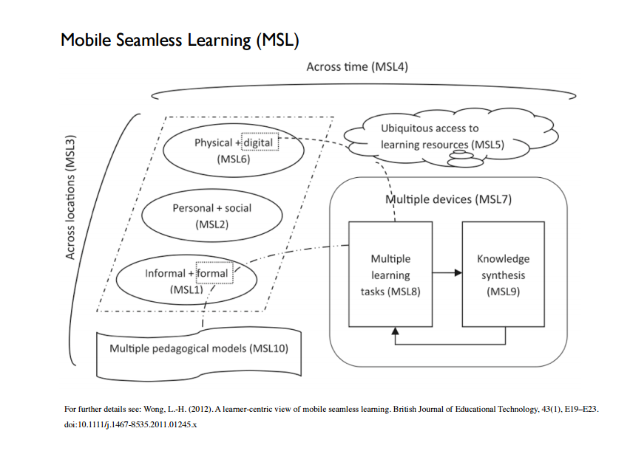
Quality of the mode of delivery

Slide 6
Standards &Criteria for the Accreditation of e-Learning Programs

Slide 7
S1
Institutional Context
S2
Learning and Teaching Resources
S3
Program Design and Review
S4
S5
Teaching, Learning and Assessment
Quality Assurance System and continuous Improvement of Program

Slide 8
  Institutional Context
S1
Criteria | Indicators
1.1 The program is in integrated into the institutional context | 1.1.1 The program is in accordance with the institutional mission 1.1.2 The institution's strategy and policies supports the character of the program
1.2 Program mission | 1.2.1 The Program has clearly defined and publicly available mission and objectives 1.2.2 The program responds to labor market - Societal Needs 1.2.3 Processes for periodic review of the mission's statement and objectives are in place

Slide 9
  Institutional Context
S1
Criteria | Indicators
1.3 Program Ethics | 1.3.1 Credibility and Transparency of information about the program are guaranteed 1.3.2 The institution has a policy to secure Copyright Issues and Intellectual Property Rights 1.3.3 There are policies in place to avoid Conflict of Interest 1.3.4 There is a policy in place to ensure Equity and non-discrimination

Slide 10
  Institutional Context
S1
Criteria | Indicators
1.4 Program Management | 4.1 Academic leadership of the program and its organization are defined and transparent 1.4.2 The administrative structure and processes effectively support the requirements of the program 1.4.3 Selection criteria and Admission Policies and Regulations are defined and published 1.4.4 A comprehensive system for Student support is in place

Slide 11
  Learning and Teaching Resources
S2
Criteria | Indicators
2.1 Human Resources | 2.1.1 The number of Academic and Teaching Staff is appropriate for the program requirements. 2.1.2 The qualifications of Academic and Teaching Staff are appropriate to the curriculum and the delivery mode of the program 2.1.3 The number and qualification of Administrative and Technical Staff is adequate for the program requirements 2.1.4 There are measures for Capacity Building of Human Resources that respond to the training needs and reflect the particular mode of delivery

Slide 12
  Learning and Teaching Resources
S2
Criteria | Indicators
2.2 Financial Resources | 2.2.1 Budget is sufficient for efficient running of the program including technical Resources 2.2.2 Evidence for sustainability of the program is available

Slide 13
  Learning and Teaching Resources
S2
Criteria | Indicators
2.3 Technical Resources | 2.3.1 IT Infrastructure is available and is in line with current security regulations and standards. 2.3.2 The education infrastructure should support different types of devices & operating systems. 2.3.3. There is a policy for data protection and backup in place 2.3.4 There is a policy and a process for Maintenance and upgrade of IT infrastructure. 2.3.5 Website and supporting platforms serving the requirements of the program are in place. 2.3.6 Adequate IT Support meeting the requirements of the program is available for student and teaching staff

Slide 14
  Learning and Teaching Resources
S2
Criteria | Indicators
2.4 Learning Material | 2.4.1 There is a diversity of learning material in accordance with the ILOs 2.4.2 Access to the learning materials is unrestricted 2.4.3 The Institution ensures the quality of the learning media according to the scientific standards. 2.4.4 A procedure for regular update of the learning media is in place.
2.5 Physical Resources | 2.5.1 Adequate Physical Resources are available for running the program 2.5.2 Physical Resources supporting the achievement of the ILOs are available (e.g. workshops, labs).

Slide 15
  Program Design and Review
S3
Criteria | Indicators
3.1 Academic Reference Standards | 3.1.1 The Program adopts NARS /Accredited Reference Standards 3.1.2 The program is in compliance with the adopted standards
3.2 Program Description | 3.2.1 Program Structure: The structure of the programme is defined and serves the achievement of the intended learning outcomes. 3.2.2 Intended Learning Outcomes:ILOs of the programme are defined, published and are appropriate for the qualification. 3.2.3 Alignment of the Outcomes:The Alignment of the Outcomes enables the achievement of the ILOS of the programme. 3.2.4 Course Descriptions:Course Descriptions are publicly available, up to date and subjected to a policy for regular review and update

Slide 16
  Program Design and Review
S3
Criteria | Indicators
3.3 Program Review and Development | 3.3.1 The program is subjected to periodic review and development 3.3.2 The review process occurs with the participation of all relevant stakeholders

Slide 17
  Teaching, Learning and Assessment
S4
Criteria | Indicators
4.1 Teaching and Learning Methods and Tools | 4.1.1 Teaching and Learning Methods and Tools are appropriate for the ILOs and the mode of the delivery 4.1.2 T & L methods and tools support flexibility of place of learning 4.1.3 T & L methods and tools support flexibility of time 4.1.4 T & L methods and tools promote a balanced personal and social learning 4.1.5 Use of a diversity of learning tasks to achieve the ILOs

Slide 18
  Teaching, Learning and Assessment
S4
Criteria | Indicators
4.2 Assessment | 4.2.1 Assessment regulations are published and available to the students 4.2.2 Administration of the assessment process is efficient (e.g. planning, delivery, identity check, feedback) 4.2.3 Methods and Tools are appropriate for the assessment of the achievement of the ILOs and to the mode of delivery 4.2.4 Mechanisms to ensure fair and transparent Assessment are in place 4.2.5 Students receive a timely and constructive Feedback 4.2.6 A system for Grievances and Complaint is in place 4.2.7 Regulations to cope with malpractices are in place 4.2.8 Specific Examination Centers for E-Learning are available( If needed)

Slide 19
  Quality Assurance System and continuous Improvement of Program
S5
Criteria | Indicators
5.1 Presence of comprehensive Policies for internal Quality Assurance | 5.1.1 The institution should have comprehensive Policies for internal quality assurance 5.1.2 The policies are avialable to relevant stakeholders. 5.1.3 The institution’s policies should provide tools to enhance the pedagogic effectiveness of technologies as help on line, website map of the environment, learner’s path tracking, structure of the page, usage of icons, etc

Slide 20
  Quality Assurance System and continuous Improvement of Program
S5
Criteria | Indicators
5.2 The institution uses Performance Indicators and Measurement Tools | 5.2.1 Use of Performance Indicators and Measurement Tools for regular self-evaluation. 5.2.2 E learning specific indicators are part of the used indicators (Learning analytics & signals for student performance used for automatic support and individualized new tasks , recommendations, suggestion…) 5.2.3 the used tools are appropriate for the assessed indicators

Slide 21
  Quality Assurance System and continuous Improvement of Program
S5
Criteria | Indicators
5.3 Evidence for Comprehensibility and continuity of Self- Assessment is available | 5.3.1 Self-evaluation /Program annual reports are available & accessible 5.3.2 Self evaluation is regular & in light of benchmarks 5.3.3 Involvement of stakeholders in self evaluation. 5.3.4 Use of different feedback and collected data from technical support to improve the system. 5.3.5 Use of feedback from tutors / staff about materials, pedagogy, assessment, workload etc...to improve the system and the administrative and operational processes.

Slide 22
  Quality Assurance System and continuous Improvement of Program
S5
Criteria | Indicators
5.4 A functioning system for evaluation of staff member performance is in place | 5.4.1 The institution should have a functioning system for regular evaluation of staff member performance. 5.4.2 The institution uses staff evaluation results for accountability, promotions, incentives and capacity building of the staff
5.5 Evidence for the implementation of Improvement Plans | 5.5.1 Corrective measures are taken in light of the self-evaluation results and student feedback. 5.5.2 The institution has established Improvement Plans based on reflective analysis of self evaluation
5.6 The institution provides evidence for Programs success | Enrolment & retention rates Drop out rates (module level ) Graduates employability rates Stakeholders satisfaction

