Slide 1
Arene – The Rectors' Conference of Finnish Universities of Applied Sciences Role and activities / co-operation between Finnish Universities of Applied Sciences Örjan Andersson, D.Sc. (Tech) President, Novia University of Applied Sciences Member of the international committee of Arene Baku, November 2016
http://www.arene.fi/en

Slide 2
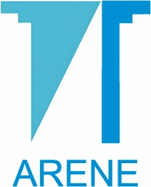
ARENE
Arene ry is the Rectors' Conference of Finnish Universities of Applied Sciences. It's main functions are influencing on the development of the Finnish higher education system and promoting closer cooperation between the universities of applied sciences.

Slide 3
The Rectors' Conference of Finnish Universities of Applied Sciences (Arene)
serves to influence and promote higher education policy in Finland and Europe.
it promotes co-operation between universities of applied sciences and exerts influence on the international stage.
it provides universities of applied sciences with the prerequisites for high-quality, workplace-oriented higher education as well as research, development and innovation.

Slide 4
The Rectors' Conference of Finnish Universities of Applied Sciences (Arene) www. http://www.arene.fi/en/
Arene members are the rectors of universities of applied sciences (actual members) and representatives of university owners (supportive members).
Conference matters are overseen by the Board, which is comprised of the President and five other members, who are elected at the annual meeting. The President and other Board members serve a term of two years.
Arene's actual members convene at joint meetings held a few times each year.
Arene Board meetings are generally held once a month.
Committees in Education, R&D, International Activities, Administration, Finance and Legislation.
Various working groups, projects and seminars.

Slide 5
Universities of Applied Sciences in Finland
1. Arcada, Helsinki
2. Diaconia University of Applied Sciences, Helsinki
3. HAAGA-HELIA University of Applied Sciences, Helsinki
4. HUMAK University of Applied Sciences, Helsinki
5. HAMK University of Applied Sciences, Hämeenlinna
6. JAMK University of Applied Sciences, Jyväskylä
7. Kajaani University of Applied Sciences, Kajaani
8. Central Ostrobotnia University of Applied Sciences, Kokkola
9. Kymenlaakso University of Applied Sciences, Kotka
10. Lahti University of Applied Sciences, Lahti
11. Laurea University of Applied Sciences, Vantaa
12. Helsinki Metropolia University of Applied Sciences, Helsinki
13. Mikkeli University of Applied Sciences, Mikkeli
14. Oulu University of Applied Sciences, Oulu
15. Karelia University of Applied Sciences, Joensuu
16. Police College, Tampere
17. Lappi University of Applied Sciences, Rovaniemi
18. Saimaa University of Applied Sciences, Lappeenranta
19. Satakunta University of Applied Sciences, Pori
20. Savonia University of Applied Sciences, Kuopio
21. Seinäjoki University of Applied Sciences, Seinäjoki
22. TAMK University of Applied Sciences, Tampere
23. Turku University of Applied Sciences, Turku
24. Vaasa University of Applied Sciences, Vaasa
25. Novia University of Applied Sciences, Vaasa
26. Åland University of Applied Sciences, Maarianhamina

Slide 6
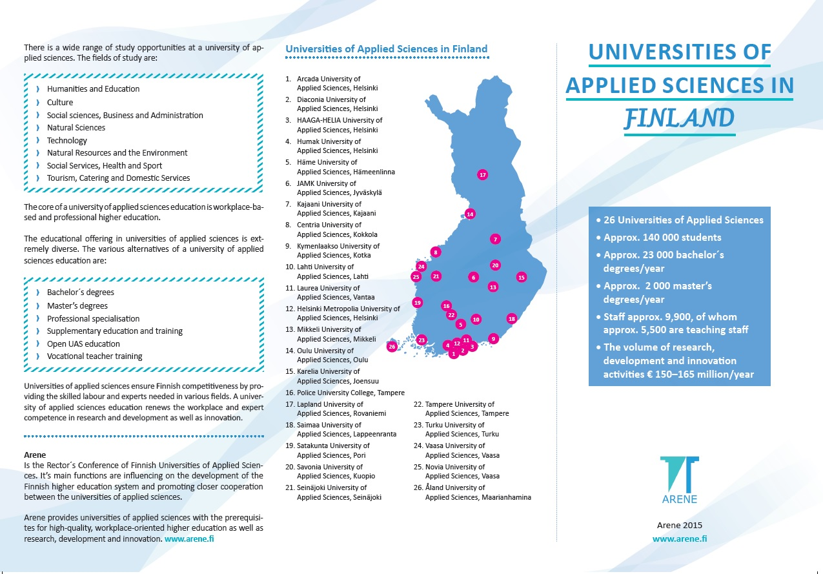

Slide 7
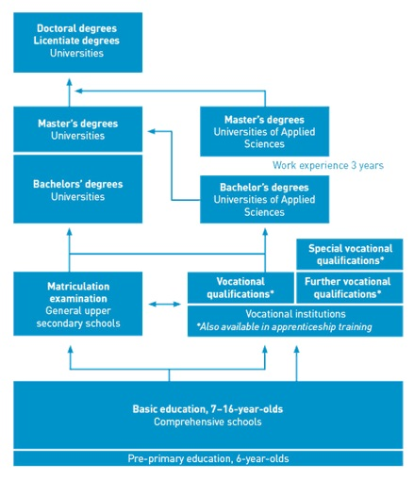

Slide 8
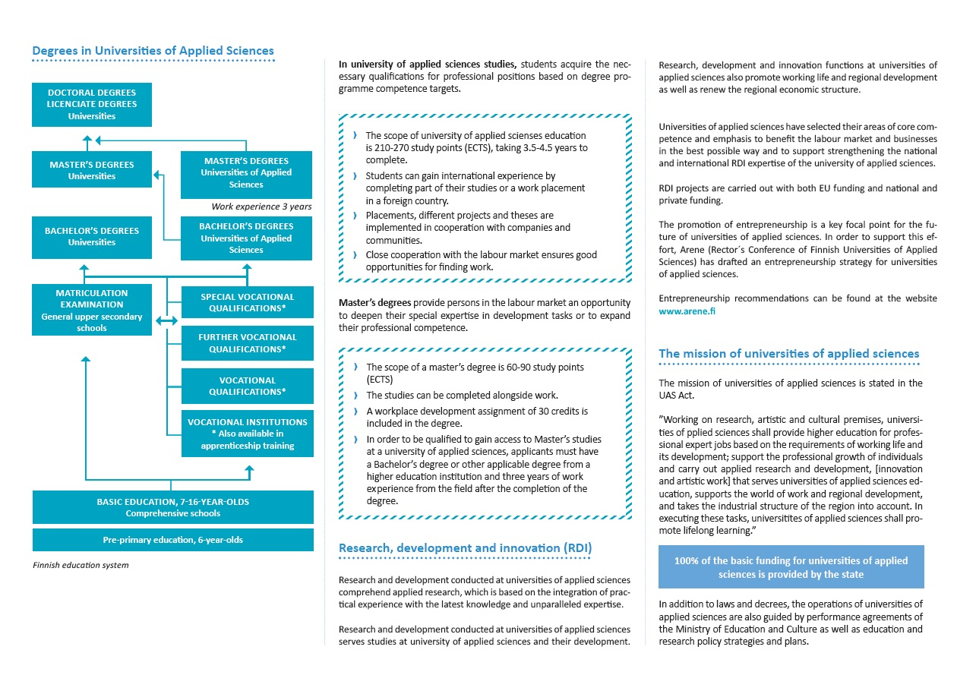

Slide 9
Examples about co-operation facilitated by Arene between Finnish UAS
Education Committee:
Joint Student Selection tests and criteria in various fields of studies in UAS- sector , https://studyinfo.fi/wp2/en/
Basic ICT studies co-operation between 10 UAS; joint courses, competence sharing, digital learning etc. (example Kajaani UAS)
Development groups in different field of studies, chairman is always a rector from one UAS; developing degree programmes, competences, seminars, master program co-operation etc.
RDI committee
RDI competence training for lecturers and RDI professionals etc., concernig practical RDI competences in UAS context (e.g. projet management, real life problem solving and co-operation with business`s)
Structural development in HEI sector and UAS
http://www.arene.fi/en/universities-applied-sciences/effectiveness/structural-development

Slide 10
Working life based Higher Education - qualifications and competences
• Research and development work is mixed into teaching and learning
Close co-operate between HEI/UAS and society and companies, especially with SME`s.
Practical projects based on real-life problems is part of curriculum
Entrepreneurship education; students start their own business`s while studying their degree.
Living labs and new kind of learning environments.

Slide 11
The key change is in the understanding of the content of degree education, teaching, learning and assessment
Creating flexible learning paths
Individual needs of students and their different levels of skills and knowledge demands a lot from institutions and teachers.
Student-centred approach
integrates the students into the academic community
increases their motivation and engagement
shortens study times and
improves learning outcomes by promoting profound learning and understanding.
How UAS sector has reacted to this change?
the changing roles of teachers and students has been raised into strategic issue
the pedagogical development and support to teachers
raising the status of innovative teaching in HEI
strengthening educational leadership, e.g. pedagogical vice presidents
developing learning environments, together with companies, students, education institutions
making strategic partnerships with business`s locally and nationally
aligning learning outcomes and assessment
developing methods for external evaluation of the quality of teaching and learning, e.g. working life feedback

Slide 12
Thank You!
http://www.arene.fi/en/universities-applied-sciences/effectiveness/structural-development.
TOWARDS THE WORLD BEST HIGHER EDUCATION SYSTEM

