Slide 1
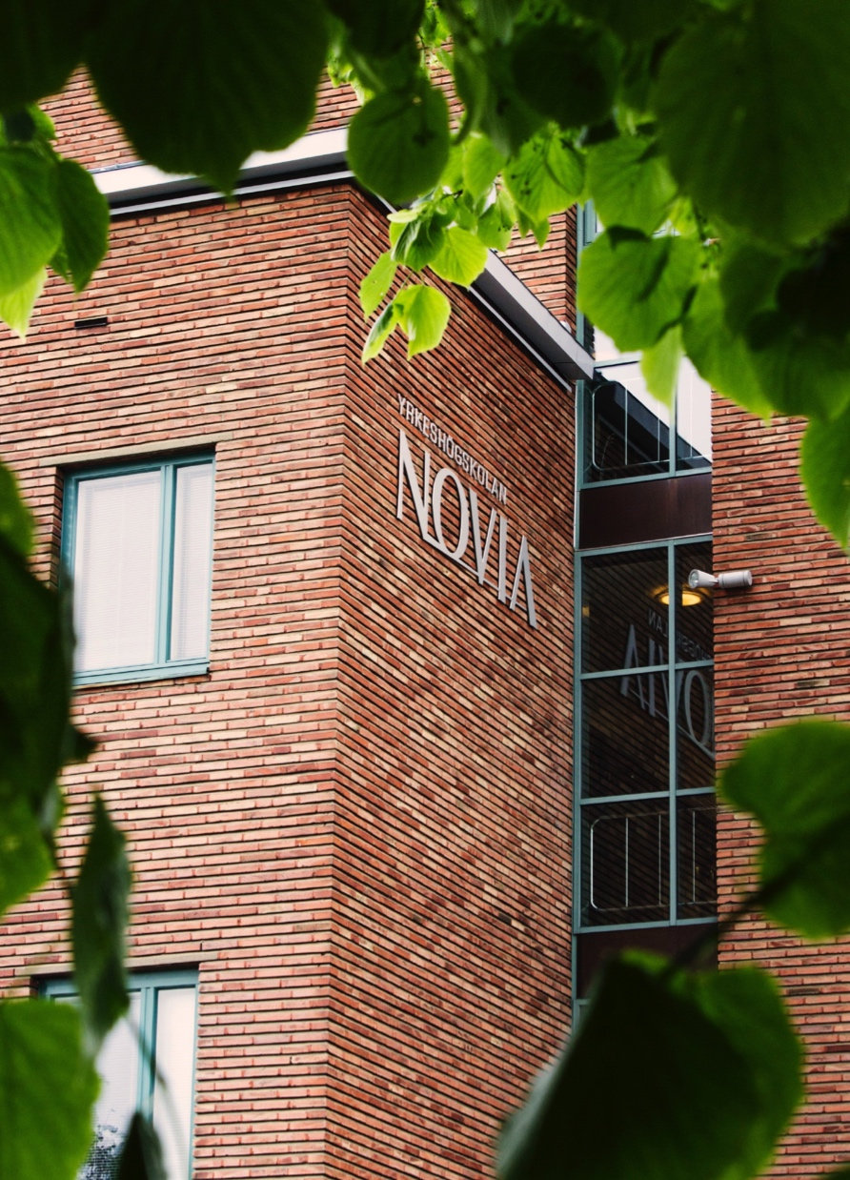
Cooperation models
- Case Vaasa
Örjan Andersson
President, Novia University of Applied Sciences Baku, November 2016

Slide 2
NOVIA UNIVERSITY
OF APPLIED SCIENCES
The largest Swedish-speaking University of Applied Sciences in Finland
Number of students: 4000
Number of staff: 300
Novia is located in four cities on the west coast of Finland
Novia UAS offers:
Bachelor’s Degree Programmes in Swedish and English
Master’s Degree Programmes in Swedish and English

Slide 3
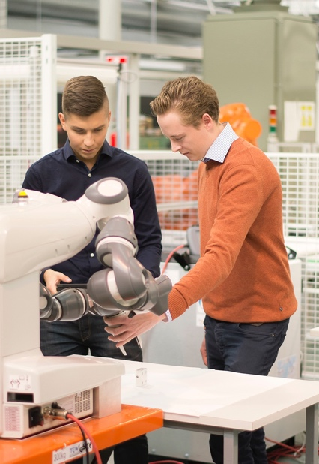
NOVIA’S DEGREE PROGRAMMES
Novia’s degree programmes are planned with focus on tomorrow’s working life in order to give our students
good opportunities on the labour market
skills in their professional field
good communicative and social skills
co-operation and team-working skills
capability to work in an international environment
Bachelor level studies
comprise 210 – 270 credits
last for 3,5 – 4,5 years
Master level studies
comprise 60 – 90 credits
last for 1,5 – 2,5 years (in general blended learning as part- time studies)

Slide 4
RESEARCH AND DEVELOPMENT
R&D activities at Novia UAS are based on long-term sustainability and carried out within five selected focus areas.
We co-operate closely with enterprises, municipalities and other organisations in order to support regional development and our education.
We conduct versatile project activities and have substantial know-how of various external funding schemes.
We co-operate with other institutions of higher education in Finland and abroad.

Slide 5
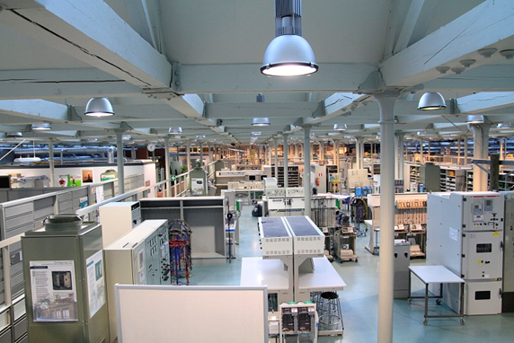
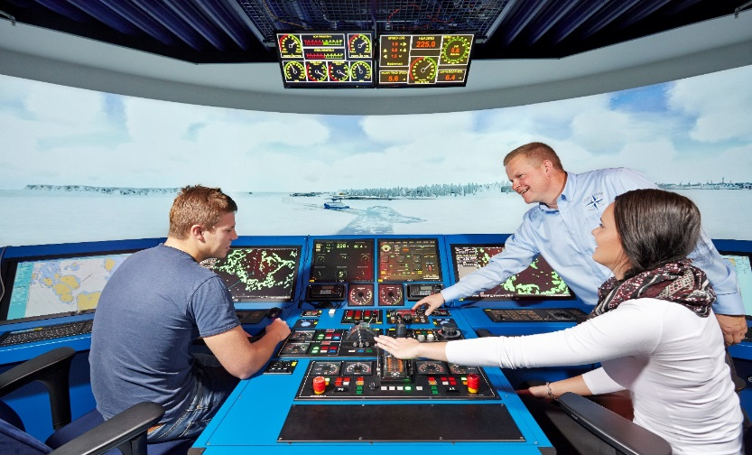
Novia’s cooperation models
Universities
Universities & Industry
Industry/Business
Vaasa Consortium of Higher Education
Education and Research Centre Technobothnia
Aboa Mare, Turku, Finland
GigaMare Inc, The Philippines

Slide 6
Vaasa
Consortium
of Higher
Education

Slide 7
Vaasa Consortium of Higher Education
University of Vaasa
Vaasa University of Applied Sciences
Novia University of Applied Sciences
Åbo Akademi University
Hanken School of Economics
University of Helsinki / Vaasa Unit of Legal Studies
The cooperation agreement was established 19 January 2001.
Mission statement
To be an internationally acknowledged, socially and culturally influential centre for higher education and research in technology, commerce, media and welfare services.
The Consortium encourages cooperation between higher education institutions in Vaasa by collecting ideas that are developed and implemented trough a versatile network.

Slide 8
Cooperation groups
Information Officers
Study Affairs
Careers and Recruitment
International Affairs
Language Teaching
Flexible study right
According to the agreement, the universities in Vaasa offer a flexible study right. The goal is to expand the education offer of each institution.
Degree students can expand his/her education through studies at other agreement universities. The agreement also includes exchange students.
JOO-studies are free of charge.
Language Teaching
Linguavaasa is a co-operation group for language teaching.
The objective is to develop and advance co-operation in language and communication teaching.
The group arranges several joint language courses for the university students in Vaasa.

Slide 9
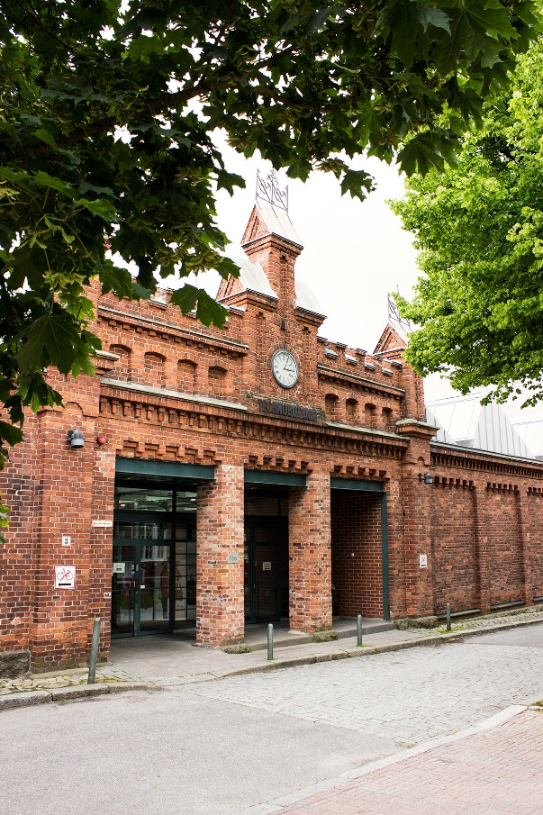
Technobothnia
Education and research centre

Slide 10
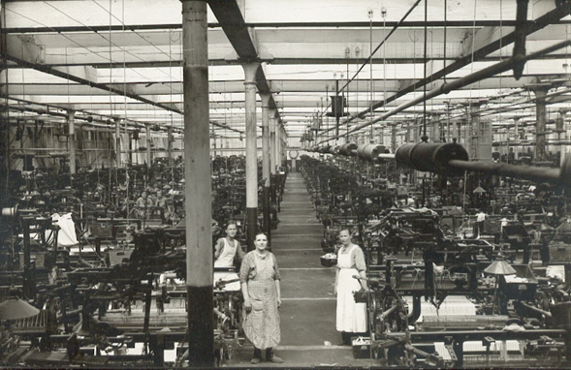
Situated in an old Cotton Factory (1857-1980), renovated to a High Tec laboratory space (1993-1996)
The laboratory has been jointly used by three universities since its opening in 1996
University of Vaasa
Vaasa University of Applied Sciences
Novia University of Applied Sciences

Slide 11
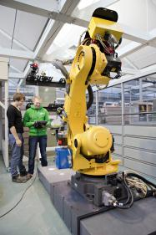
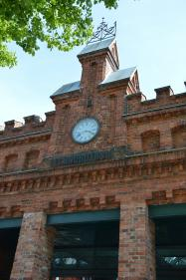
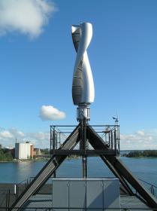
Mission statement:
provide a framework for high-class education and research in the field of technology
serve as a channel of cooperation between educational institutions, enterprises and other research institutes and technology centres
offer research, and product development, as well as education, measurement and testing services to the private and the public sector

Slide 12
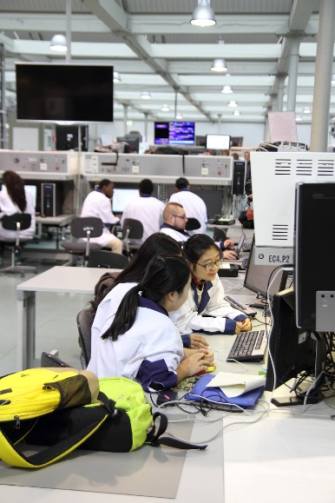
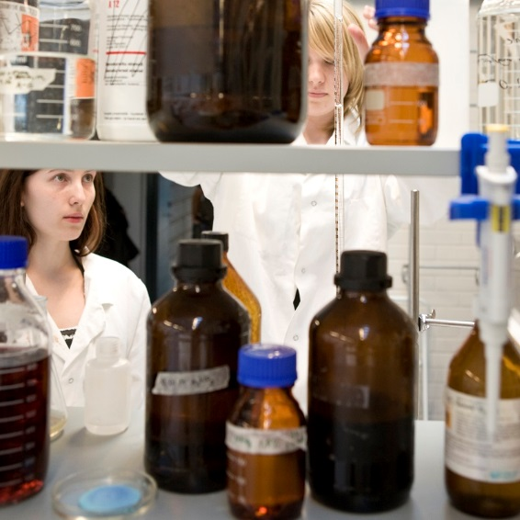
Activities
Engineering education
Research and product development
Services for industry, business life and other organizations
Facilities
8 000 m2
Laboratories for electrical, mechanical, construction engineering, and environmental and information technology.
Atmosphere
A unique atmosphere that promotes creativity and development.
Multilingual: Finnish, Swedish and English.

Slide 13
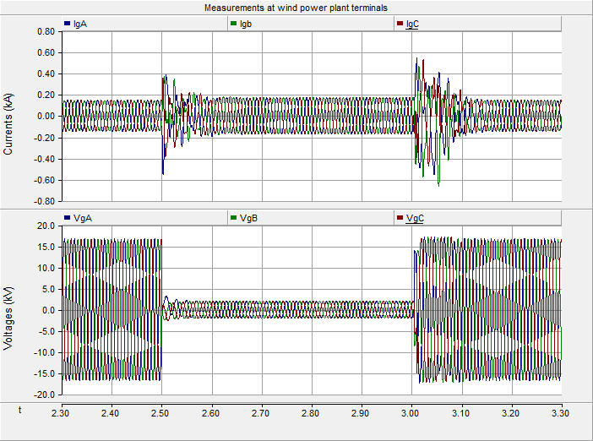
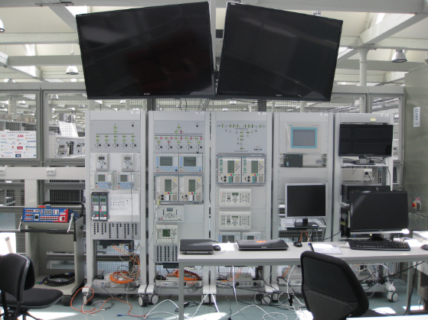
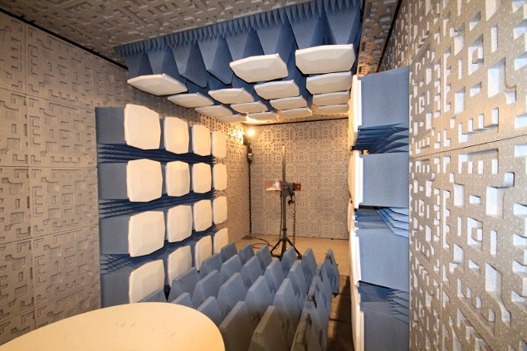
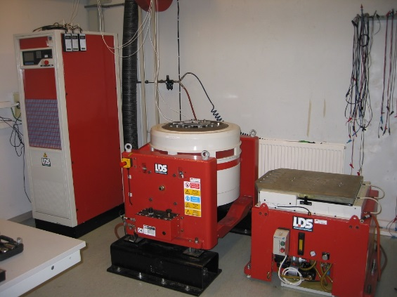
CORPORATE SERVICES
EFFICIENT ENERGY AUTOMATION WITH THE IEC 61850 STANDARD - SMART GRID
POWER SYSTEM SIMULATION
ELECTRICAL MEASUREMENT AND TESTING SERVICES
ACCELERATED STRESS TESTS
MECHANICAL ENVIRONMENTAL TESTS
EMC TESTING SERVICES
CONSTRUCTION TESTS AND MATERIAL MEASURMENTS
3D SCANNING AND PRINTING SERVICES

Slide 14
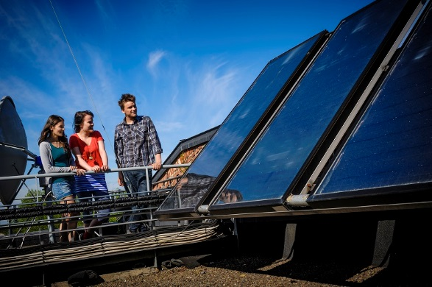
Administration of the laboratory:
Based on an agreement between three universities.
The budget is prepared by the management team of the center and included in each university’s own budget.
Costs are shared based on number of students ….
.…not based on use!
Cost efficient: For example Novia UAS
30 % of costs for operation and investments
100 % access to facilities and equipment

Slide 15
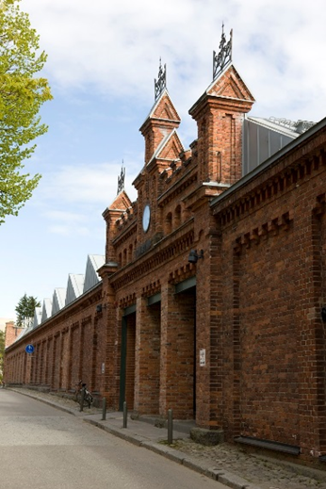
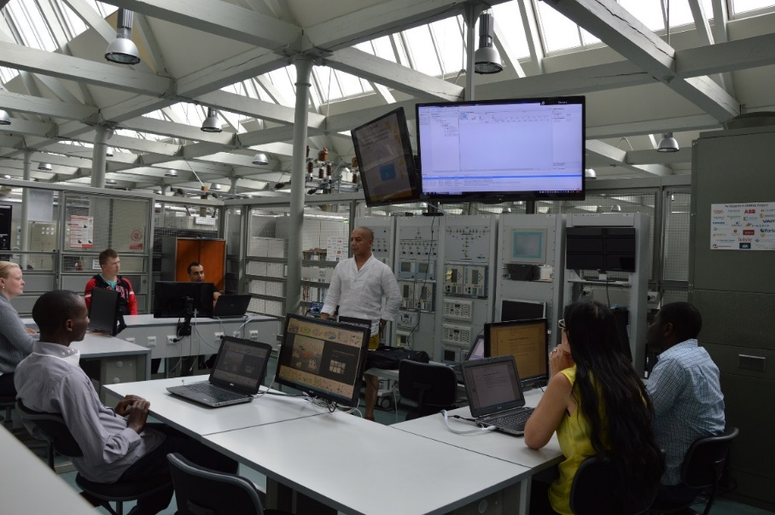
Administration of relations to industry
Corporate Advisory Boards
Energy Chain – for Energy and Electric engineering companies in the region
Energy Technology and Manufacturing – for Machine and Production companies in the region
Energy Efficient Buildings and Environment – for companies working with community development and construction
10-15 companies represented on each board.
Meetings 2-3 times per year.
Meeting agenda is set according to initiatives from the corporate members and based on the universities´ development needs.

Slide 16
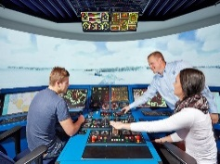
SUMMARY
Novia’s cooperation models
Universities
Universities & Industry
Industry/Business
Vaasa Consortium of Higher Education
Coordination of efforts
Wide offering to students
Light administration and each party responsible for own costs.
Education and Research Centre Technobothnia
Quality in education
Sharing of costs with other univ. according to agreed budget
Taking into account needs from industry in developing curricula
Industry cooperation platform
Services /sales
Aboa Mare, Turku, Finland
GigaMare Inc, The Philippines
Quality in education
Sponsoring from industry
Further education / sales
Feedback on curricula

Slide 17
Thank you!
Further information, please contact:
Örjan Andersson, D.Sc (Tech)
orjan.andersson@novia.fi

